Slide 1
Changes in our lives
第一课时
WWW.PPT818.COM

Slide 2
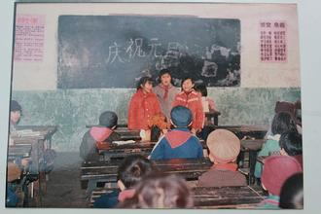
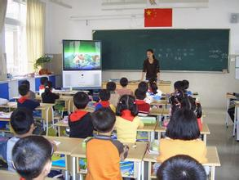
Warm up
Welcome to our school
Now
In the past

Slide 3
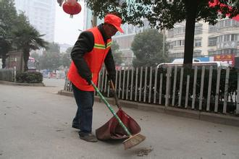
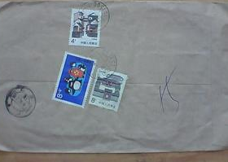
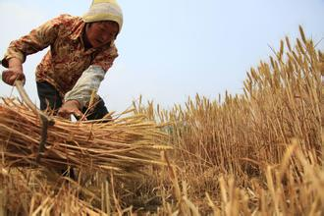
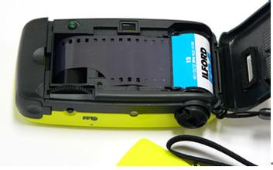
Warm up
In the past
Do you know them?

Slide 4
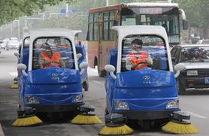
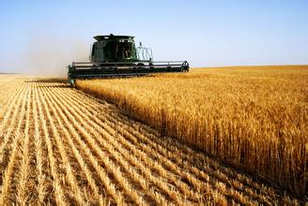
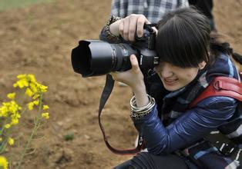
Warm up
Now

Slide 5
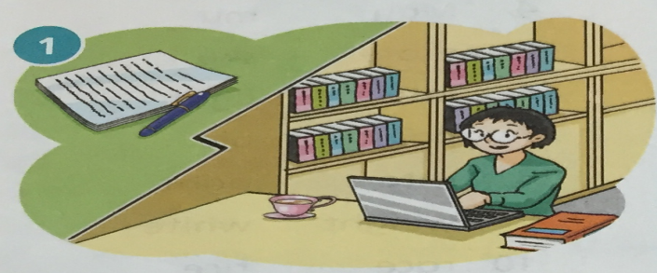
Listen and write
Ms Wen is a writer. In the past, she used _______ and _______ to write her book. Now she uses __________.
a pen
paper
a computer

Slide 6
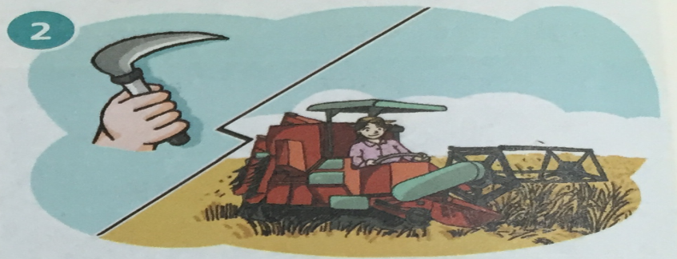
Listen and write
Mrs Hong is a farmer. In the past, she got her crops in ________. Now she uses __________.
by hand
a machine

Slide 7
Read and write
Mr Zhang is a photographer. In the past, he used _____ to take photos. Now he uses ________________. He can see his photos right away.
film
a digital camera

Slide 8
Read and write
Mr Yang is a street cleaner. In the past, he swept the streets with __________ .
Now he drives _________________. It can clean the streets in a short time.
a broom
a street sweeper

Slide 9
Correct
1.In the past, she a pen and paper to write her books.
2.In the past, she her crops in by hand.
3. Now he a digital camera.
4. he swept the streets with a broom.
used
uses
got
gets
uses
used
In the past
Now

Slide 10
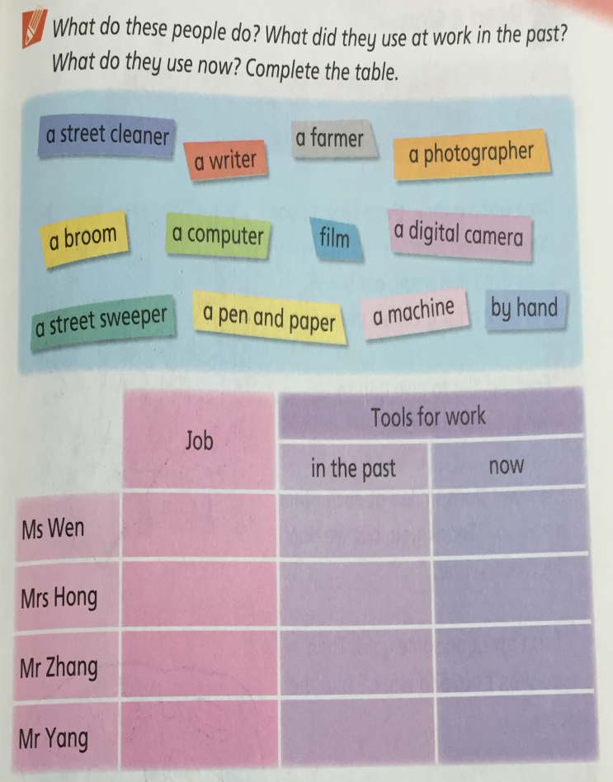
Practice
a writer
a pen and paper
a computer

Slide 11
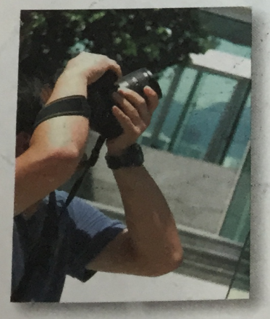
Presentation
photographer
Mr Zhang is a photographer.

Slide 12
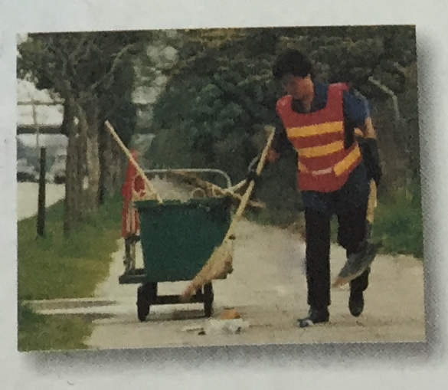
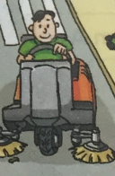
Presentation
street cleaner
Mr Yang is a street cleaner.

Slide 13
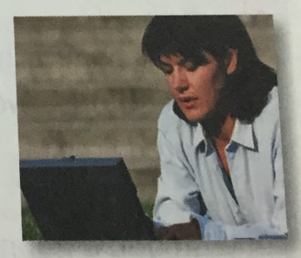
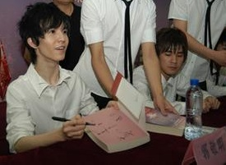
Presentation
writer
Ms Wen is a writer.
Guo Jingmin is a writer, too.

Slide 14
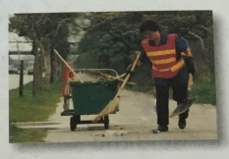
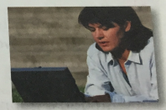
Read and write
cleaner
1.Ms Wang is a _______ .
2.Mr Liu is a ____________ .
3.Miss Brown is a ______ .
photographer
writer

Slide 15
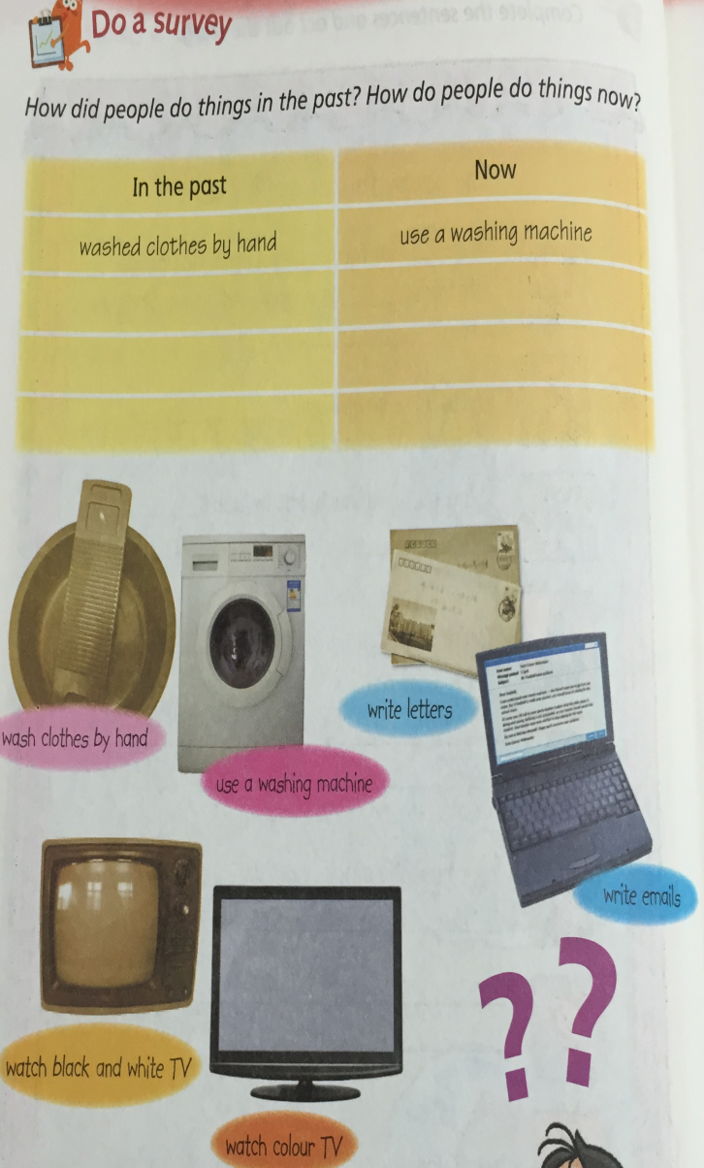
Homework

