Slide 1
I’m in Class One, Grade Three.
第4课时
WWW.PPT818.COM

Slide 2
I’m in Class … , Grade …
我在……年级……班。
How old are you? 你多大了？
I’m …
你能说出下列电话号码吗？
13887150386
15643778253
0874-3327506
13508812162

Slide 3
New numbers 新数字
nine
ten
1 + 8 = ? 2 + 7 = ? 3 + 6 = ? 4 + 5 = ?
1 + 9 = ? 2 + 8 = ? 3 + 7 = ? 4 + 6= ?
+ and = is

Slide 4
What time is it?
It’s nine o’clock.
几点了？
现在是九点钟。
clock
钟
o’clock
点钟

Slide 5
What time is it?
It’s ten o’clock.

Slide 6
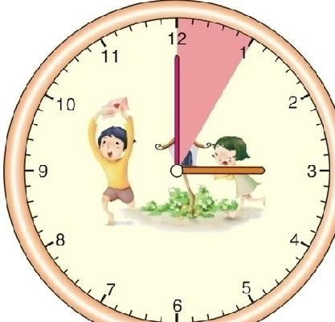
Guess! What time is it?
It’s … o’clock.

Slide 7
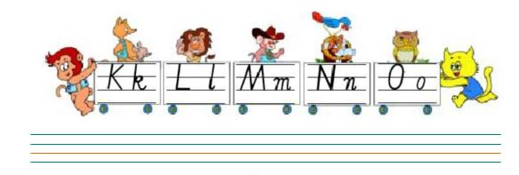

Slide 8
Homework
1、背诵课文。
2、完成练习册。
3、把所学的单词、字母、句型教给父母。

Slide 9
Thank You.

