Slide 1
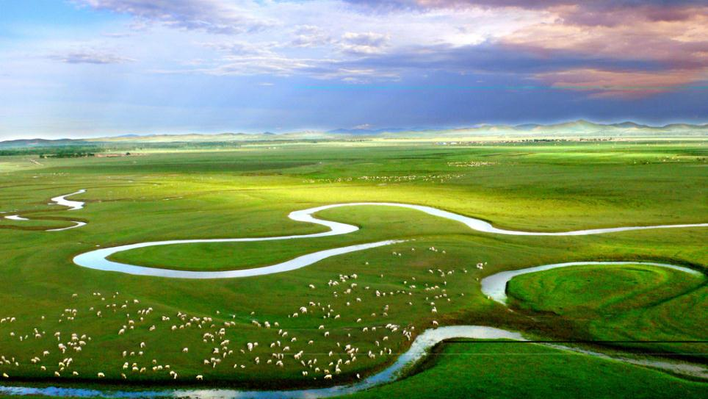
Unit 3 On the move
Period Three Using language & Developing ideas
WWW.PPT818.COM

Slide 2
PART 1
语篇理解
PART 2
基础自测
PART 3
互动探究
PART 4
达标检测

Slide 3
PART
1
语篇理解
精读精练 萃取文本精华

Slide 4
Ⅰ.Read the passage and judge whether the following sentences are true(T) or false(F).
1.If you are a runner with a story to tell，you can click into this global site.( )
2.David won silver in the under 18’s 10,000 metres！( )
3.Sarah entered the Great Gorilla Run in London.( )
T
F
F

Slide 5
Ⅱ.Read the passage carefully and choose the best answer.
1.What’s the main idea of the passage?
A.Running is the best sport all over the world.
B.This global site is very popular all over the world.
C.Reasons for starting running and benefits gained from running.
D.Running can cure your disease and make you better and better.
√

Slide 6
2.Why does Li Yue start running?
A.He loves running since childhood.
B.He was born with asthma and has to start running.
C.Running can improve lung function and help him treat his asthma.
D.He wants to win gold in national competitions.
√

Slide 7
3.Which of the following is NOT true according to the passage?
A.The Great Gorilla is a programme to save endangered gorillas.
B.David always feels anxious due to work pressure before running.
C.David thinks his stress has disappeared by the end of the run.
D.Sarah starts running just to see her name in the top five.
√

Slide 8
PART
2
基础自测
自主学习 落实基础知识

Slide 9
Ⅰ.重点单词
1. adj. 理想的，最好的
2. v. 监视，监测
3. adj. 可用的，可获得的
4. v. 跳绳
5. adj. (位置)较上的，较高的，上面的
6. n. 骨头，骨
7. v. 包含，需要
8. n. 大师，能手
9. n. 资料，数据
ideal
monitor
available
skip
upper
bone
involve
master
data

Slide 10
10. n. 标签，标记
11. n. 哮喘(病)
12. n. 肺
13. n. 人际关系网，联络网
14. n. 紧张，焦虑
15. n. 大猩猩
16. v. (持续而隐隐地)作痛
17. n. (尤指体育比赛中的)冠军，第一名
label
asthma
lung
network
tension
gorilla
ache
champion

Slide 11
18. adj. 可调整的，可调节的
→ v. 调整
→ n. 调整，调节；适应
19. n. 平衡
→ adj. 平衡的
20. n. 回答，回复
→ v. 回答，作出反应
21. n. 力量
→ adj. 强有力的
adjustable
adjust
adjustment
balance
balanced
response
respond
power
powerful

Slide 12
22. v. 消失，不见
→ n. 消失
23. adj. 满是汗的，被汗水湿透的
→ n. 汗水
v. 使出汗
24. v. 鼓舞，激励
→ n. 鼓舞
→ adj. 鼓舞人心的
disappear
disappearance
sweaty
sweat
inspire
inspiration
inspiring

Slide 13
掌握规律 巧记单词
adjust(v.调整)＋-ableadjustable(adj.可调节的)
avail(v.有用)＋-ableavailable(adj.可用的)
如：changeable(可改变的)，serviceable(有用的)，reliable(可靠的)，deniable(可否认的)等。

Slide 14
Ⅱ.核心短语
1. 成千上万
2. 参加
3. 偶遇
4. 不再
5. 爱上，喜欢上
6. 反过来，转而；轮流，依次
7. 处理；涉及
8. 从……到……
9. 到……末
10. 灭绝
tens of thousands
take part in
come across
no longer
fall in love with
in turn
deal with
from...to...
by the end of
die out

Slide 15
Ⅲ.经典句式
1.状语从句的省略
about a new topic，it is important to collect facts and figures.当学习一个新话题时，收集事实和数据是很重要的。
2.make＋宾语＋宾补
These are often represented through charts or graphs，because they can
.
这些通常通过图表或图形表示，因为它们可以使信息更快、更容易解释。
When learning
make information quicker and easier to interpret

Slide 16
3.what引导宾语从句
It’s important to read its title to know ...
重要的是阅读它的标题，知道事实和数字代表什么……
4.as well as也；既……又……
I had a great day out in London， helping to save gorillas！
我在伦敦度过了美好的一天，也帮助拯救了大猩猩！
what the facts and figures represent
as well as

Slide 17
PART
3
互动探究
探究重点 互动撞击思维

Slide 18
重点词汇
1
...while its waterproof band is fully adjustable so that it is comfortable to wear.……而它的防水带是完全可调的，所以穿起来很舒服。
adjustable adj.可调节的
※adjust vi.& vt.调整；(使)适应
adjust to doing sth. 适应做某事
a djust...to...调整……以适应……
adjust oneself to...使某人自己适应……
※adjustment n.调整，调节；适应
make an adjustment/adjustments作出调整

Slide 19
(1)For example，making an adjustable desk lamp is your fantasy.
例如，做一盏可以调节的台灯纯属是你的想象。
(2)To be exact，other people can extend our intelligence and help us understand and adjust our emotions.
确切地说，其他人能够拓展我们的智力，帮助我们理解、调整我们的情感。
(3)She soon the new surroundings.她很快适应了新环境。
(4)Some schools will make (adjust) in agreement with the national soccer reform.为了与国家足球改革相一致，一些学校将做出调整。
adjusted herself to
adjustments

Slide 20
2
Using only a rope，you can develop your footwork and balance.只使用一根绳子，你就可以练就你的步法和平衡感。
balance n.天平；平衡；结余，余额 vt.平衡；权衡
※keep one’s balance保持平衡
lose one’s balance失去平衡
out of balance不平衡
balance A against B 权衡A与B
※balanced adj.平衡的，均衡的
a balanced diet均衡的饮食

Slide 21
(1)Try to balance your diet by eating more fruit and less dessert.
尽量多吃些水果，少吃甜食，使饮食均衡合理。
(2)The doctor advised me to have a balanced diet.
医生建议我均衡饮食。
(3)When he was running after his brother，the boy and had a bad fall.在追赶哥哥时，这个男孩失去平衡，重重地摔了一跤。
(4)The girl seemed to be on the ice.
这个女孩在冰上似乎失去了平衡。
(5)We must balance the advantages the disadvantages before we decide.
在做决定之前我们必须权衡利弊。
lost his balance
out of balance
against

Slide 22
3
During the interview，listen carefully to each question and try to understand the main ideas within the interviewee’s responses.在面试过程中，仔细听每个问题，试着理解受访者回答中的主要观点。
response n.回答；答复
※in response to回答……；回应……
make a response to对……作出回应
※respond vi.回答；响应；作出反应
respond to回答……；回应……

Slide 23
(1)How did he respond to the news about his personal life?
他对有关他私生活的消息是如何回应的？
(2)The law was passed in (respond) to the public pressure.
在公众压力下该法规获得通过。
[一句多译]
(3)我建议他制定一个新计划，但是他没有回复。
①I suggested that he work out a new plan but he didn’t it.(respond)
②I suggested that he work out a new plan but he didn’t _________________ it.(response)
response
respond to
make a response to

Slide 24
4
Then I discovered an app called Running Power.然后我发现了一个名为Running Power的应用程序。
power n.力量；能力；权力；职权；政权；电力供应
※come to power上台，当权(表示动作，不能和一段时间连用)
be in power当权，执政(表示状态，可以和一段时间连用)
have the power to do sth. 具有做某事的能力/权力
beyond/out of one’s power某人力所不能及的
※powerful adj.强有力的

Slide 25
(1)There was a time when the little girl lost the power of speech.
有一段时间这个小女孩失去了说话的能力。
(2)Could you tell me when the president Trump came to power?
你能告诉我特朗普总统是什么时候上台的吗？
(3)She had the power (control) the situation.她有能力控制局面。
(4)I am sorry it’s my power to make such a decision.
对不起，我无权做此决定。
(5)This kind of animals has some (power) teeth.
这种动物有强大的牙齿。
to control
beyond/out of
powerful

Slide 26
5
This is a programme run by The Gorilla Organization to raise money to save the world’s last remaining gorillas from dying out. 这是由大猩猩组织发起的一个项目，旨在筹集资金拯救世界上仅存的大猩猩，不可让它们灭绝。
die out灭绝；逐渐消失；逐渐熄灭
die away (声音、光等)逐渐减弱；消失
die of/from因……而死
die down逐渐平息；逐渐暗淡
die off相继死去

Slide 27
(1)Many old traditional works of literature have died out already.
许多古老的传统文学巨著已经绝迹了。
(2)After the talk the man’s anger died a bit.
谈话之后，这名男子的怒气平息了一点。
(3)If the snowstorm doesn’t blow over，the cattle will die .
如果暴风雪不停息，牛就会相继死去。
(4)The sound of the car died in the distance.
汽车的声音渐渐消失在远方。
down
off
away

Slide 28
6
End by saying why he/she inspires you. 最后说说他/她为什么会激励你。
inspire vt.鼓舞，激励；激发；启示
※inspire sb. to do sth. 鼓励某人做某事
※inspiring adj.令人鼓舞的，鼓舞人心的
※inspired adj.受到鼓舞的
※inspiration n.灵感；鼓舞

Slide 29
(1)We need an adult who can inspire the team to cheer up.
我们需要一位能激励团队振奋起来的成年人。
(2)The actors hope to inspire the children (work) hard for their dreams.
这些演员希望鼓舞孩子们为了梦想而努力学习。
(3)Hearing the news，the children were very .(inspire)
听到这个鼓舞人心的消息，孩子们都很受鼓舞。
(4)I really wonder where his (inspire) came from.
我确实很想知道他的灵感来自哪里。
to work
inspiring
inspired
inspiration

Slide 30
7
He then persuaded me to try ice hockey. 然后他说服我去打冰球。
persuade vt.说服，劝说
注意：persuade表示“说服”，强调说服的结果；advise表示“劝说，建议”，对方不一定接受，强调动作。“劝说但不一定有效果”应表述为：advise sb. to do sth. 或try to persuade sb. to do sth. 。

Slide 31
(1)I decided to persuade him to change his mind.
＝I decided to persuade him into changing his mind.我决定说服他改变主意。
(2)He tried to persuade us his honesty.
＝He tried to persuade us he was honest.
他试图说服我们相信他是诚实的。
(3)None of us could persuade him .
＝None of us could persuade him .
我们中没有人能说服他不做那件事。
(4)The girl her father to give up smoking，but failed.
那个女孩劝她父亲戒烟，但没有成功。
of
that
not to do that
out of doing that
advised

Slide 32
经典句式
I had a great day out in London，as well as helping to save gorillas！
我在伦敦度过了美好的一天，也帮助拯救了大猩猩！
※as well as也；既……又……；不但……而且……；和……一样好。
①用作连词，连接两个相同的成分，如名词、形容词等，通常不位于句首，相当于not only。当as well as连接主语时，谓语动词须和as well as前面的主语在人称和数上保持一致(即与比较远的那个主语保持一致，简称 “就远原则”)。类似的词还有together with，along with，with，besides，but，except，including，rather than等。

Slide 33
②用作介词，相当于besides，in addition to，意为“除……之外(还有
……)”，后面通常接名词或动词-­ing形式。
※as well常位于肯定句句末，无须用逗号与句子分开。
※may/might as well还是……为好；不妨……。表示委婉的建议，一般是
针对当时的情况提出另外的提议。

Slide 34
(1)On the Internet，people can seek information about their favorite stars and complain as well.
在网上，人们可以查找他们最喜欢的明星的信息，也可以发牢骚。
(2)My sister，as well as her classmates who late for class， criticized by Mr Hunt.(be)
我姐姐和她迟到的同学都被亨特老师批评了。
(3)Now that you have a good chance，you make full use of it.
既然你有一个好机会，你不妨充分利用这次机会。
were
was
may/might as well

Slide 35
PART
4
达标检测
当堂检测 基础达标演练

Slide 36
Ⅰ.单句语法填空
1.The man failed (persuade) his wife to go with him.
2.I guess they will make (adjust) to my salary this month.
3.As a result，these endangered animals may even die .
4.He was one of the most (power) men in Bohemia.
5.What will happen to you if you don’t eat a (balance) diet?
6.The actor will hold a party in (respond) to the news.
to persuade
adjustments
out
powerful
balanced
response

Slide 37
Ⅱ.完成句子
7.I tried to this new situation.
我努力适应这里的新环境。
8. the sunny weather, I decided to explore the woods.
阳光明媚的天气令人振奋，我决定到森林里寻幽探胜。
9.Tom as well as his brothers by a car the other day.
前几天，汤姆和他的兄弟们被一辆汽车撞了。
make the necessary adjustment to
Inspired by
was hit

Slide 38
Ⅲ.课文缩写——概要写作
下面是根据课文内容写的一篇60词左右的内容概要，请根据括号内的汉语提示完成短文。
This global site is a place for runners to 10.____________________________
(分享他们跑步的故事).So many runners tell their stories to us.Running led Li Yue to 11. (实现他从未想过自己能做的事情)，making Sarah 12. (爱上了跑步)，13.____________
(帮助大卫减轻压力和焦虑).Besides，it also had Grace spend a great day in London 14. (也帮助拯救了大猩猩).
share their stories about running
achieve what he never thought he could do
fall in love with it
helping David
relieve his stress and anxiety
as well as help to save gorillas

