Slide 1
初中英语仁爱版七年级下
Unit6 Topic2
My home is in an apartment building.
Section A
WWW.PPT818.COM

Slide 2
Warm-up
1
Presentation
2
Summary
3

Slide 3
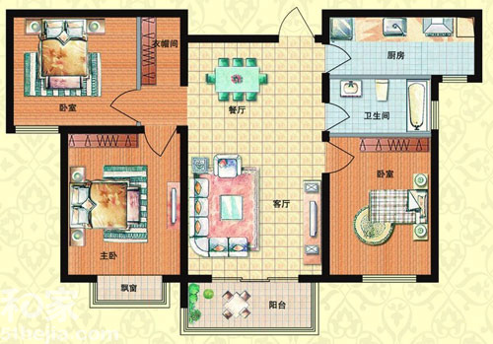
This is my home. It’s an apartment.
Warm-up
kitchen
bedroom
dining room
washroom
bedroom
living room
bedroom

Slide 4
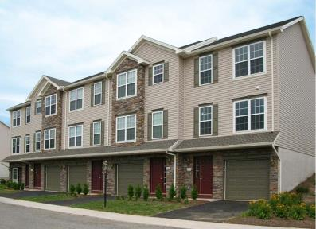
Apartment building
Presentation
Townhouse

Slide 5
Farmhouse

Slide 6
What kind of home do you live in?

Slide 7
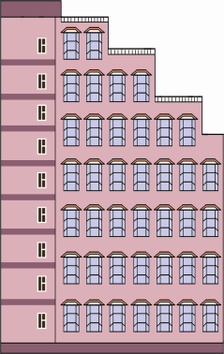
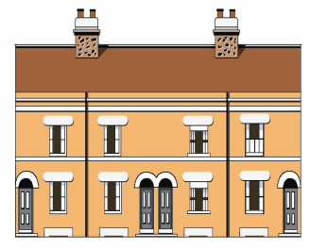
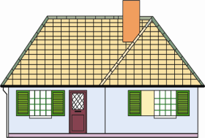
Listen to 1a and match the buildings with the people.
1b
A. Kangkang
B. Wang Wei
A
C. Wang Wei's grandparents
B
C
apartment building
farmhouse
townhouse

Slide 8
Work in pairs and practice 1a. Then make up a new conversation with your partner. These words or phrases may help you:
what kind of home…
live in
a townhouse
a big farmhouse
an apartment
grandparents
in the country

Slide 9
Survey your group about the different types of homes they live in and report it to your class.
Example:
A: What kind of home do you live in?
B: It’s an apartment.
Home | apartment | townhouse | farmhouse | …
Name
You can report like this:
In our group, three students live in…

Slide 10
Listen to the conversation and choose the correct answers.
2
What kind of home does Michael want to rent?
A. A townhouse B. An apartment
C. A farmhouse
2. Does Michael want to rent a quiet room for the students?
A. Yes, he does. B. No, he doesn't.
C. We don't know.

Slide 11
3. Michael wants to rent a room under _____ a month.
A. ¥ 900.00 B. ¥ 960.00
C. ¥ 800.00
4. What do they want to write?
A. FOR RENT B. FOUND
C. ROOM WANTED

Slide 12
Yushancun Community Bulletin Board
3a
房屋求租
出租
FOR RENT
Small apartment for students
¥850.00 a month
Call Ms. Zhang
Tel: 6264-2404
ROOM WANTED
Look for a quiet room for two people under
¥300.00 a month.
Call Bob at 139-7382-4946
less than, 低于

Slide 13
Look, read and complete the sentences.
1. Michael can rent a small apartment for ________ a month from Ms. Zhang.
2. You can rent a room for two persons to ________ for ¥480.00 a month.
3. We can watch a ping-pong game at _______ p.m. on _________ in the gym.
4. I can't find my wallet. I can call ___________.
¥850.00
Bob
3:00
Saturday
372-5423

Slide 14
Work in groups. Suppose you want to rent a house from/to others. Discuss how to write an ad and then write it down.
3b
ROOM WANTED
...
...
FOR RENT
...
...

Slide 15
Listen and read the sounds and words aloud.
4a

Slide 16
Read the words by yourself. Then listen, check ( ) and repeat.
4b
nose pole pot hot goat
road fold gold hour ghost

Slide 17
Summary
1. What kind of home … live in?
It's a townhouse with two floors.
It's an apartment.
It's a farmhouse in the country.
How many floors are there in your building?
There are seven.
2. Call sb. at…
3. If you want to rent a house
from/to others, how do you
write the ad?

Slide 18
Homework:
1. Suppose Mr. Li has a house with two bedrooms for rent, and the price is ¥300 a month at least. His mobile phone number is 13900004696. Please write a renting ad for him.
2. Preview Section B.

