Slide 1
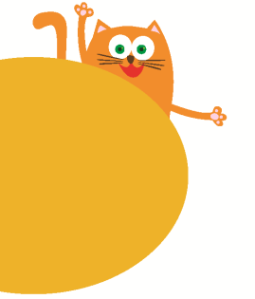
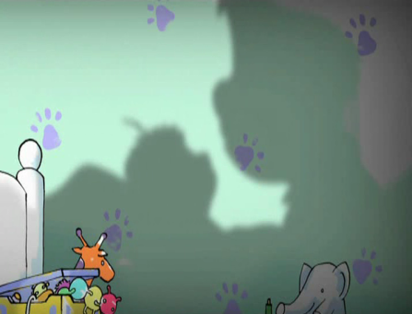
Look and see
3
第二课时
WWW.PPT818.COM

Slide 2
Let’s guess
It is black.
It always follows you.
You can see it in the daytime,
but not at night.
What is it?
a
o w
sh_d_ _

Slide 3
Let’s guess
Look at the shadows.
Who are they?

Slide 4
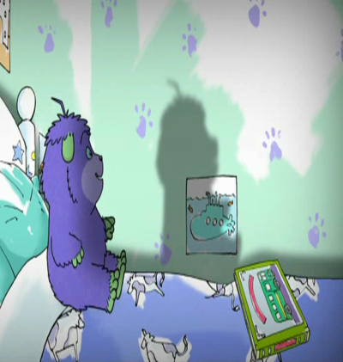
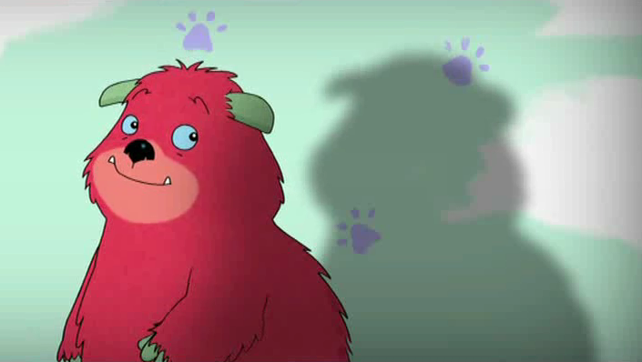
Humf
Humf’s dad

Slide 5
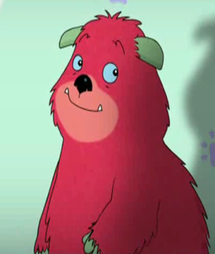
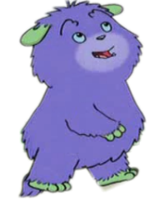
Does the shadow change
from morning to evening?
How does it change?

Slide 6
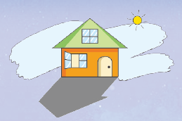
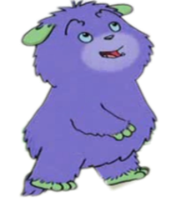
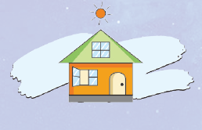
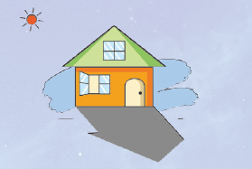

Slide 7
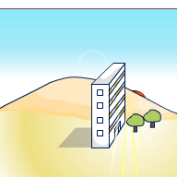
The sun rises in the morning.
The shadow is long.

Slide 8
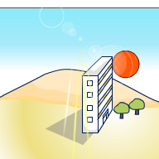
At noon, the sun is high in the sky. The shadow is short.

Slide 9
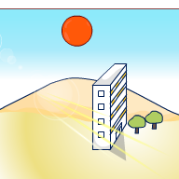
The sun goes down in the evening. Look at the shadow. It is long again.

Slide 10
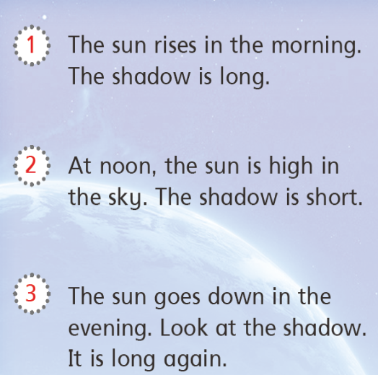
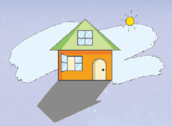
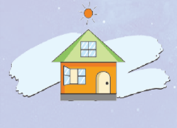
Read and match
A
B
C

Slide 11
Think and say
How does the shadow change?
The sun rises in the morning.
The shadow is long.
The sun is high in the sky.
The shadow is short.
The sun goes down in the evening.
The shadow is long again.

Slide 12
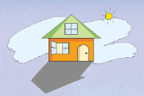
Look and say
The sun rises in the morning.
The shadow is long.
At noon, the sun is high in the sky.
The shadow is short.
The sun goes down in the evening.
Look at the shadow.
It is long again.

Slide 13
Read and choose
in the morning
at noon
in the evening
The sun goes down ________________.
Look at the shadow. It is long again.
in the evening
___________, the sun is high in the sky. The shadow is short.
At noon
The sun rises _________________.
The shadow is long.
in the morning

Slide 14
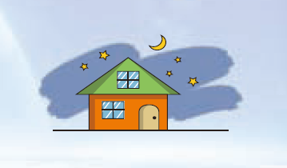
Look and think
What is high in the sky? When can we see them?
The moon and the stars are high in the sky.
Do we have shadows at night?

Slide 15
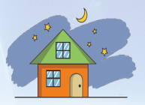
Read and write
The sun _______ in the morning. The shadow is long.
At ______, the sun is _____ in the _____. The shadow is short.
The sun goes down in the _________. Look at the shadow. It is long again.
At ______, the ______ is _____ in the _____.
rises
noon
high
sky
evening
night
moon
high
sky

Slide 16
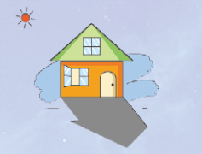
Look and think
Why does the shadow change?

Slide 17
Let’s play
A tree/a plant
A Flashlight or a torch

Slide 18
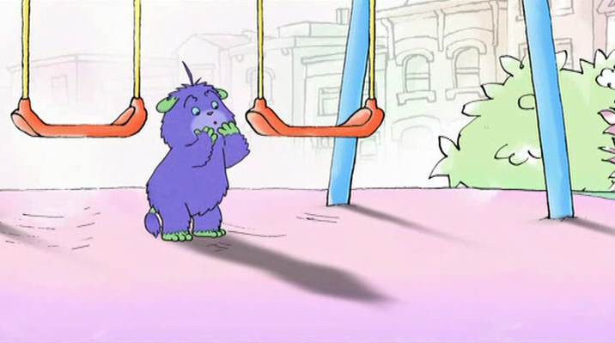
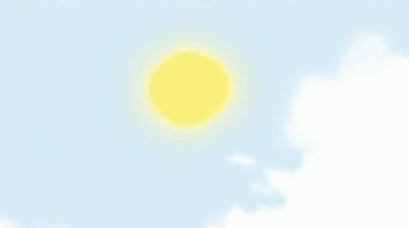
Look at my shadow!
When is it?
It’s in the morning.
How is the weather?
It’s sunny.

Slide 19
Where is my shadow?
Why?
It’s cloudy.

Slide 20
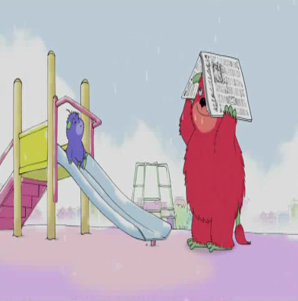
How is the weather now?
It’s rainy.
Can you find my shadow?

Slide 21
When we are at home at night, do we have shadows?

Slide 22
When there is light, we have shadows.
When do we have the shadows?
When there isn’t any light, we have no shadows.

Slide 23
Look at the shadows. What are they?

Slide 24
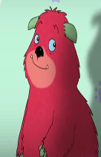
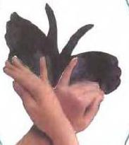
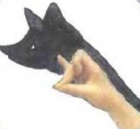
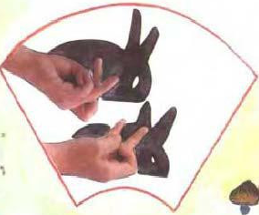
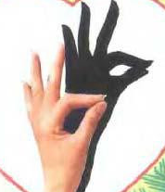
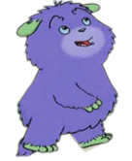
Can you make the shadows?

Slide 25
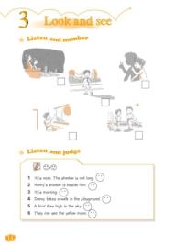
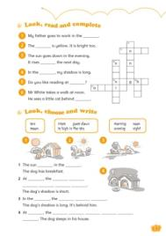
Homework
1. Copy the words below.
evening night moon
2. Read the passage on page 10 twice.
3. Sing the song on page 11.
4. Complete Workbook 4B pages 14
and 17.

