Slide 1
Unit 3 Robots Reading (II)
WWW.PPT818.COM

Slide 2
The home robot
How did the robot help Mr Jiang in the morning?
In the first few weeks , what did MrJiang think of the robot?
Afer a few comfortable weeks , what happened to the robot?

Slide 3
The home robot
How did the robot help Mr Jiang in the morning?
In the first few weeks , what did Mr Jiang think of the robot?
Afer a few comfortable weeks , what happened to the robot?
When Mr Jiang got up in the morning, breakfast was made, his business suit was smoothly ironed and his lunch box was already prepared.

Slide 4
The home robot
How did the robot help Mr Jiang in the morning?
In the first few weeks , what did Mr Jiang think of the robot?
Afer a few comfortable weeks , what happened to the robot?
In the first few weeks, Mr Jiang thought that in general the robot satisfied his needs.

Slide 5
The home robot
How did the robot help Mr Jiang in the morning?
In the first few weeks , what did Mr Jiang think of the robot?
Afer a few comfortable weeks , what happened to the robot?
The robot caught a virus and no longer worked properly.

Slide 6
When Mr Jiang got home , he would find his flat in a complete
mess. What happened to the things in his flat?
Things | Where they were found
Food
Milk
Coins, bills and his private papers
was laid on the bed
was stored in the rubbish bin
were spread all over the floor

Slide 7
Group work

Slide 8
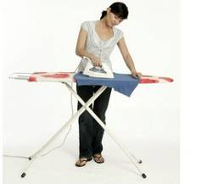
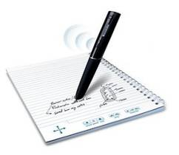
Language
points
When he got up in the morning, his business suit was smoothly ironed.
1
smoothly
look as good as new
satisfy …
catch a virus
work properly
in a complete mess
be stored
be spread
what to do with
She has ironed her
son’s T-shirt ________.
smoothly
The pen writes
_____________.
smoothly

Slide 9
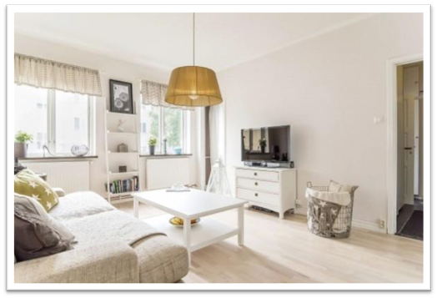
Language
points
When Mr Jiang returned home from
work, his flat would look as good as new.
2
smoothly
as good as …
satisfy…
catch a virus
work properly
in a complete mess
be stored
be spread
what to do with
very nearly

Slide 10
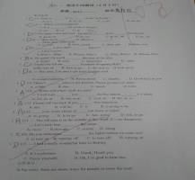
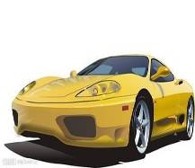
Language
points
It seemed that in general the robot satisfied Mr Jiang’s needs.
3
provide what
is needed
smoothly
look as good as new
satisfy …
catch a virus
work properly
in a complete mess
be stored
be spread
what to do with
satisfied
This paper _______ his
teacher and parents.
I believe this car ______
her needs.
will satisfy

Slide 11
Language
points
The robot caught a virus and no longer worked properly.
4
smoothly
look as good as new
satisfy …
catch a virus
work properly
in a complete mess
be stored
be spread
what to do with
This computer can’t work properly because it has caught a virus.

Slide 12
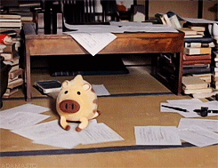
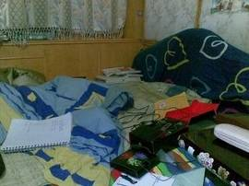
Language
points
When he got home, he would find his flat in a complete mess.
5
smoothly
look as good as new
satisfy …
catch a virus
work properly
in a complete mess
be stored
be spread
what to do with
The room is in a
complete mess, but this lovely robot can
put things in order.
The bed is in a complete mess.

Slide 13
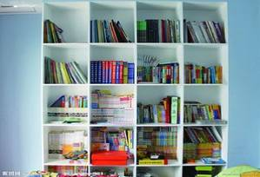
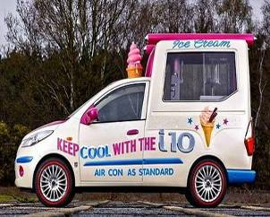
Language
points
Milk was stored in the rubbish bin.
6
My father ______________
many books in his study so far.
smoothly
look as good as new
satisfy …
catch a virus
work properly
in a complete mess
be stored
be spread
what to do with
has stored
A lot of ice cream
_____________ in the lorry.
is stored

Slide 14
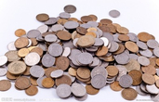
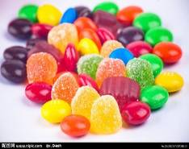
Language
points
Coins, bills and his private papers
were spread all over the floor.
7
smoothly
look as good as new
satisfy …
catch a virus
work properly
in a complete mess
be stored
be spread
what to do with
Coins are spread all
over the place.
Sweets are spread
on the table.

Slide 15
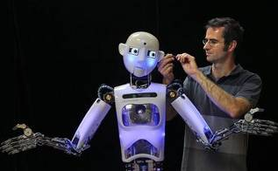
Language
points
Mr Jiang didn’t know what to do with it.
8
smoothly
look as good as new
satisfy …
catch a virus
work properly
in a complete mess
be stored
be spread
what to do with
The boy doesn’t know
what _______ (do) with
this math problem.
to do
Mr Li knows
what______ (do) with this robot.
to do

Slide 16
Mr Jiang b___________ a robot a few weeks ago.
At f_______ the robot worked p______________ .
When he got up in the morning, breakfast w_______
made, his business suit was s_______________ ironed
and his lunch box was already prepared.When he returned
home from w__________, his flat would look as g_______
as new. It seemed that in g____________ the robot s______
Mr Jiang’s needs.
However, a few weeks later, the robot caught a v______.
It began to make stupid mistakes. When Mr Jiang returned
home, he would find his flat in a complete m______. Milk
was s_________ in the rubbish bin. Coins, bills and his
private papers were s___________ all over the floor. Mr Jiang
didn’t know w__________ to do with it.
In the end, he decided to returned the robot to the robot shop.
ought
irst
roperly
as
moothly
ork
ood
eneral
atisfied
irus
ess
tored
pread
hat

Slide 17
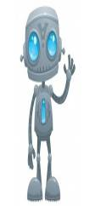
Advantages
Disadvantages
may
do housework for us
be easy to catch a virus
take care of our pets
make stupid mistakes
iron our business suits
put our food in the wrong place
do some shopping for us
move around and knock things over
let us have more free time
make our house in a complete mess
let us have more sleep
not work properly
prepare our lunch boxes
wake up too early
cook delicious meals

Slide 18
What’s your
ideal robot?

Slide 19
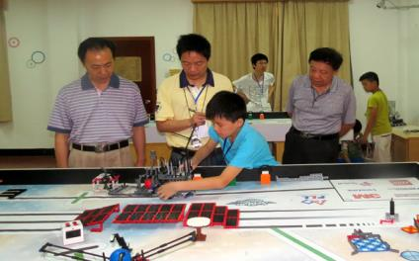
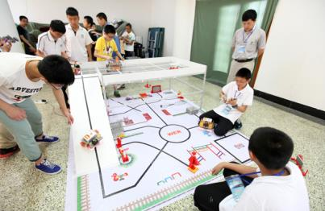
China’s National Robot Competition
Every year, many students take part in China’s National
Robot Competition. They design all kinds of robots. Do
you want to join them?

Slide 20
China’s National Robot Competition
scientists will work hard and design useful robots in the future;
students will study better with the help of
new types of robots;
people will have more free time and live
Longer because of the robots;
robots will not catch viruses easily.
Every year, many students take part in China’s National
Robot Competition. They desighed all kinds of robots.

Slide 21
Homework
1. Remember new words,
phrases and sentences.
2. Recite the article.

