Slide 1
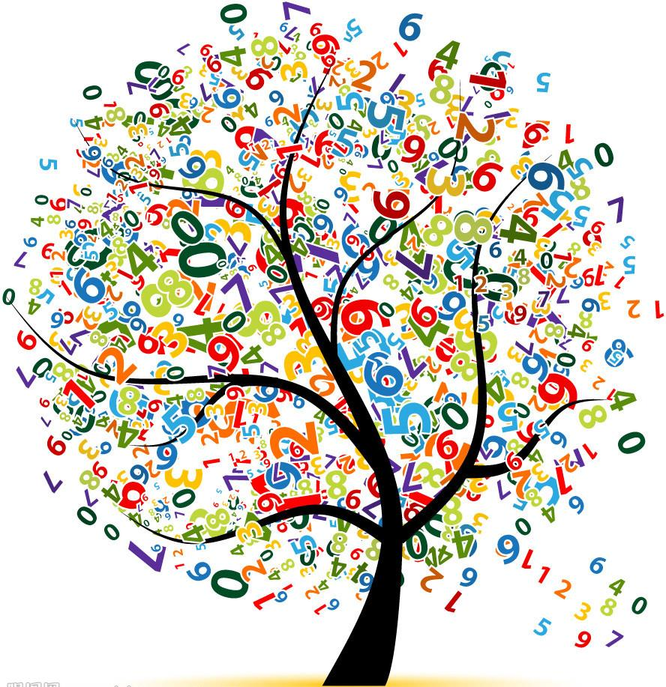
Numbers
WWW.PPT818.COM

Slide 2
Match the numbers

Slide 3
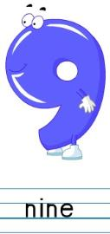
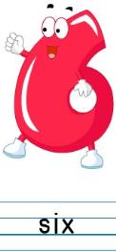
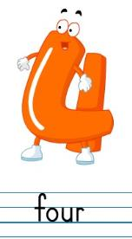
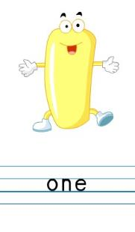
Spell the numbers

Slide 4
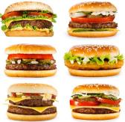
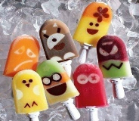
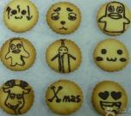
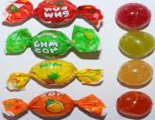
Say out the food
1
apple
2
pears
3
pies
4
eggs
5
bananas
6
hamburgers
7
ice creams
8
cakes
9
biscuits
10 sweets

Slide 5
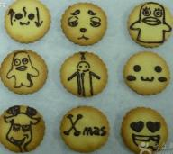
Let's act
What do you like?
I like cakes.
How many cakes?
Eight cakes.
Taste the cake.
Yummy!

Slide 6
Let's act
Pair work: Let’s act the dialogues with your partner. One can be Donald, the other one can be the ant.
同桌活动：一人扮演唐老鸭，一人扮演蚂蚁，表演对话。

Slide 7
Let's act
What do you like?
I like cakes.
How many cakes?
Eight cakes.
Taste the cake.
Yummy!

Slide 8
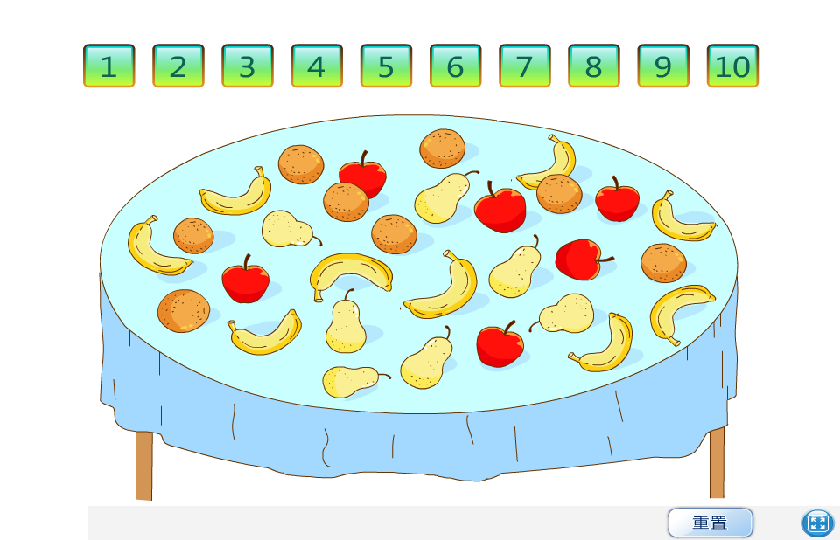
S1:How many … ? S2: …
Play a game

Slide 9
Let's chant
One apple, two apples, three apples, four,
Five apples, six apples, seven apples, more,
Eight apples, nine apples, ten apples, all.

Slide 10
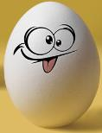
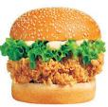
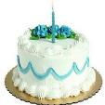
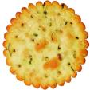
Make a new chant
One ____, two ____s, three ____s, four,
Five ____s, six ____s, seven ____s, more,
Eight ____s, nine ____s, ten _____s, all.

Slide 11
Sharp eyes

Slide 12
Write and say
There are many food! Let’s have a picnic in groups. 这里有许多美食！小组一起野餐吧！参考以下句型：
A:What do you like?
B:I like .
A:How many ?
B: .
A:Taste/Smell the .
B:Yummy/Super/How nice/Very good!

Slide 13
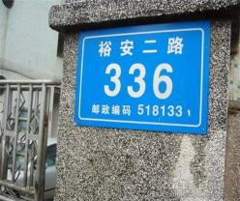
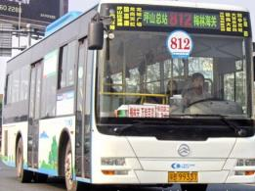
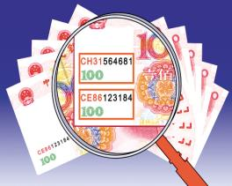
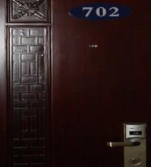
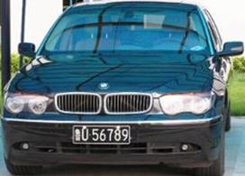
More to know
Numbers around us
Road numbers
Phone numbers
Bus numbers
Money numbers
Car numbers
Room numbers

Slide 14
Find the right numbers
1. 444 333 222 1?1
1
2. 155 145 135 1?5
2
3. 146 157 168 1??
79
4. 3556 3666 3776 3??6
88
5. 765 654 543 ??2
43

Slide 15
True or flase
one
( )
2. twe
( )
3. thrre
( )
4. fore
( )
5. fave
( )
6. six
( )
7. seven
( )
8. eight
( )
9. nine
( )
10. tan
( )
Notes:
15

Slide 16
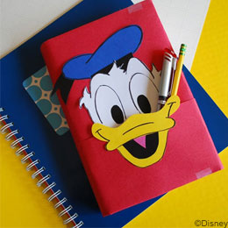
Homework：
Do a survey: Ask your friends: How many…？
用“How many…？”调查身边物品的数量。
2.Find more numbers around us.
发现身边更多与数字相关的事物。
3.Say more things around us with numbers.
用数字说说更多生活中的物品。

