Slide 1
Unit 1
Past and present
(Revision)
WWW.PPT818.COM

Slide 2
Activity One: Preview show

Slide 3
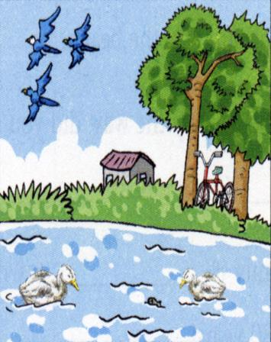
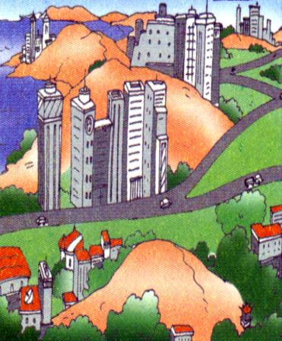
Activity Two: Speaking
a place of natural beauty
a modern town

Slide 4
Fill in the blanks with the right words
well
Mr Chen knows Sunshine Town very ____ . He lived with his family he got _____. Then he and his wife ____ to another ____ in the ____ of town. Last year they moved again his children _____ them a new flat .
The pollution was _______ then because the factory ____ to dump its _____ into the river. The ______ in the waste killed fish and plants and ________ the river. Later the government _______ it was a very serious problem and took action to ______ the pollution. Now the river is much _______.
In some ways，he thinks life is better now. Many of his old friends ___ ____ other areas and he feels ___ ___ lonely ____ ___ ___ ___.
till
married
moved
flat
centre
because
bought
terrible
used
waste
poison
polluted
realized
reduce
cleaner
moved
to
a
bit
from
time
to
time

Slide 5
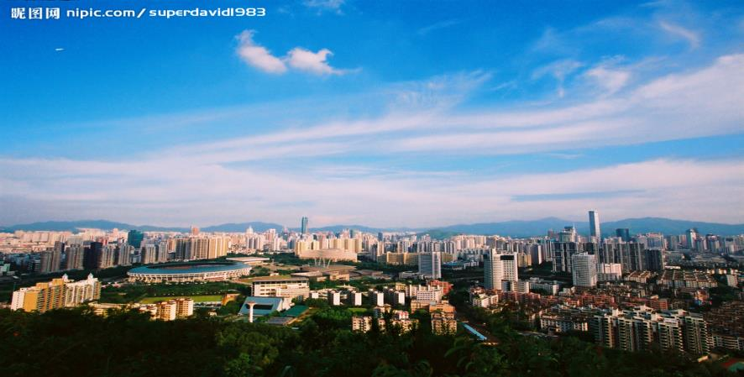
Activity Three: Listening
The changes to Shenzhen

Slide 6
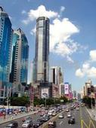
( ) 1. When was the photo of old Shenzhen taken?
A. in the early1970s B. in the late 1970s C. in 1970
( )2.How is today’s Shenzhen?
A. It’s quiet and modern B. It is busy and noisy
C. It is busy but still
( )3.What’s in the photo of today’s Shenzhen?
A. some old houses and a few small buildings.
B. many tall buildings and many people in the wide streets.
C. just a park.
( )4.What changes can we see in the photo of today’s Shenzhen?
A. Shenzhen has become a rich and important city, a place to do business.
B. It has become a small village.
C. We can’t see any changes in the photo.
( )5.Which is right according to the dialogue?
A. The changes of Shenzhen have brought some problems for people.
B. Life in Shenzhen was better in the past than now.
C. Shenzhen has been a good place to do business.
A
B
B
A
C

Slide 7
Activity Four: Grammar
------The present perfect tense
现在完成时是由助动词have（has）+过去分词构成。 现在完成时表过去发生的某一动作对现在造成的影响或结果, 或表示过去已经开始，持续到现在的动作或状态，也可以表示可能继续下去的动作或状态。通常和 for, since引导的时间状语连用.以及 so far（至今）, by now（直到现在）, these days, in the last ten years 等连用。

Slide 8
规则动词
原形 | 过去式 | 过去分词
ask
plant
live
move
carry
cry
play
enjoy
stop
plan
asked
asked
planted
planted
lived
lived
moved
moved
carried
carried
cried
cried
played
played
enjoyed
enjoyed
stopped
stopped
planned
planned

Slide 9
不规则动词
原形 | 过去式 | 过去分词
be
come
go
see
eat
give
put
make
write
do
was/were
been
came
come
went
gone
saw
seen
ate
eaten
gave
given
put
put
made
made
wrote
written
did
done

Slide 10
competition
1
2
3
4
5

Slide 11
选用 for和 since填空:
1.We haven’t seen each other ______ a long time.
2.His father has been in the Party ______ 10 years ago.
3.The film has been on ______ 20 minutes.
4.Mr Green has worked here ______ he came to China.
for
since
for
since
Tips:
for refers to a length of time.
since refers to the beginning of a period
and continues to present.

Slide 12
Fill in the blanks with correct adverbials
1) yet or already
A: Have you done your homework ?
B: No, I haven’t done it .
B: Yes, I have done it .
2) ever or never
A: Have you been to Hong Kong
B: No, I have been there before.
3) Just or just now
A: Clean the blackboard, please.
B: We have cleaned it.
A: When did you clean it?
B: We cleaned it_________.
yet
yet
already
ever
never
just
just now

Slide 13
时态填空
1.He _________ (know) the city since he was very young .
2. _____ you ____ (see) my watch ? Yes, I ___ (see) it on your desk five minutes ago .
3.Last night ,it ______ (rain) heavily .
4.--When _____ you _____ (finish) your work ?
-- Half an hour ago .
has known
Have
seen
saw
rained
did
finish
Tips:
一般过去时表示过去某个时间发生的动作或状态，常和表示过去的时间连用，yesterday, last night, in 1990, two days ago等。易与现在完成时混淆。

Slide 14
句型转换
1.The boy has already gone home .
（改为一般疑句）
__________________________
2.The girl has just given it to me .
（改为否定句）
___________________________
3.They have ever visited Beijing before.
（改为否定句）
____________________________
Has the boy gone home yet?
The girl hasn’t given it to me yet.
They have never visited Beijing before.

Slide 15
翻译句子
1.我已完成我的家庭作业。
2.我半小时前完成的家庭作业。
3.陈先生自出生以来就住在阳光镇。
4.陈先生五年前住在阳光镇。
have
finished
I already my homework.
I my homework half an hour ago.
finished
Mr Chen in Sunshine Town since he was born.
has lived
Mr Chen in Sunshine Town five years ago.
lived

Slide 16
Activity Five: Writing
What do you know about your hometown?
Have a discussion in your groups and try to finish the table!
 | In the past | At present
Environment
Transport
Advantages
Problems
Notes:
16

Slide 17
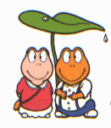
Writing :
The changes to Yancheng
Para1: General introduction of Yancheng.
Para2: In the past, what was Yancheng like?
Para3: At present, what’s Yancheng like?
Para4: Conclusion

Slide 18
Homework
1.Review unit 1 of 8A,
2.Finish the exercises on the sheet.

Slide 19
Thank you !

