Slide 1
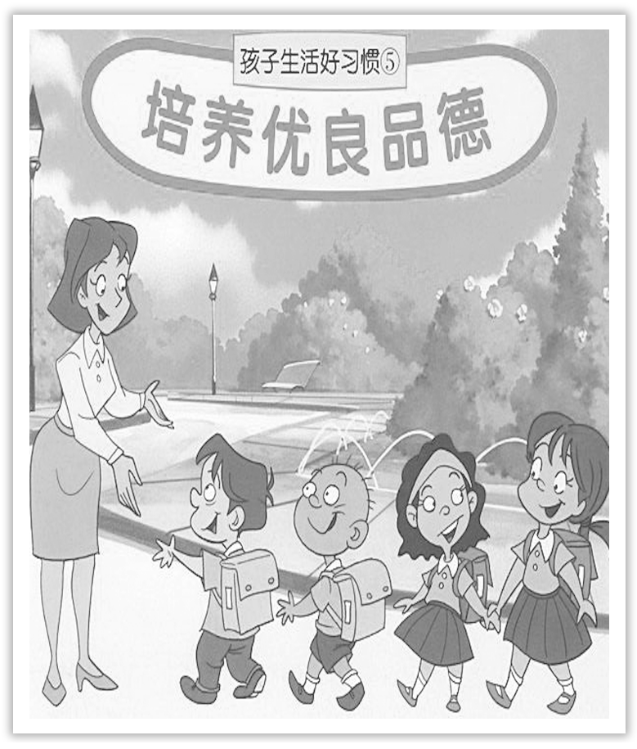
Unit 2 Morals and Virtues
Section Ⅴ Listening and Talking
WWW.PPT818.COM

Slide 2
1.Translate the following words and phrases.
①chain n. ___________________________
②café n. ________________
③waitress n. _________________________
④pregnant adj. ________________
一连串(人或事)；链子；链条
咖啡馆；小餐馆
(餐馆的)女服务员；女侍者
怀孕的；妊娠的

Slide 3
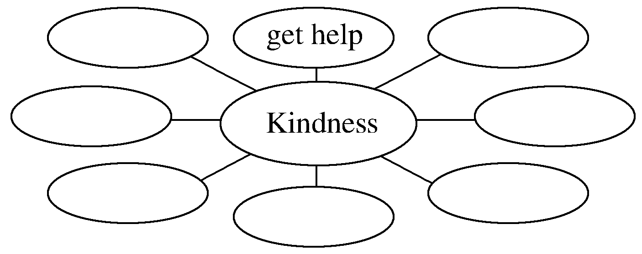
2.Brainstorming：What is the importance of kindness?
________________________________________________________________________
The answer is open.

Slide 4
1.Finish Ex.1 on Page 19.
2.Finish Ex.2 on Page 19.
Talking—Finish Ex.3 on Page 19.

Slide 5
语言知识积累
讲述故事的常用表达
1.I still clearly remember what happened during my first speech contest.
我仍清楚记得第一次参加演讲比赛时发生的事。
2.A dog jumped at me when I was walking in the street.
我正在街上走的时候，一条狗突然往我身上扑过来。

Slide 6
3.I saw a terrible smashup on my way to school.
我在去学校的路上看到一起可怕的汽车相撞事故。
4.It was a big day for us.
对我们来说这是重要的一天。
5.I knew something was happening because there were a lot of people on the street.
我知道有事发生因为街上人头攒动。

Slide 7
chain n.一连串(人或事)；链子；链条
[合作探究] 体会chain的用法和意义
①He now owns a chain of 970 food stores.
他现在拥有970家连锁食品店。
②The prisoner was led away in chains.
犯人____________给带走了。
[自主发现]
③________________ 一连串的；一系列的
④____________ chains 戴着镣铐；在囚禁中；当奴隶
戴着镣铐
a chain of
in

Slide 8
[词块积累]
iron chains 铁链
a chain of events 一连串的事件
[巩固内化] 单句语法填空
①The drug dealer is being kept ____________ chains.
②Their actions caused ____________ chain of events to occur throughout the country.
in
a

