Slide 1
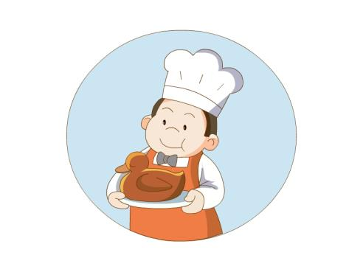
Unit 1 He looks like a cook.
WWW.PPT818.COM

Slide 2
look
like
看起来像。。。。

Slide 3
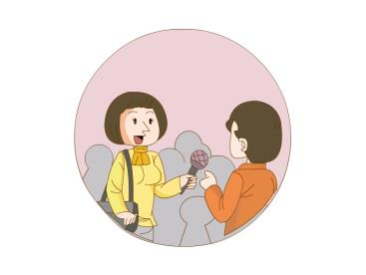
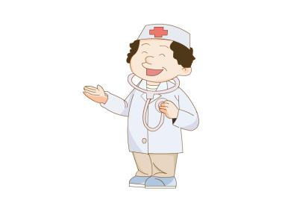
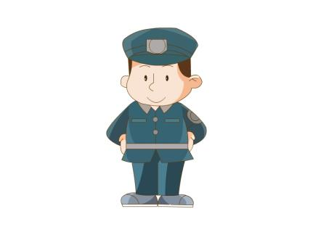
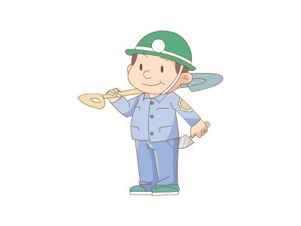
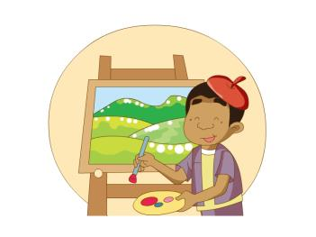
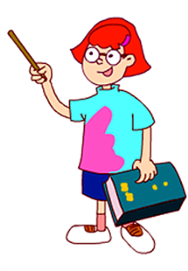
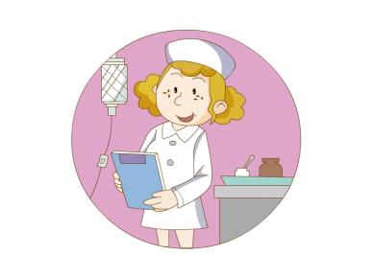
people

Slide 4
teacher
Teacher can teach people.

Slide 5
doctor
Doctor can help sick people.

Slide 6
nurse
Nurse can help sick people.

Slide 7
cook
Cook can cook nice food for people.

Slide 8
painter
Painter can draw pictures.

Slide 9
policeman
Policeman can help people.

Slide 10
builder
Builder can build good house for people.

Slide 11
reporter
Reporter can get news for people.

Slide 12
Who’s that woman\man?

Slide 13
Who’s that man ?
with a hat
with
有，和……一起
He looks like a cook.

Slide 14
Who’s that woman ?
with glasses
glasses
眼镜
She looks like a teacher.

Slide 15
Who’s that man ?
in a uniform
uniform
制服
He looks like a policeman.

Slide 16
Who’s that woman ?
in a uniform
She looks like a policewoman.

Slide 17
Who’s that man in a blue uniform ?
a blue uniform
He looks like a builder.

Slide 18
Who’s that woman in a yellow blouse ?
in a yellow blouse
She looks like a reporter.

Slide 19
Who’s that woman in a white coat ?
in a white coat
She looks like a doctor.

Slide 20
Who’s that woman in a white dress ?
in a white dress
She looks like a nurse.

Slide 21
Who’s that man with a red hat ?
with a red hat
He looks like a painter.

