Slide 1
Unit 5 Country Life
How many ducks do you have?
WWW.PPT818.COM

Slide 2
EVERYDAY ENGLISH
每日英语
口语练习~

Slide 3
What grade are you in?
---- I am in Grade ______.
What class are you in?
---- I am in Class ______.

Slide 4
How many colours do you know?
---- I know many colours. Such as ……（据实际情况回答）

Slide 5
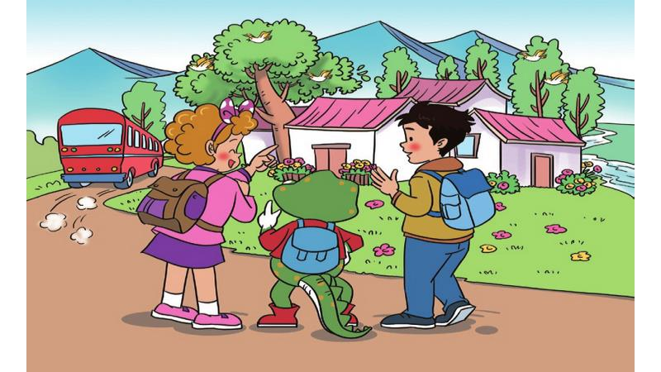

Slide 6
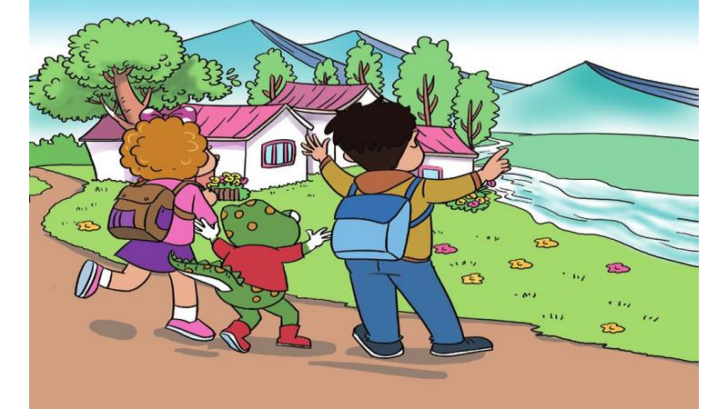

Slide 7
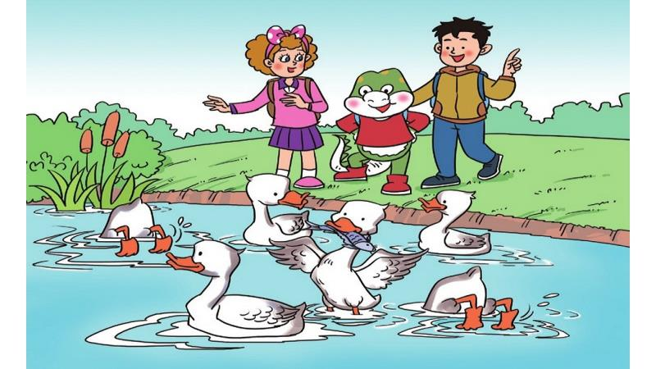

Slide 8
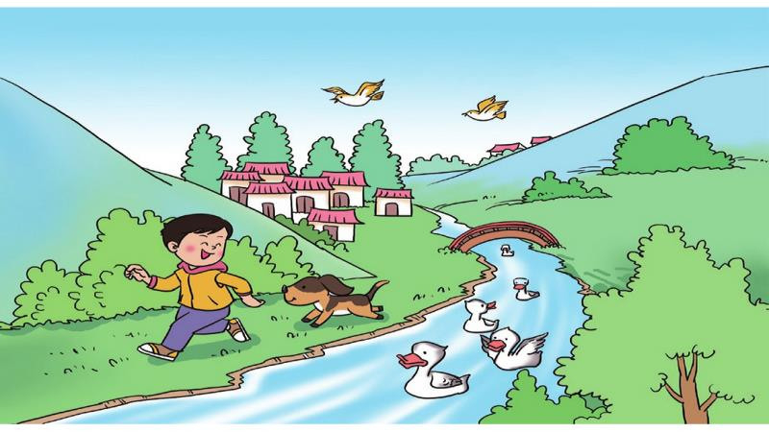

Slide 9
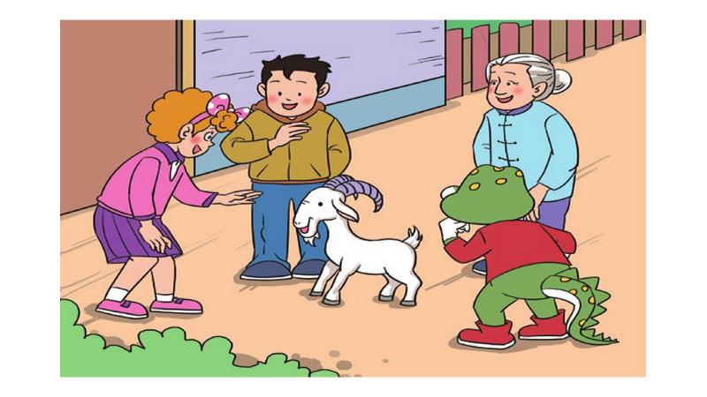
Where are they ?

Slide 10
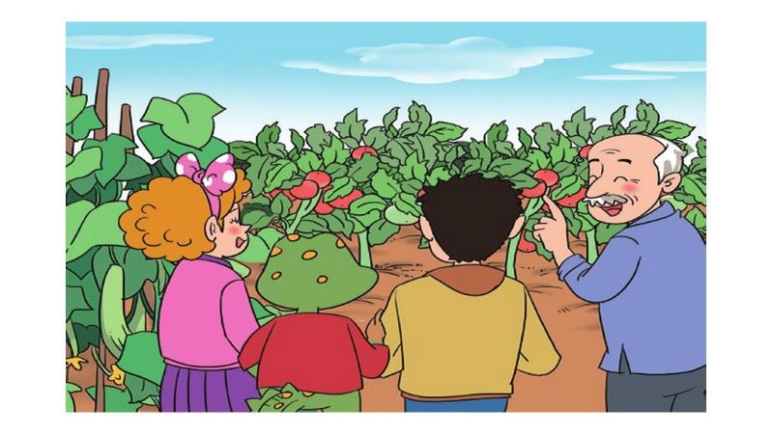

Slide 11
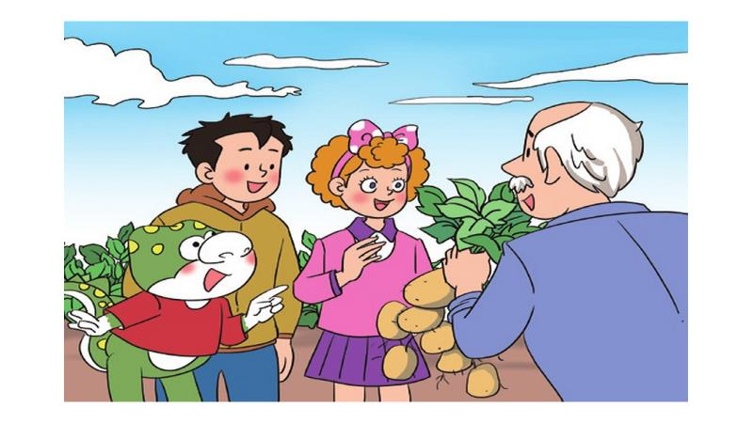

Slide 12
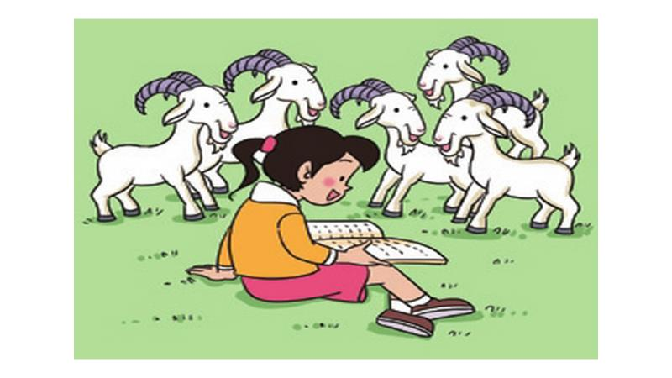

Slide 13
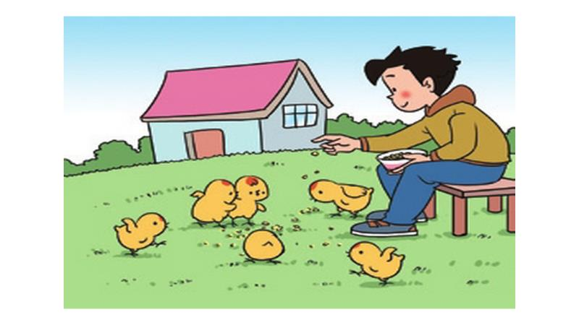

Slide 14
Thank You

