Slide 1
Unit 9
I like music that I can dance to. Section A (第2课时)
WWW.PPT818.COM

Slide 2
Warming up
What kind of films
do you like?

Slide 3
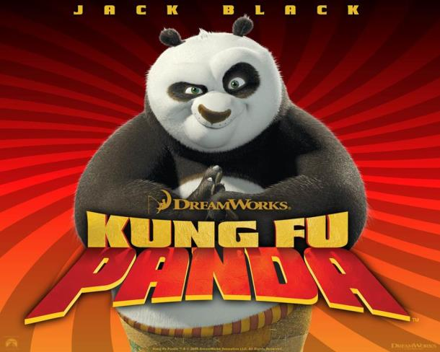

Slide 7
3a
Read the passage. Underline the different kinds of movies and circle the movie names.
What Do You Feel Like Watching Today?
While some people stick to only one kind of movie, I like to watch
different kinds depending on how I feel that day.
When I'm down or tired, I prefer movies that can cheer me up.
Comedies like Men in Black or cartoons like Kung Fu Panda have
funny dialog and usually have a happy ending. The characters
may not be perfect, but they try their best to solve their problems.
After I watch them, my problems suddenly seem less serious
and I feel much better again. Laughing for two hours is a good way to relax!

Slide 8
I don’t watch dramas or documentaries when I’m sad or tired. Dramas like Titanic make me feel even sadder. Documentaries like March of the Penguins which provide plenty of information about a certain subject can be interesting, but when I’m tired I don’t want to think too much. I don’t mind action movies like Spider-Man when I’m too tired to think. I can just shut off my brain, sit back and enjoy watching an exciting superhero who always saves the world just in time.

Slide 9
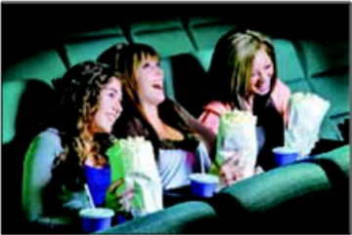
Once in a while, I like to watch movies
that are scary.They can be fun, but
I’m too scared to watch them alone.
I always bring a friend who isn’t afraid
of these kinds of movies,and it doesn't
feel so scary anymore.

Slide 10
Read the passage again and answer the questions.
3b
1. How does the writer describe each kind of movie?
Comedies or cartoons have funny dialog and ususlly have a happy ending;Dramas like Titanic make him/her feel even sadder;
Documentaries like March of the Penguins which provide plenty of information about a certain subject can be interesting;Scary movies can be fun,but he/she is too scared to watch them alone.

Slide 11
2. What kinds of movies does the writer prefer to watch
when he or she is sad or tired?
3. How does the writer feel after watching these movies?
4. Does the writer like scary movies? When does
he or she watch them?
He/She prefers movies that can cheer him/her up.
After watching them,the problems suddenly seem less
serious and he/she feels much better.
Yes,he/she does.Once in a while,he/she likes to watch
scary movies.

Slide 12
What kinds of movies do you like to watch? Complete the chart.
3c
When I'm ... | I like/prefer to watch movies that/which ... | Examples (movie names)
happy
sad
tired
bored

Slide 13
Language Points
1.feel like 想要……
通常的结构为feel like (doing) sth, 想（干）……，
相当于would like/want to do sth.。
e.g.:I feel like eating pizza.
2.shut off 关闭，停止运转
e.g.:Please shut off the computer in two hours.
3.once in a while 偶尔地，间或
相当于at times“有时”或sometimes “有时”。
e.g.:Once in a while,I like smooth music that makes me relaxed.

Slide 14
4. When I'm down or tired,I prefer movies that can
cheer me up. 当我不高兴或累的时候，我更喜欢能使我
高兴起来的电影。
（1）down adj. 悲伤的，沮丧的；adv.向下
e.g.:He's down today and let's go and see him.
（2）cheer sb. up 使某人高兴起来。相当于make sb. happy。
5. Documentaries like March of the Penguins which
provide plenty of information about a certain subject
can be interesting.像《帝企鹅日记》这样提供大量有关
某特定主题信息的纪录片会有趣。
（1）which provide...是定语从句。
（2）plenty of “大量，充足”，相当于a lot of 或enough。

Slide 15
Exercise
一、用所给的正确形式填空。
1.He sticks to ______(solve) the problem at once.
2.I feel like______(have) a happy ending.
3.The movie_______(cheer) me up.
4.He only likes movies that are ______ (fun) .
5.I don't mind________(watch) cartoons though I'm
already 20 years old.
solving
having
cheers
funny
watching

Slide 16
二、单项选择。
( )1.He doesn't have_____ money to buy a car.
A.many B.plenty of
C.a lots of D.lot of
( )2.Tony prefers groups that ______ songs.
A.write B.writes
C.writing D.to write
B
A

Slide 17
( )3.Maybe he won't depend______ others. He wants
to live on his own.
A.with B.in C.on D.of
( )4.You should stick _____ listening to slow songs.
A.in B.to C.on D.of
( )5.The workers shut _____ the machine and went home.
A.on B.off C.of D.down
C
B
B

Slide 18
Homework
1.Learn the new words and expressions by heart.
2.Retell the story.

Slide 19
Thank you!

