Slide 1
Unit5 What colour is it?
人教精通版三年级上册
WWW.PPT818.COM

Slide 2
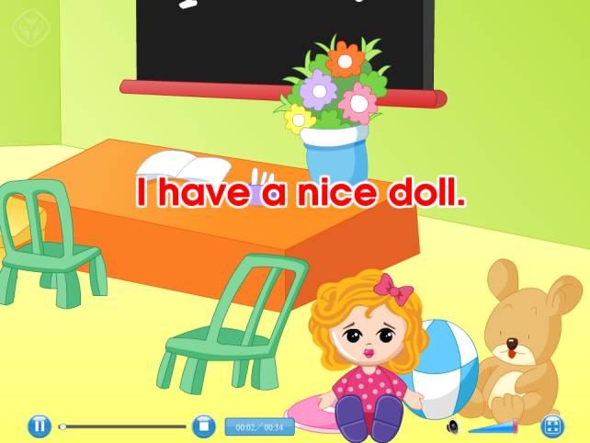
Review
Let’s sing

Slide 3
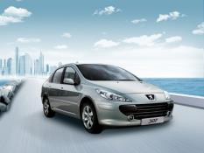
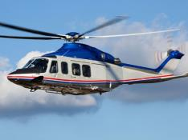
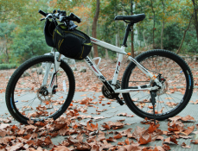
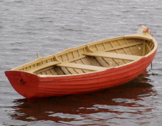
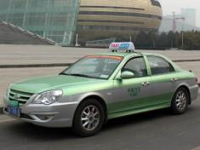
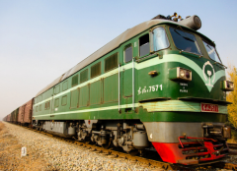
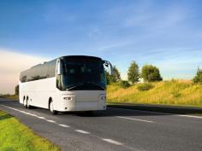
Review
Play a game
快速抢答
I have a …

Slide 4
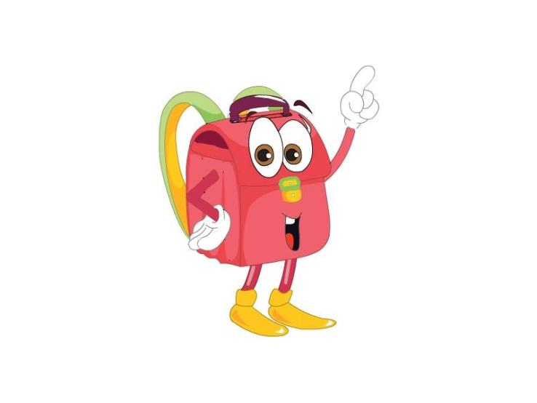
Presentation
Just learn
I have a bag. What colour is it?
red
It’s red.

Slide 5
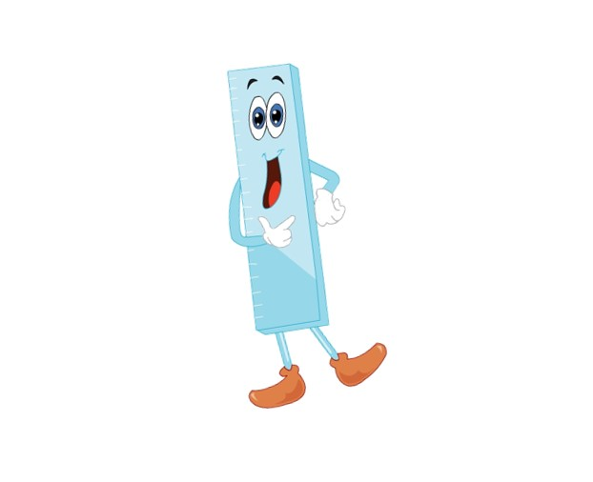
Presentation
Just learn
I have a bag. What colour is it?
blue
It’s blue.

Slide 6
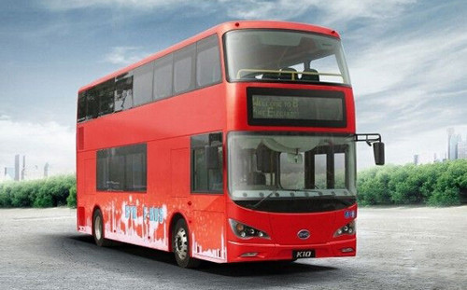
Presentation
Look and say
What colour is it?
It’s red.

Slide 7
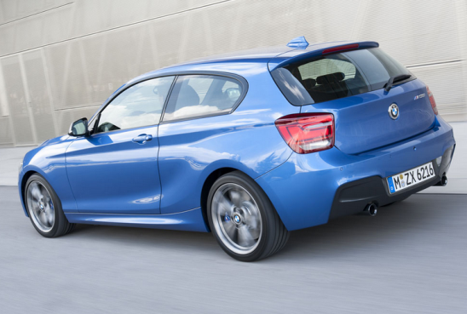
Presentation
Look and say
What colour is it?
It’s blue.

Slide 8
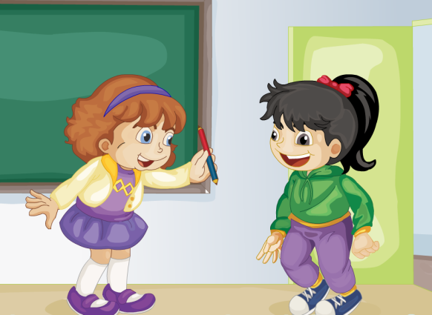
Presentation
Look and answer
What colour is the pencil?
It’s red and blue.

Slide 9
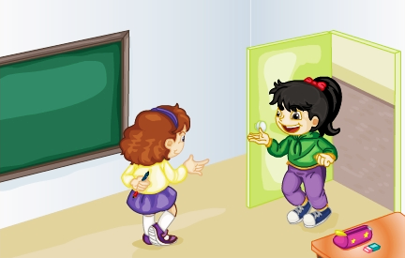
Presentation
Listen and imitate
What colour is it?
Hi, Li Yan. I have a new pencil.

Slide 10
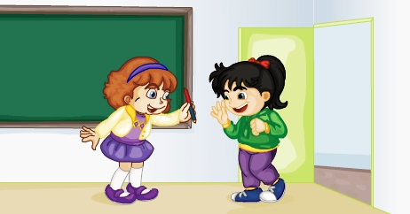
Presentation
Listen and imitate
Look! Red and blue.
Oh, how nice!

Slide 11
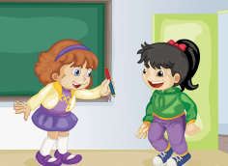
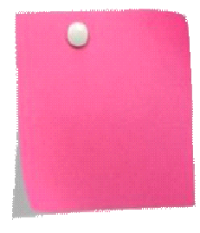
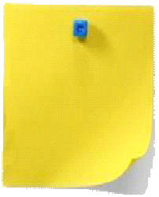
Practice
Let’s read
1
2
3
Read together.
(齐读)
Read in roles.
（分角色读）
Read in groups.
(分组读）

Slide 12
Show time
两人一组试着来表演，其他同学评价。
 | 模仿录音中的语音语调，有感情地朗读。
 | 可以脱离课本，适当改动其中部分，语音地道。
 | 适当添加内容，意思完整，有创新，表演生动。
Good
Great
Excellent

Slide 13
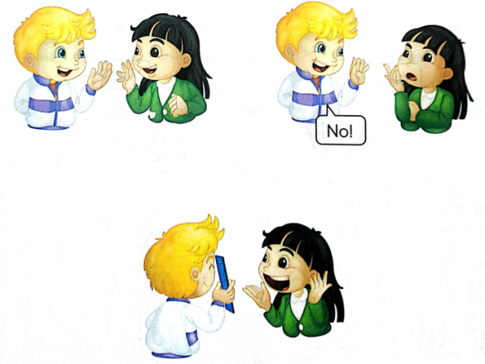
Practice
Guessing game
I have a new ruler.
What colour is it?
Guess.
Red?
No!
Look, it’s blue.
Oh, how nice.

Slide 14
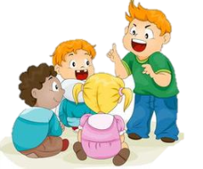
Practice
Group work
联想游戏
活动内容：把学生分成6人小组，各小组运用头脑风暴，联想日常生活中有红色或蓝色的常见物品，并一一记录下来。学过的用英语，不会说的可以用汉语。然后全班展示各小组的联想结果。
活动时间：2分钟
活动方式：小组合作

Slide 15
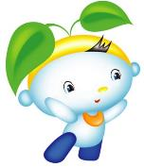
Summary
本课学习的颜色类单词有:
red
blue

Slide 16
Summary
如何询问某物的颜色并做相应回答？
—What colour is it?
—It’s ... (red/blue…).

Slide 17
Homework
1.跟读Just talk部分的课文录音，并注意语音、语调。
2.搜集你身边红色或蓝色的文具或玩具，与你的朋友一起来谈论它们的颜色。
3.预习Lesson26。
Close

