Slide 1
Module 1 Travel
Unit 2 It’s a long story.
WWW.PPT818.COM

Slide 2
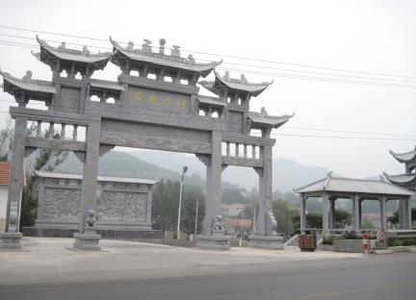
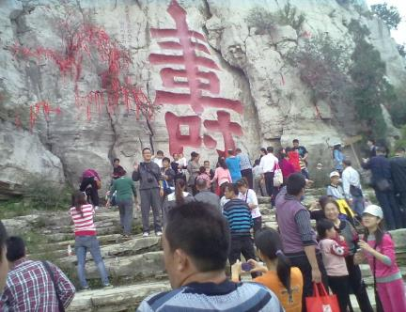
Free talk

Slide 3
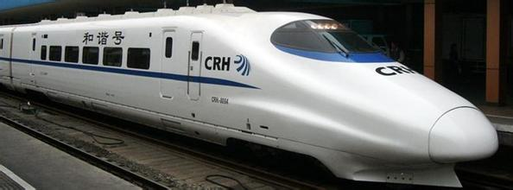

Slide 4
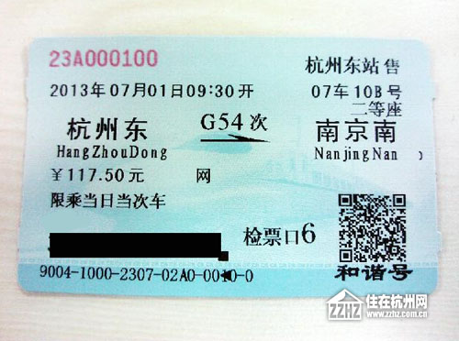

Slide 5
学习目标:
1、通过快速读课文，能找出课文中的重点短语并理清文章的线索。 （重点）
2、通过精读课文，能捕捉课文中的信息，。（重点、难 点）
3、通过本单元的学习，能够运用所学知识与同学交流自己的旅行经历，包括 when, where, who, how and what happened等的信息，并写英语短文来描述旅行中发生的事情。（难点）
4、通过学习，做一个像李林这样的人：热心、爱心、友好的对待他人

Slide 6
Task 1
要求：跳读课文，完成问题1、2。
自己先做，对子交流，评价：好的1分。
时间6分钟

Slide 7
Skipping(跳读)：
Skip to find the key words，then number the expressions.
1、Read the play and number(给…标号) the expressions in the order they appear.
3
□1. …get up and starts to…
□ 3….goes past people…
4
2
1
□ 2. …looks for his ticket…
□ 4. …gets on the train…
2、Can you find the leading roles （主角）
in the play?

Slide 8
Task 2
要求：1、细读课文，回答问题。时间6分钟
2、细读课文，单选。时间3分钟

Slide 9
While- reading
Read and find out the correct answer.
When will Lilin and Liwei meet later ?
Who took the wrong seat ?
They will meet at Spring Festival.
The elderly man took the wrong seat.
Which car should the elderly man take?
He should take the Car9.
Why is the elderly man sitting in Lilin’s seat?
Because he thinks it is his seat.

Slide 10
While- reading
Read and choose the correct answer.
解题技巧： find out the key words ,
read the article ,then choose the best answer.
1. What does the elderly man want to do?
a) Take the seat c) Change seats with Li Lin
b) Go and find Car 9 d) Buy another ticket
2. What does Li Lin decide to do?
a) Take the seat from the elderly man
b) Ask the ticket officer for help
c) Change seats with the elderly man
d) Get off the train
3. Who does Li Lin meet in Car 9?
a) Li Wei c) His friend
b) Another elderly man d) His classmate

Slide 11
Task 3
要求：1、细读课文后，完成短文。时间6分钟
2、细读课文后，分角色表演，时7分钟

Slide 12
Post- reading
读文章，在了解文章大意的同时，识记重点信息
assage with the words and expressions in the box.
afraid miss officer sir take care take off
Li Lin says goodbye to his sister Li Wei. Li Lin says that he will _____ his family, and Li Wei tells him to ____. When Li Lin gets on the train, he sees an elderly man sitting in his seat. He politely calls the elderly man _____ and says he is ______ the elderly man is sitting in his seat. The ticket ______ arrives and explains the mistake. Li Lin kindly offers to change seats with the elderly man, and goes to Car 9. There he sees his friend Wen Peng, who is happy to see him and tells him to _____ his jacket, sit down and make himself comfortable.
miss
take care
afraid
sir
officer
take off

Slide 13
Post- reading
role-play
独白
Requirements:
★分角色，一人一角色
★ 声音流畅、洪亮
★7 minutes
Li Lin
Li Wei
Elderly man
Ticket officer
Wen Peng

Slide 14
talking
Q1: What do you think of Li Lin?
helpful, kind-hearted, nice, friendly…
Q2:Suppose(假设) you were Li Lin, would you make the same decision?
Yes

Slide 15
达标测试 Write a short play about a trip you have had. 要求：根据提示仿写，先自己写，对子 交流，学生展示，好的，加1分。时间：10分钟。
Writing

Slide 16
pay attention to the keywords(要点）,
Tense（时态）, phrases（短语）,link words
（逻辑连接词）从句（Clauses）
☺ when and where you went
Last summer I went to Hong Kong for a holiday.
☺ how you travelled
I travelled by train/ plane.

Slide 17
☺ who travelled with you
I travelled with my parents.
☺ what happened during the trip
I lost my ticket. The ticket officer didn’t allow me to get on the train.
☺ how the story ended
A good-hearted person saw my ticket on the floor. Then he picked it up and gave it to an officer. We were called to take my ticket back.
Now write the play.

Slide 18
Summary
What have you learned？
Read the questions, circle the key words
reading
find out the key words ,
read the article ,then choose the best answer.
writing
pay attention to the keywords(要点）,
Tense（时态）, phrases（短语）,link words
（逻辑连接词）从句（Clauses）
To be a man like Lilin:
helpful, kind-hearted, nice, friendly…
.

Slide 19
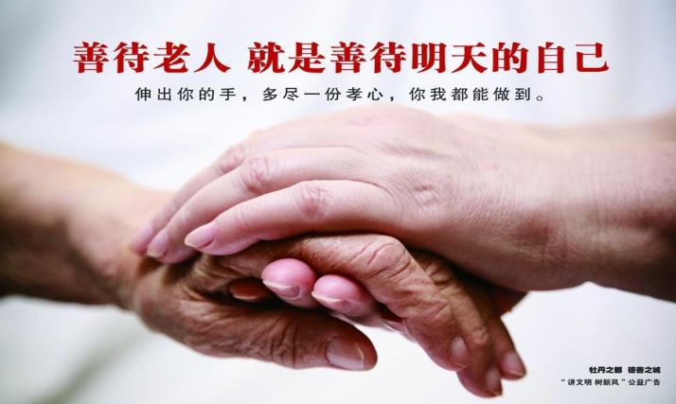
A little kindness goes a long way.
待人以善，行将更远

Slide 20
Homework
Retell the story to your partner.

