Slide 1


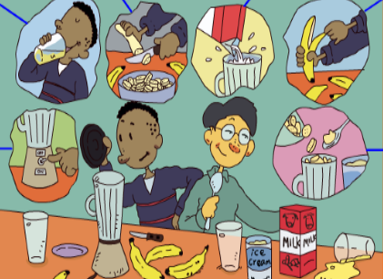
人教版八年级上册
Unit 8
How do you make a banana milk shake?
Section A（第1课时）
WWW.PPT818.COM
0

Slide 2
To learn to describe the process of making banana milk shake and Russian soup.
能正确描述制作香蕉奶昔和罗宋汤的步骤。
To learn to share foods with others.
能与他人分享食物。
To learn to respect different culture according to their food.
学会尊重不同的饮食文化。
学习目标

Slide 3
自学互研
新词自查
根据句意及汉语提示完成句子
1. We can use the blender (搅拌机) to make orange juice.
2. Please cut up a watermelon (西瓜),I’m thirsty and hu-
ngry.
3. Do you know how to make a banana milk shake (奶昔)?
4. Could you please tell me how to add (添加) the salt?
5. Finally (最后),We can drink the soup together.

Slide 4
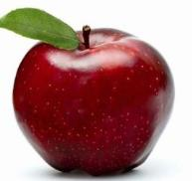
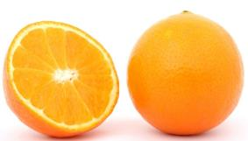
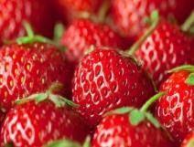
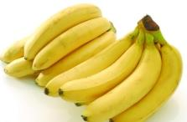
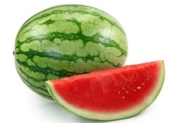
情景导入
Ask and answer
What’s your favorite fruit?
apple
orange
strawberry
banana
watermelon

Slide 5


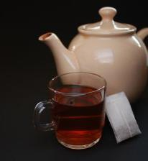
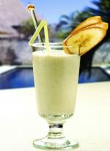

What’s your favorite drink?
water
juice
tea
coffee
milk shake

Slide 6
Present New words
peel 剥皮; 去皮
cut up… 切碎
put … into... 把 ……放入……
pour… into... 把……倒入……
turn on… 打开；接通（电流、煤气）
turn off… 关上（电器）
finally 最后；最终
drink 喝
blender 食物搅拌器
milk shake 奶昔
watermelon 西瓜

Slide 7
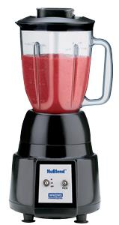
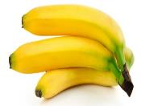
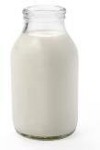
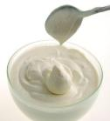
Do you like milk shake?
Can you make a banana milk shake?
What do we need?
Ingredients
Tool
Milk

Slide 8
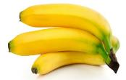
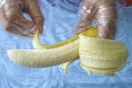
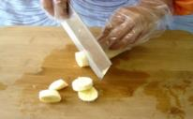
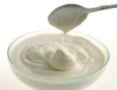
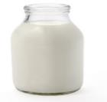
1a Write these words in the blanks in the picture above.
turn on cut up drink peel pour put
Milk

Slide 9
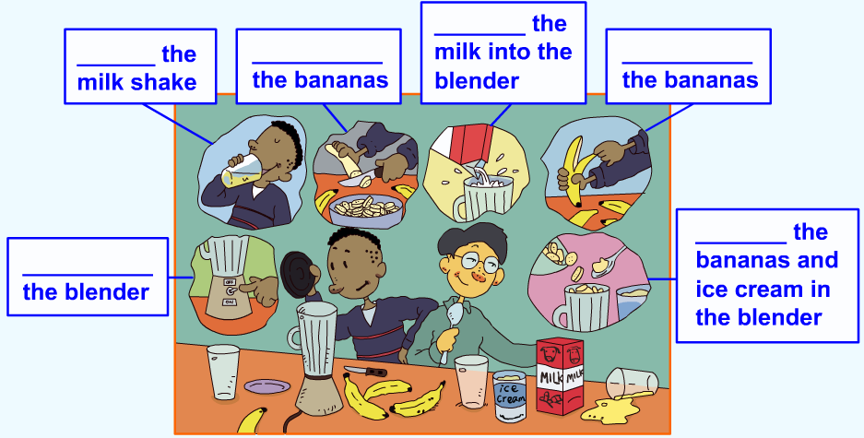
pour
drink
cut up
peel
put
turn on

Slide 10

1b Listen and put the instructions in order.
Turn on the blender.
Cut up the bananas.
Drink the milk shake.
Pour the milk into the blender.
Put the bananas and ice-cream in the blender.
1 Peel three bananas.
5
2
6
4
3

Slide 11
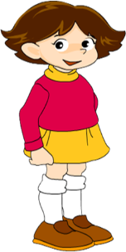
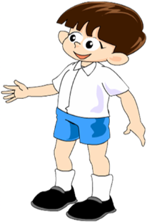
1c Cover the instructions above. Tell your partner how to make a banana milk shake.
How do you make a banana milk shake?
First, peel the bananas…

Slide 12

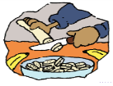



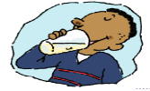
First,
peel bananas.
Then,
cut up the bananas.
Then,
put the bananas and ice-cream into the blender.
Then,
pour the milk into the blender.
Next,
turn on the blender.
Finally,
drink the banana milk shake.

Slide 13
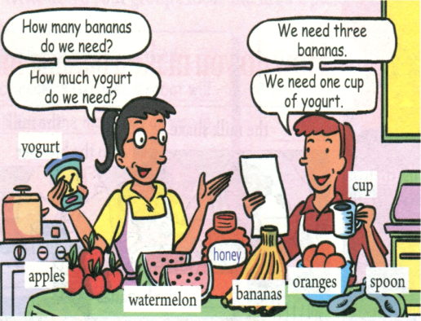
2a Listen and complete the chart.
How much | How many
yogurt | bananas
honey
watermelon
apples
oranges

Slide 14
2b Listen again. Write the ingredients under the correct amount in the chart.
one | watermelon
two
three
one cup
two spoons
apples
bananas
yogurt
honey

Slide 15
2c Ask and answer questions about how to make fruit salad.
A: Let’s make fruit salad.
B: OK, good idea. How much yogurt do we need?
A: One cup.
B: How many apples do we need?
A: Let me think… We need two apples.
B: OK, and how much…

Slide 16
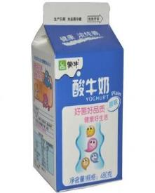
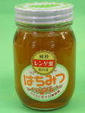
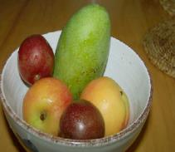

Do you know how to make fruit salad?
What ingredients do we need?
some fruits
knife
yogurt
honey

Slide 17
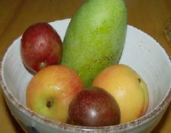
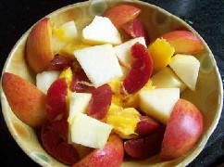
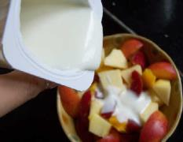
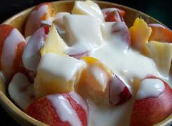
Show time
First, wash some kinds of fruit such as apples,
pears, grapes and so on.
Next, cut them up and put them into a big bowl.
Then, pour some yogurt into the bowl and mix it all up.
Finally, eat the salad.

Slide 18
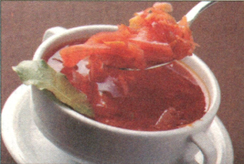
2d Role-play the conversation.
Anna: Sam, I want to make Russian soup for
a party on Saturday. Can you tell me how?
Sam: Sure. First, buy some beef, one cabbage,
four carrots, three potatoes, five
tomatoes and one onion. Then, cut up the
vegetables.
Anna: What’s next?
Sam: Next, put the beef, carrots and potatoes into a pot and add
some water. After that, cook them for 30 minutes. Then,
add the cabbage, tomatoes and onion and cook for another
10 minutes.
Anna: Ok, that’s it?
Sam: No, one more thing. Finally, don’t forget to add some salt.

Slide 19
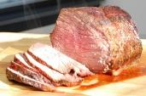
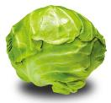
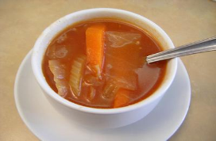
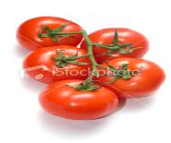
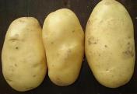
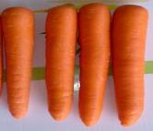
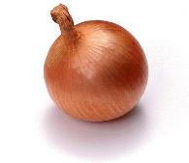
some beef
one cabbage
three potatoes
five tomatoes
Russian soup
four carrots
an onion

Slide 20
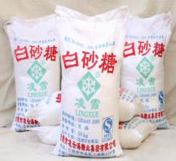
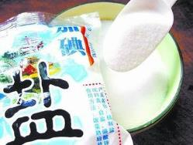
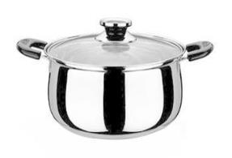
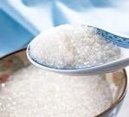
Do we need…?
sugar
salt
pot

Slide 21
问题探究
1. one more thing 另外一件事情
another 10 minutes 再多十分钟
“数字+ more + 物品” 指“另外的······”。
“another + 数字 + 物品” 指“另外的······”。
Give me two more hamburgers.再给我两个汉堡。
2. Finally, don’t forget to add some salt.
最后，别忘记加些盐。
forget to do sth. 忘记（去）做某事
Don’t forget to close the windows.不要忘记关上窗户。

Slide 22
3. turn 相关的短语：turn on 打开；turn off 关上；turn up（把音量）调大；turn down （把音量）调小。
辨析：turn on 与open
1）turn on 表示“打开（电灯、自来水开关、煤气、无线电等）”，反义短语为turn off。如：Please turn on the TV 请打开电视。
2）open表示“开门，开窗”，反义词为close。如：please open the window. It’s too hot in the room. 请打开窗户，房间里太热了。
4. One more thing 另外一件事情
Another ten minutes 再多十分钟
“数字+more +物品”指“另外的…”。
当数词超过一时：数词+more +n. =another +数词+n. 如：two more apples= another two apples 再要两个苹果

Slide 23
课堂评价
根据汉语提示完成句子。
1. Can you ______ (切碎) the bananas, Tom?
2. Please ___ (加) some salt to the soup.
3. _____ some cold water ____ (将······倒入) the glass,
please.
4. ___ the bananas _____ (将······放进) the blender.
5. Don’t ____________ (忘记做) your homework.
cut up
add
Pour into
Put into
forget to do

Slide 24
Homework
1.做自己喜欢的水果奶昔，并简要说明过程。
2.可以用first, next, then, finally等表示过程
的词汇来让你的描述更加清晰明了。

