Slide 1

Unit 2 Let’s play sports!
Integrated skills
WWW.PPT818.COM

Slide 2








Speak out
What sports are they?
basketball
badminton
table tennis
rowing
boxing
swimming
tennis
football
Notes:
2

Slide 3
Free talk
A: What is your favourite sport?
B: …
A: Do you often play it after school?
B: …
Notes:
3

Slide 4
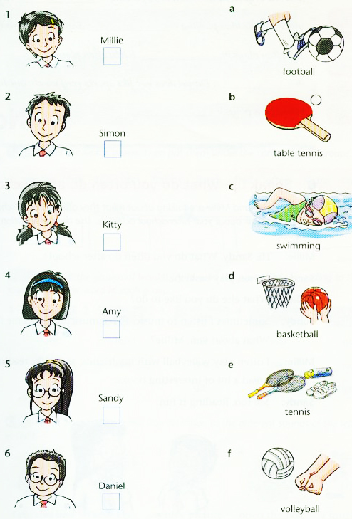
Read and guess
What are their favourite sports?

Slide 5
Listening skills
Tip One: Try to guess the answers before
listening.
Tip Two: Pay attention to the key words.
Tip Three: Write the first letter of the word
if time is limited.
eg: s→swimming
v→volleyball

Slide 6
Listen and choose
f
a
e
c
d
b

Slide 7
Ask and answer
A: What sport does … like?
B: She/He likes ….
f
a
e
c
d
b

Slide 8
Listen and complete
Many of my students like sports. Amy likes _________ and she is good at it. Simon likes playing _______ very much. Millie likes playing _________. Sandy is tall, and he often plays _________. Kitty often plays _____. Daniel does not like sports very much, but he sometimes plays __________.
swimming
football
volleyball
basketball
tennis
table tennis

Slide 9
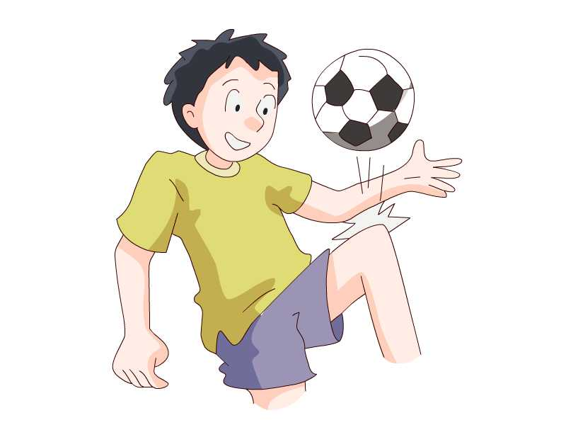
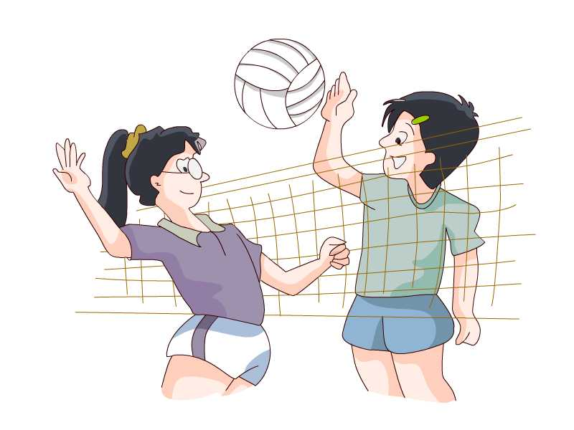
Free talk
What do you like doing after school?

Slide 10
Listen and answer
What do Sandy and Millie like doing
after school?

Slide 11
Read and judge T or F
Music makes Sandy feel great.
Sandy also likes playing volleyball.
Millie likes listening to music.
Millie plays volleyball with friends.
Both Millie and Sandy read a lot of interesting books.
T
Millie
F
Sandy
F
T
T

Slide 12
Make a dialogue
A: Hi, what do you do after school?
B: I often …
A: What else do you like to do?
B: Sometimes I …. What about you?
A: I often …
B: … is fun.

Slide 13
Make a survey
Work in a group of 4.
Ask your group members something
about their hobbies.
Write a note to report to the whole class.
We use the simple present tense to give a
report.

Slide 14
Useful expressions
… like(s) … very much.
… is his/her favourite sport.
… enjoy(s) … at the weekend.
In his/her free time, he/she often plays …
with …
… like(s) playing … after school.
… make(s) … feel great/happy.
… is fun.

Slide 15
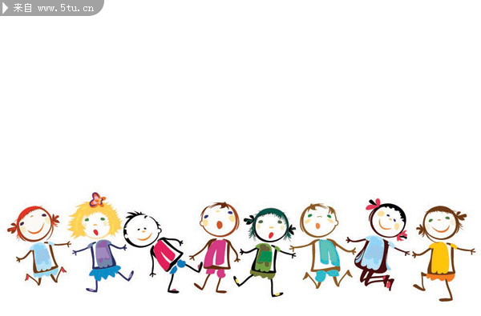
Homework
Show your report to your parents.
Recite the dialogue in the textbook.
Notes:
15

