Slide 1
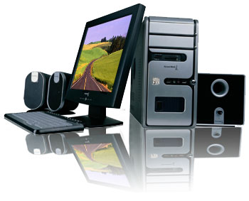
Module 7 Computers
Unit 3 Language in use
WWW.PPT818.COM

Slide 2
与分享
和他的顾客交谈
上网
查看火车时刻
制定旅行计划
听音乐
看电影
搜寻信息
查看发送电子邮件
玩电脑游戏
每个星期五晚上
在学校
在家
每逢星期日
share … with…
talk to his customers
go on the Internet
check the times of trains
make travel plans
listen to music
watch movies
search for information
check / send emails
play computer games
every Friday night
at school
in my home / at home
on Sundays
Notes:
2

Slide 3
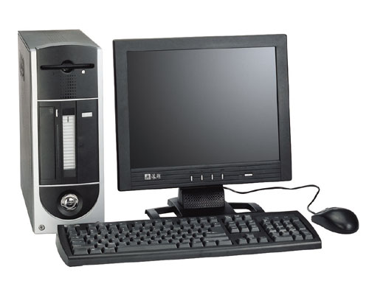
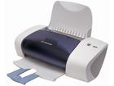
monitor
/ screen
printer
computer
mouse
keyboard
connect the mouse to the computer
turn on the computer

Slide 4
Instructions of how to write your homework on the computer
Steps | What to do | how
first
Click the mouse on
“new document”.
Open a new
document
Write your homework
in the new document
next
Use the keyboard”.
next
Click “save”.
or
Save the new
document.
write a name in the box for it
then
Click “save”again.
finally
put the paper in the printer
Print the document
Click “print” and “OK”

Slide 5
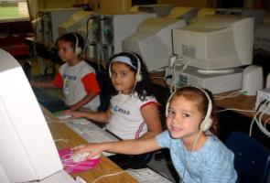
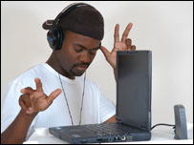
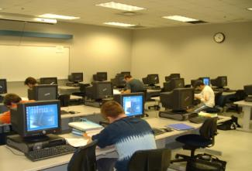
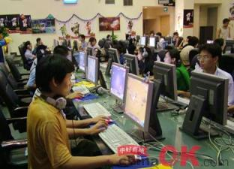
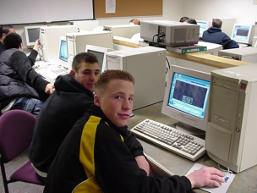
What can we use computers for? / What can we do on the computer?

Slide 6
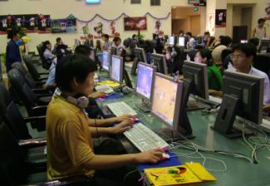
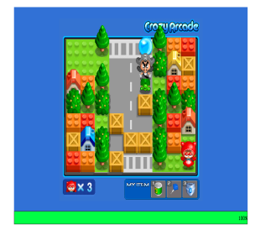
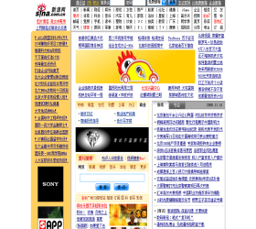
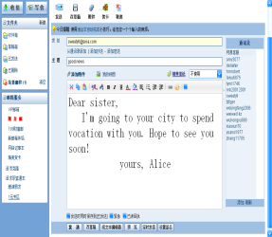
do homework
go online
download music
play games
visit a website
send an email

Slide 7
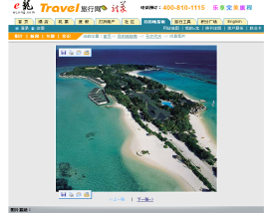
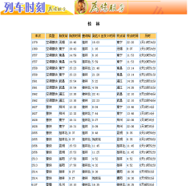
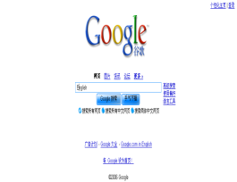
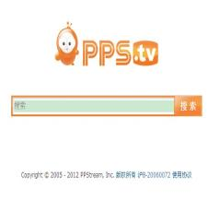
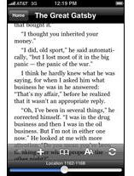
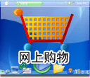
get information
/search for information
make travel plans
check timetable
watch movies
buy things online
read books

Slide 8
Word map:
printer
mouse
computer
keyboard
screen

Slide 9
Word map:
emails
games
time table
Internet
check
play
information
send
use
download
document
computer
save
website
visit
turn on
listen to
open
write
computer
music
click
document
“save”
homework

Slide 10
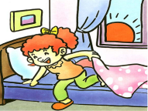
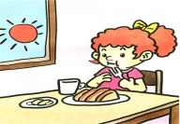
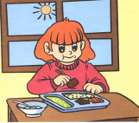
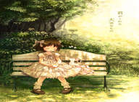
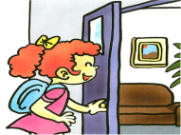
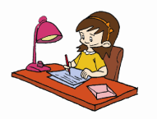
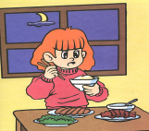
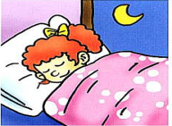
get up
have breakfast
go to school
have lunch
have a break
go home
do homework
go to bed
have dinner

Slide 11
6:00 am
What time does she get up ?
What time do you get up ?
I get up at six o’clock .
get up
she gets up at six o’clock.
gets up
get--- gets

Slide 12
6:30 am
What time does she have breakfast ?
What time do you have breakfast ?
I have breakfast at half past six .
have breakfast
She has breakfast at half past six .
has breakfast
have--- has

Slide 13
7:00 am
What time does shego to school?
What time do you go to school?
I go to school at seven o’clock .
go to school
She goes to school at seven o’clock.
goes to school
go---goes

Slide 14
7:30 pm
What time does she do her homework ?
What time do you do your homework ?
I do my homework at half past seven.
do my homework
She does her homework at half past nine.
does her homework
do---does

Slide 15
9:30 pm
What time does she go to bedl?
What time do you go to bed?
I go to bed at half past nine.
go to bed
She goes to bed at half past nine.
goes to bed
go---goes

Slide 16
gets up
has breakfast
goes to school
has lunch
has a break
goes home
has dinner
does homework
goes to bed

Slide 17
6:00 am
6:20 am
get up
Do you get up at six o’clock in the morning?
Yes ,I do.
I get up at six o’clock.
No , I don’t.
I don’t get up at six o’clock.
I get up at twenty past six.

Slide 18
6:00 am
6:20 am
get/gets up
Does lingda get up at six o’clock in the morning?
Yes ,she does.
=she gets up at six o’clock.
No , she doesn’t.
=she doesn’t get up at six o’clock.
She gets up at twenty past six.

Slide 19
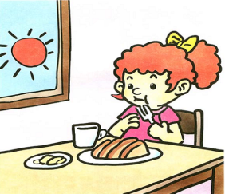
7:00 am
7:30 am
have breakfast
Do you have breakfast at seven o’clock in the morning?
Yes ,I do.
I have breakfast at seven o’clock.
No , I don’t.
I don’t have breakfast at seven o’clock.
I have breakfast at half past seven .

Slide 20
7:00 am
7:30 am
Have/has breakfast
Does lingda have breakfast at seven o’clock in the morning?
Yes ,she does.
=she has breakfast at seven o’clock.
No , she doesn’t.
=she doesn’t have breakfast at seven o’clock.
She has breakfast at half past seven.

Slide 21
7:50 am
8:15 am
go to school
Do you go to school at ten to eight in the morning?
Yes ,I do.
I go to school at ten to eight .
No , I don’t.
I don’t go to school at ten to eight .
I go to school at a quarter past eight.

Slide 22
7:50 am
8:15 am
go/ goes to school
Does lingda go to school at ten to eight in the morning?
Yes ,she does.
=she goes to school at ten to eight .
No , she doesn’t.
=she doesn’t go to school at ten to eight .
She gets up at a quarter past eight.

Slide 23
7:00 pm
7:30 pm
do homework
Do you do your homework at seven o’clock in the evening?
Yes ,I do.
I do my homework at seven o’clock.
No , I don’t.
I don’t do my homework at seven o’clock.
I do my homework at half past seven .

Slide 24
7:00 pm
7:30 pm
do/ does her homework
Does lingda do her homework at seven in the evening?
Yes ,she does.
=she does her homework at seven .
No , she doesn’t.
=she doesn’t do her homework at seven .
She does her homework at half past seven .

Slide 25
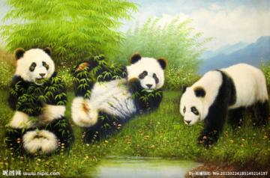
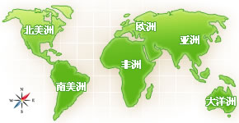
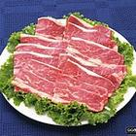
Do pandas come from China?
Yes, they do.
=they come from China .= they are from China .
Pandas from China.
come/are
Where do pandas come from?
=Where are pandas from?
Do pandas eat meat ?
No, they don’t .
=they don’t eat meat .
They eat bamboo .
Pandas bamboo.
eat
What do pandas eat ?

Slide 26
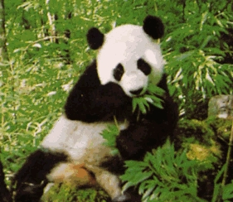
Does the panda come from England?
No, it doesn‘t.
=It doesn’t come from England
It comes from China.
comes
The panda from China.
Where does the panda come from ?
Does the panda eat bamboo?
eats
Yes, it does.
It eats bamboo.
The panda bamboo.
What does the panda eat ?

Slide 27
一般现在时
定义：
表示经常性、习惯性的动作或现在的
状态。
构成：
肯定句：主+V.
V. 原形
V. 第三人称单数

Slide 28
don’t
否定句：主 +
+V.原
doesn’t
Yes, 主+do/does.
一般疑问句
Do
+主+V原？
No, 主+don’t/doesn’t.
Does
特殊疑问句：特殊疑问词 +一般疑问句？

Slide 29
注意：
当主语为I/We/You/They/名词复数时，
用V原形；
当主语为He/She/It/不可数名词/名词单数
时，用V第三人称单数。
3. 与之连用的时间状语:
always, usually, often, sometimes, seldom,
never, every day/week, on Sundays/…, at
the weekend

Slide 30
第三人称单数行为动词的一般现在时
肯定句： 主语（第三人称单数）+V.-s/es +其他
否定句：主语（第三人称单数）+doesn’t+V.-原
+其他
一般疑问句：Does +主语（第三人称单数）+V.-原
+其他？
肯定回答：Yes, 主语+does.
否定回答：No， 主语+doesn’t.

Slide 31
肯定句
The dog (go) to the park.
否定句
The dog doesn’t go to the park.
一般疑问句
Does the dog go to the park?
Yes, it does. No, it doesn’t
goes

Slide 32
一般现在时主语单三人称时的动词变化 ①在一般现在时中，当主语为第三人称单数时，动词要用“s”型（即第三人称单数形式）。 ②所谓动词“s”型的构成，可按名词变复数的规则来记，

Slide 33
i）在动词尾直接加 s。如： play—plays， want—wants， work—works， know—knows， help—helps，get—gets ii）以字母s、x、ch或o结尾的动词加-es；如： guess—guesses， fix—fixes， teach—teaches， brush—brushes，go—goes，do—does，watch—watches，catch—catches
iii）以辅音字母＋y结尾的动词，先变y为i，再加-es。如： study—studies，carry—carries，fly—flies，worry—worries

Slide 34
他们在黑板上写字。
They write the words on the blackboard.
否定句
They don’t write the words on the blackboard.
一般疑问句
Do they write the words on the blackboard?
特殊疑问句
What do they write on the blackboard?
Where do they write the words?
他在黑板上写字。
He writes the words on the blackboard.
He doesn’t write the words on the blackboard.
Does he write the words on the blackboard?
What does he write on the blackboard?
Where does he write the words?

Slide 35
Grammar
一、特殊疑问句的构成：是由“疑问代词或疑问副词 + 一般疑问句”构成的。
二、特殊疑问词：
what(什么)
what color（颜色）
what time（几点）
what day （哪一天）
what kind of(哪一种)
who(谁)
when(时间)
where(哪里)
which(哪一个)
why(为什么)
How（怎样） How many+可数名复数
How old (年龄) How much +不可数名词
How often(频率) How long(多长、多久)
How often do you go to the library? Once a week.一周一次

Slide 36
Match the questions with the answers.
Where do you save your homework?
When do you use a computer?
How many emails do you write every week?
Who do you write to?
I write to my friends.
I save my homework in a document.
I use my computer after school.
I write three or four emails.
写信给…

Slide 37
I have got a new laptop.
否定句：
I haven’t got a new laptop.
一般疑问句：
Have you got a new laptop?
肯定/否定回答：
Yes, I have . No, I haven’t.
划线提问：
What have you got?

Slide 38
My father has an old computer.
My father doesn’t have an old computer.
Does your father have an old computer?
Yes, he does. No, he doesn’t.
What does your father have?

Slide 39
Jack sends four emails to his friends every week.
（1）
（2）
How many emails does Jack send to his friends?
How often does Jack send emails to his friends?

Slide 40
I often get information on the computer.
What do you often do on the computer.
I use the computer in the evening.
When do you use the computer ?

Slide 41
2 Complete the conversations.
— Where do your grandparents live?
— They live in Australia.
1. — _________ save my document?
— Click “save” and “OK”.
2. — ______________ with his computer?
— He sends emails.
How do I
What does he do
用
3. — ________________ her computer?
— She uses her computer every Sunday.
4. — ________________ emails to?
— I write emails to my friends.
5. — _________________________ every day?
— They send ten emails every day.
When does she use
Who do you write
How many emails do they send

Slide 42
3 Complete the sentences with the correct for
of the words in brackets.
1. Tony ______ (not see) his uncle, but he ___ (send) emails.
2. We ____ (use) the Internet on our computer, but we ________ (not play) games.
doesn’t see
sends
use
don’t play
doesn’t use
3. Daming ___________ (not use) a computer to do his homework, but he ______ (play) music.
4. She ________ (make) travel plans on the Internet,
but she ___________ (not buy) tickets.
5. We ___________ (not have) a computer at home,
but we _____ (use) the computer at school.
plays
makes
doesn’t buy
don’t have
use

Slide 43
4 Complete the sentences with the correct form of the words from the box.
plan
n. 计划 make a plan for
v. 打算 plan to do sth
plan sth / plan for sth
check like plan talk use
1. Tom _______ his email every Saturday.
2. I have a computer, but I don’t ____ it.
3. Come to my office. Let’s _____ for our holiday.
checks
use
plan
4. My mother doesn’t _______ computer games.
5. I can _______ to my friends on the Internet.
like
talk

Slide 44
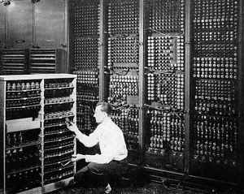
Around the world
The first computer

Slide 45
The first computer
My name is ENIAC. I am the first computer in the world. I was born in 1946 in America. I am very big, about one and a half times the size of a classroom. I am very heavy — 30, 000 kilos!
I was born in 2000. 出生
The size of my shoes is 35.

Slide 46
Exercises
用所给词的适当形式填空。 1. Mr Li usually ________ (use) a computer
at work.
2. My father _____________ (not write) his
novels on his computer.
3. ______ you ________ (have) a computer
at home?
4. Where _____ they _____ (live)?
5. How many e-mails ________ Li Ming
_____ (send) every week?
uses
doesn’t write
Do
have
do
live
does
send

Slide 47
按要求完成下列句子。 1. They play computer games. (改为否定句)
__________________________
2. He writes letters to me. (对画线部分提问)
__________________________
3. I never check my e-mails on Monday. (对画线部分提问)
__________________________
They don’t play computer games.
Who does he write letters to?
How often do you check your e-mails on Monday?

Slide 48
4. Mary has a computer. Mary doesn’t often use the computer. (合并句子)
________________________________ ________________________________
5. We usually download music on the Internet. (对画线部分提问) _______________________________
6. I use the computer at the weekend. (改为一般疑问句)
________________________________
Mary has a computer but she doesn’t often use it.
What do you usually do on the Internet?
Do you use the computer at the weekend?

Slide 49
二、对划线部分提问。
1. I usually do my homework on your
at home.
2. I sometimes play Counter Strike and
Final Fantasy.
What do you usually do on your
computer have a computer at home?
What games do you play?

Slide 50
3. I have breakfast at eight.
4. I want to make friends with you.
5. I come from USA.
6. I sleep eight hours every night.
When do you have breakfast?
Who do you want to make friends with?
Where do you come from?
How many hours do you sleep every
night?

Slide 51
基数词和序数词
基数词：
one, two, three, four, five, …, nine, ten, eleven, twelve, …, twenty, twenty-one, …,
序数词：
first, second, third, fourth, fifth, ninth, tenth, eleventh, twelfth, twentieth, twenth-first, …

Slide 52
基数词
1. one
2. two
3. three
4. four
5. five
6. six
7. seven
8. eight
9. nine
10. ten
序数词
first
second
third
fourth
fifth
sixth
seventh
eighth
ninth
tenth
序数词缩写
1st
2nd
3rd
4th
5th
6th
7th
8th
9th
10th

Slide 53
基数词
11. eleven
12. twelve
13. thirteen
14. fourteen
15. fifteen
16. sixteen
17. seventeen
18. eighteen
19. nineteen
序数词
eleventh
twelfth
thirteenth
fourteenth
fifteenth
sixteenth
seventeenth
eighteenth
nineteenth
缩写
11th
12th
13th
14th
15th
16th
17th
18th
19th

Slide 54
基数词
20. twenty
30. thirty
40. forty
50. fifty
60. sixty
70. seventy
80. eighty
90. ninety
序数词
twentieth
thirtieth
fortieth
fiftieth
sixtieth
seventieth
eightieth
ninetieth
缩写
20th
30th
40th
50th
60th
70th
80th
90th

Slide 55
基数词
21. twenty-one
32. thirty-two
43. forty-three
55. fifty-five
64. sixty-four
76. seventy-six
89. eighty-nine
98. ninety-eight
序数词
twenty-first
thirty-second
forty-third
fifty-fifth
sixty-fourth
seventy-sixth
eighty-ninth
ninety-eighth
缩写
21st
32nd
43rd
55th
64th
76th
89th
98th

