Slide 1
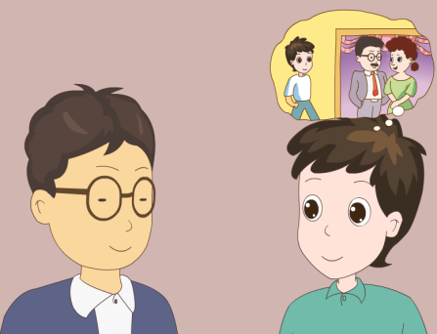
人教版八年级上册
Unit10
If you go to the party, you’ll have a good time!
Section A（第1课时）
WWW.PPT818.COM
0

Slide 2
1）能掌握以下单词和短语： meeting, video, chocolate, taxi, advice, potato chips 。 2）学习运用第一条件句If…, will…，对未来事件进行假设和推断。 A:I think I’ll go to the party with Karen and Anna. B:If you do, you’ll have a great time.
学习目标
0

Slide 3
自学互研
新词自查
根据句意及汉语提示完成句子
1. Our teacher don’t let us wear jeans (牛仔裤) in P.E. lessons.
2. Sorry, I am not available now, I’ll call you back after the
meeting (会议).
3. My parents won’t allow the children to watch the video (录
像).
4. Mr.Green organized (组织) some interesting games at his
daughter’s birthday party.
5. I bought some flowers and chocolate (巧克力) as Jim’s b-
irthday gift.

Slide 4
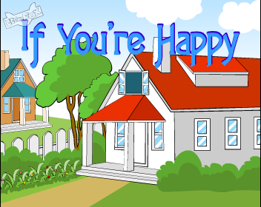
Enjoy a song
情景导入
If you are happy
If you're happy and you know it clap your hands
If you're happy and you know it clap your hands
If you're happy and you know it never be afraid to show it
If you're happy and you know it clap your hands
If you're happy and you know it stomp your feet
If you're happy and you know it stomp your feet
If you're happy and you know it never be afraid to show it
If you're happy and you know it stomp your feet
If you're happy and you know it wink your eye
If you're happy and you know it wink your eye
If you're happy and you know it never be afraid to show it
（点击播放视频）

Slide 5
If you are happy, what will you do?
Ask and answer
If I am happy, I will play soccer/computer games...
If you are sad, what will you do?
If I am sad, I will stay at home/ listen to music…

Slide 6
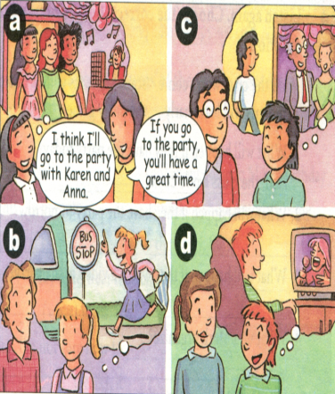
1a Match the statements with the pictures.
Statements
___I think I’ll wear jeans to the party.
___I think I’ll stay at home.
___I think I’ll take the bus to the party.
___I think I’ll go to the party with Karen and Anna.
c
d
b
a

Slide 7
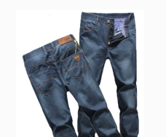
Make conversations
A:What will you wear to the party?
B: I’ll wear jeans.
A: If you wear jeans, you’ll ….

Slide 8
1b Listen and complete the responses in 1a.
Statements | Responses
I think I’ll wear jeans to the party. | If you do, the teachers won’t ________ .
I think I’ll stay at home. | If you do, you’ll_________.
I think I’ll take the bus to the party. | If you do, you’ll________.
I think I’ll go to the party with Karen and Anna. | If you do, you’ll _________________.
let you in
be sorry
be late
have a great time

Slide 9
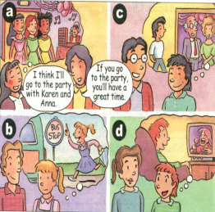
Look at the pictures above and make conversations.
A: Are you going to the party tomorrow night?
B: Yes, I am.
A: Who will you go with?
B: I think I’ll go with Karen and Anna.
A: If you do, you’ll have a great time.

Slide 10
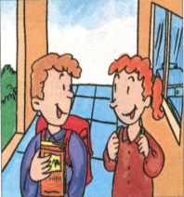
2a Listen and circle the correct answer to complete the sentences.
1.The students are talking about when to have
( a class party / a class meeting / a birthday party).
2. They plan to have it on (Friday evening /
Saturday afternoon / Saturday evening).

Slide 11
2b Listen again. Choose the correct short answer in the box to answer each question.
half the class won’t come some students will be bored
make some food students will leave early
the party games
1. What will happen if they have the party today?
Half the class won’t come.
2.What will happen if they have the party tomorrow?
______________________________________________
Students will leave early.

Slide 12
3.What will happen if they watch a video at the party?
_____________________________________________
4.What will Mark organize?
_____________________________________________
5.What will Nelly do?
_____________________________________________
Some students will be bored.
The party games.
Make some food.

Slide 13
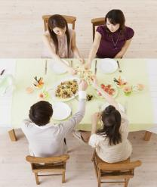
Role-play the conversation between Nelly and Mark.
A: OK, when is a good time to have the party?
B: Let’s have it today.
A: If we have it today, half the class
won’t come.

Slide 14
2d Read and answer the questions.
(1) What will happen if we ask people to bring food?
_______________________________________
(2) We will give people some small gifts if they win. What will happen?
_________________________________________
They will bring potato chips and chocolate.
More people will want to play the games.

Slide 15
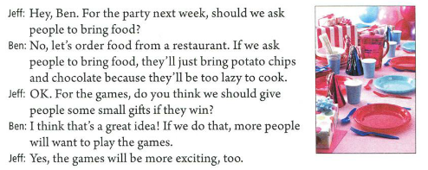
Read the dialogue.

Slide 16
Group work
Before you go to a party, you should finish your homework first. What will happen if you don’t finish your homework? Let’s have fun in groups of four. Look at this conversation, and then choose a topic to talk and try to make it funny.

Slide 17
A: If I don’t finish my homework, my teacher will be angry.
B: If my teacher is angry, she will call my parents.
C: If she calls my parents, they will beat me.
D: If they beat me, I will cry.
A: If I cry, I will do my homework.
B: If I do my homework, …

Slide 18
Summary
Words:
meeting, video, organize
Sentences:
I think I’ll go to the party with Karen and Ann.
If you go to the party, you’ll have a great time.
Are you going to the party tomorrow night?
Yes, I am.
What will happen if they have the party today?
Half the class won’t come.

Slide 19
问题探究
Half the class一半的同学
Half作形容词，意为“一半的，半个的”，放在冠词前。如：Half the workers come from Shandong.
Half还可作名词，意为“一半，半数”，复数形式为“halves”.
导练：two years and a half = two and a half years意为“两年半”。
2）half of… 意为“半数的”，后面的名词或代词为单数时，谓语用单数；后面的名词或代词为复数时，谓语就用复数。
导练：Half of the students come from China.半数的学生来自中国。
half (of ) the fruit is bad.
3) half用作名词，其复数形式为halves.以-f(e)结尾的名词，其复数形式有的直接在-f(e)后加-s,有的要变-f(e)为-ve再加-s；个别单词上述两种形式均可。如：handkerchief →handkerchiefs或handkerchieves .

Slide 20
以- f(e)结尾的名词变复数的歌谣：妻子持刀去宰狼，小偷吓得发了慌；躲在架下保己命，半片树叶遮目光。
温馨提示：wife（妻子），knife（小刀），wolf（狼），thief（小偷），shelf（架子），self（自己），life（生命），half（一半），leaf（树叶）。这九个词变复数时，都是改-f（e)为-ve,再加-s
2.When is a good time to have the party?什么时候是举办聚会的好时间？
1）when既可指具体的时间，也可指不具体的时间，而what time只能指具体的时间。如：What time/When do you get up every day?
2)To have the party是不定式作定语修饰前面的名词time。不定式作定语通常放在所修饰的名词或代词之后。
导练：Shanghai is a nice place to have fun

Slide 21
课堂评价
I. Fill in the blanks with the correct words
1. I will watch TV every day. My mother will be angry.
If I ________TV this weekend, my mother _____ _____angry.
2. He will have a strange haircut. The teachers won’t agree.
If he _____ a strange haircut, the teachers
______ _______.
watch
will
be
has
won’t agree

Slide 22
II. 选择
B
1. If it rains tomorrow, we _____ visit the museum.
A. don’t do B. won’t go to C. aren’t go to D. didn’t go to
2. Will you go to the park if it ____ fine?
A. will be B. was C. is D /
3. If you __to school late, your teacher _____ angry with you.
A. come; are B. come, will be
C. will come; are D. will come; will be
4. If you _____ hard, you will ___ successful.
A. work, are B. works, is
C. to work, be D. work, be
5. If I ____ too much TV, my mother will _______.
A .watch, angry B .watched, be angry
C .watch, be angry D .will watch, be angry
C
B
D
C

Slide 23
Homework
Read words and phrases. Recite the conversation in 2d after school.

