Slide 1
1111
Unit 3 Writing Home
五年级下册
Lesson15 Sending the Postcards
WWW.PPT818.COM

Slide 2
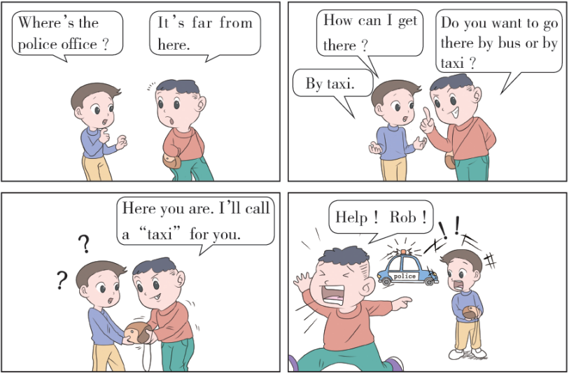

Slide 3
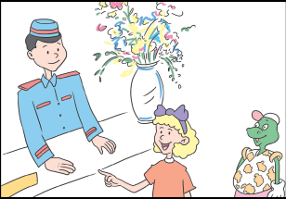
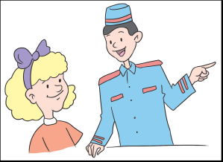
1. Where’s the post office ?
Danny and Jenny want to send the postcards. Where is the post office ？
Excuse me，where’s the post office?
Go straight. Turn left at the traffic lights.
Thanks!

Slide 4
知识点1
—Excuse me, where’s the post office ?
打扰一下！邮局在哪里？
—Go straight. Turn left at the traffic lights.
直走。在交通信号灯处向左转。
问句句式：Excuse me，where is/ where’s + 地点名词？
用于询问地点，属于wh 问句。而且通常在句首加Excuse me 或者句末加“please”，会显得更有礼貌。
用法：

Slide 5
How can I get to + 地点名词？
Which is the way to + 地点名词？
Can you tell me the way to + 地点名词？
同义句：

Slide 6
答语：指路的常用语
Go straight 直着走。
Go down/along the street. 沿着这条街走。
Turn left/right at... 在……向左/ 右转。
You can go there by.../on foot. 你可以乘……/ 步行去那里。
You will see/find...on the right/left.
你将会看见/ 发现……就在右/ 左边。
例句：
—Where’s the bookstore，please ？请问书店在哪里？
—Turn right at the traffic lights.在交通信号灯处向右转。

Slide 7
Go straight. 直走。
若接宾语则需要加介词，常用的介词有down 或along。
Please go straight down the street.
请沿着这条街道直走。
例句：

Slide 8
turn /tɜːn/ v. 转向；转弯
turn left 向左转 turn right 向右转
turn on 打开
例句：
根据句意和首字母提示将句子补充完整。
T right at the first crossing （第一个十字
路口） and you can find it on your right.
典例
urn

Slide 9
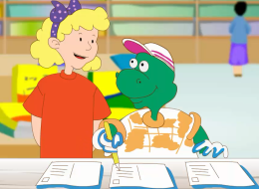
2. At the post office
Jenny: I need stamps for two postcards to Canada. How much are they ?
The post office clerk: They are twenty yuan.
Jenny: I’ll take them, please.
Jenny: Do you need stamps，Danny ？
Danny: Yes，but not now ！
Jenny: What are you doing ？
Danny: I’m writing nine postcards to my mother.
Jenny: Nine ？！
Danny: Yes ！ Look ！
Jenny: Oh，no ！Danny，you are wrong.
Danny: Oops！

Slide 10
知识点 2
Do you need stamps, Danny ?
丹尼，你需要邮票吗？
句式：Do you need + 某物（+ 其他）？［难点］
这是一个由Do 开头的一般疑问句，用于询问对方是否需要某物。
用法：
—Do you need this bag ? 你需要这个包吗？
—Yes，please. 是的，谢谢。
例句：

Slide 11
need 此处为实义动词，意为“需要”。
其后可以接名词、动词的ing形式、动词不定式或代词。
易错点
提示
need 作实义动词时，既可用于肯定句，也可用于否定句和疑问句，构成否定句和疑问句时要借助于助动词do 或does。

Slide 12
I need some books. 我需要一些书。
—Do you need any help ？ 你需要帮助吗？
—No，thanks. 不用了，谢谢。
What do we need to take for the picnic ？
这次野餐我们需要带些什么？
例句：

Slide 13
知识点 3
wrong /rɒŋ/ adj. 错误的
例句：
Your answer is wrong. 你的答案是错误的。
对应词记忆法：
right 正确的
拓展
wrong 还可以表示“（状况）有问题的；（身体）有病的”。
例句：
What’s wrong with you ? 你怎么啦？
There is nothing wrong with the bike.
这辆自行车没问题。

Slide 14
3. Let’s do it!
1. Look and write.
How much is... ？
How much is... ？
_____________________ ______________________
_____________________ ______________________
_____________________ ______________________ _____________________ ______________________
How much is this postcard?
It’s five yuan.
How much are these shoes ？
They are thirty yuan.
How much is that cap？ It's fifteen yuan.
How much are those postcards?
They are eight yuan.

Slide 15
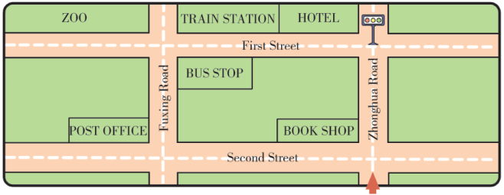
3. Let’s do it!
2. Look and talk.
Excuse me，where is the hotel ?
Go straight. Turn left at the traffic lights. You will see the hotel on the right.
Thank you.

Slide 16
我当交警来指路。
两名同学一组，一人扮演交警，一人扮演路人，根据下面的图片，利用Excuse me，where is the... ？进行问路活动。
hospital hotel school park

Slide 17
一、单项选择。
（ 1）________ ，where is the library ？
A. Excuse B. Goodbye C. Excuse me
（ 2）Turn left ________ the traffic lights.
A. on B. at C. of
（ 3）—Excuse me， ________ is the post office ？
—Go straight. It’s on the left of the road.
A. what B. where C. how
C
B
B

Slide 18
二、按要求改写句子。
He needs a car.（改为一般疑问句）
_______ _______ _______ _______ _______ ？
Does he need a car

Slide 19
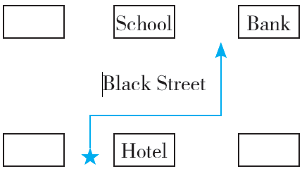
三、看图指路。帮助小明找到去银行的路。
Step 1: Go _______ and turn_______ at the first crossing.
Step 2: Go _______ along Black Street. There is a______ and a school.
Step 3: Turn _______.Then you can see the bank on your ______.
straight
right
straight
hotel
left
right

Slide 20
本节课我们学习了以下知识，请同学们一定加强巩固，以便能和同学们进行灵活交流哦！
重点词汇：turn, need, wrong➢
重点短语：go straight
重点句式：—Excuse me, where’s the post office ？
—Go straight. Turn left at the traffic lights.

Slide 21
1 熟记本节课所学的句型、短语和单词，必须会听、说、读、写。
2 将At the post office的对话朗读流利。
3 完成配套的课后作业。

