Slide 1
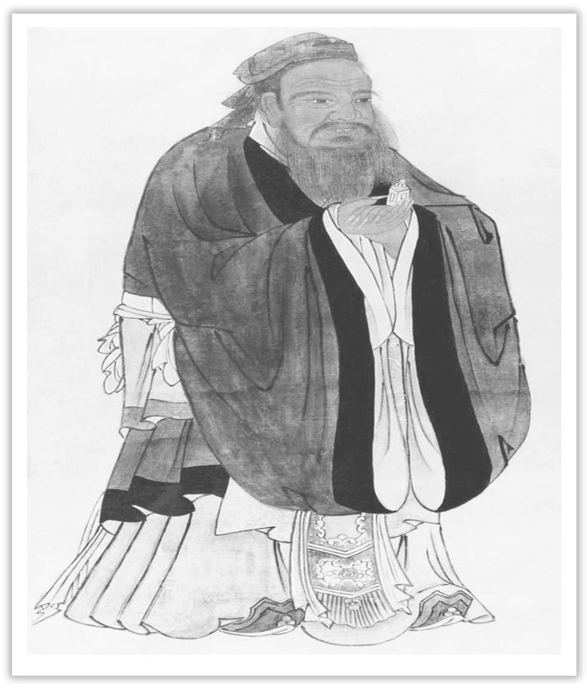
Unit 4 History and Traditions
Section Ⅶ Reading for Writing
WWW.PPT818.COM

Slide 2
介绍地点的说明文
本单元的读写任务是先读一篇关于爱尔兰的文章后，再写一篇介绍地点的说明文。
Ⅰ.Pre-writing
(Ⅰ)Learning to write after the model
BEAUTIFUL IRELAND AND ITS TRADITIONS
①Ireland’s beautiful countryside has always had a great influence on its people and traditions.②The country has a long history of producing great writers and poets.③Its beautiful countryside excites and inspires all, offering something for each of the senses.④The peaceful landscape of the “Emerald Isle” and its many green counties is a true

Slide 3
feast for the eyes, with its rolling green hills dotted with sheep and cattle.⑤And down by the sea, the roar of the ocean waves and cries of the seabirds make up the music of the coast.⑥On a quiet morning in the mountains, feel the sun on your skin, and breathe in the sweet scent of fresh flowers while birds greet the new day with their morning song.
⑦With all this beauty, it is not surprising that Ireland has developed strong traditions that include music, dancing, and dining.⑧To have a chance of experiencing this, stop by a village pub and relax with a glass of wine or a local beer.⑨Better yet, enjoy a delicious traditional Irish Beef Stew.⑩If you are lucky, you might be able to enjoy some traditional music and the dancing, too. ⑪And if you introduce yourself to a friendly face, you are more than likely to experience local culture and customs first-hand.

Slide 5
(Ⅱ)Preparation for writing—words and phrases
①________________ 有着悠久历史
②__________________ 美丽的乡村景色
③___________________ 宁静的风景
④___________________ 真正的视觉盛宴
⑤_________________________________________ 起伏的绿色山丘上点缀着牛羊
⑥________________ 一个宁静的早晨
⑦_______________________ 美味的传统美食
⑧________________ 传统音乐
⑨________________ 友好的面孔
have a long history
beautiful countryside
the peaceful landscape
a true feast for the eyes
the rolling green hills dotted with sheep and cattle
a quiet morning
a delicious traditional snack
traditional music
a friendly face

Slide 6
Ⅱ.While-writing
假设你是河源市的李华，你市为吸引国外游客，拟制作英文版河源旅游宣传手册，并公开征稿。请根据下面信息，用英语写一篇短文应征。
1.位于广州的东北方向，离广州约198 公里。
2.由五个县(county)组成，人口约 324 万。
3.历史悠久，名胜众多；万绿湖(Wanlü Lake)景点优美；湖水清澈；鱼类繁多。
4.博物馆中有各种恐龙蛋化石(fossil)，吸引了来自全世界的游客。

Slide 7
Step 1 List the outline of the passage.
Paragraph 1：__________________________________________________________
Paragraph 2：__________________________________________________________
______________________________________________________________________
Paragraph 3：__________________________________________________________
the brief introduction of Heyuan
the body of the passage, including its population, history, tourist attractions and its museum
the ending—invite visitors to go sightseeing

Slide 8
Step 2 List the words, phrases and sentences.
1.Words and phrases
①____________ 悠久的历史 ②____________ 由……组成
③_____________ ……人口 ④_________________ 名胜
⑤_________________ 旅游胜地 ⑥____________ 各种各样的
⑦_________________ 恐龙蛋化石 ⑧____________ v. 展出
⑨____________ v. 吸引 ⑩____________ adj. 令人愉快的
a long history
consist of
a population of
places of interest
a tourist destination
a variety of
dinosaur egg fossils
display
attract
enjoyable

Slide 9
2.Sentences
①河源市位于广州的东北部，离广州198公里。(which引导的非限制性定语从句)
________________________________________________________________________
②河水如此干净以至于里面有各种各样的鱼。(so...that...的倒装句)
________________________________________________________________________
③有很多恐龙蛋化石在当地博物馆中展出。(there be句型＋非谓语动词)
________________________________________________________________________
Heyuan lies to the northeast of Guangzhou, from which it is about 198 kilometers away.
So clean is the water there that there is a variety of fishes in it.
There are many dinosaur egg fossils displayed in the local museum.

Slide 10
Step 3 Draft the article by using the following words and phrases.
thus, in addition, I believe
Heyuan, with a long history, lies to the northeast of Guangzhou, from which it is about 198 kilometers away.
The city of Heyuan, consisting of 5 counties, has a population of about 3，240，000.There are many famous places of interest in Heyuan, one example of which is Wanlü Lake, an inviting tourist destination.So clean is the water there that there is a variety of fishes in it.In addition, there are many dinosaur egg fossils displayed in the local museum, thus attracting visitors from every corner of the world.
Why not give it a try？I believe your trip to Heyuan is sure to be enjoyable and worthwhile.

Slide 11
Ⅲ.Post writing—polishing the passage
Exchange your passage with your partner and pay attention to the following points.
□1.Does the writer start with an image, quote, or question?
□2.Is the description well-organised and easy to read?
□3.Has the writer included sensory details?
□4.Does the writer use specific words and give examples?
□5.Is the ending effective?
□6.Can you find any grammar or spelling mistakes？

Slide 12
篇章结构
第一句为该段第一层，也是该段的主题句，说明爱尔兰的乡村美景对其居民及传统有着深远的影响。
该段第二层(第二句至第六句)描述了爱尔兰美丽的风景，由近及远，由动到静。
第三层(第七句至最后)叙述了爱尔兰人在这种美轮美奂的风景中形成的独特传统和习俗。

Slide 13
常用词汇
1.be located/lie in... 位于
2.cover an area of... 占地……
3.with a history of... 有……的历史
4.date back to/from... 追溯到……
5.the most popular tourist attraction 最受欢迎的景点
6.places of interest 名胜
7.enjoy great popularity 深受欢迎

Slide 14
8.attract v. 吸引
9.feature n. 特色
10.be worth doing 值得做……
11.make sb unwilling to leave 使某人流连忘返

Slide 15
亮点表达
1.基本信息
①It is located/lies in..., with an area of...
②It covers an area of..., with a history of...
③..., located in...and covering an area of..., is one of China’s most famous scenic spots.
④The history of...dates back to...
⑤It has become the most popular tourist attraction since...

Slide 16
2.特色
①There are many places of interest, such as...
②You can enjoy..., which has a high reputation both at home and abroad.
③With...，...is/are attracting more and more tourists.
④An interesting feature of...is...
⑤With its pleasant climate, rich natural resources and beautiful scenery，...is one of China’s major tourist cities.
⑥A trip along...will enable you to get to know...

Slide 17
3.总结陈述
①...is well worth visiting.
②...is a place you have to visit and the extraordinary view will make you unwilling to leave.

Slide 18
写作技巧
1.地点描写的方法
①一个让人惊讶的开头。
②详实的主体段落。
③回味无穷的结尾。
2.地点描写的语言特点
①surprising—make the reader eager to read your writing
②use sensory details
③give examples
④inviting

