Slide 1
Unit 4 A good read
Study skills
WWW.PPT818.COM

Slide 2
To improve your writing, you need to make sure that your ideas, both in sentences and paragraphs, stick together and have coherence. One way to do this is to use transitional words or phrases that help bring ideas together.

Slide 3
When we write, we have different ways to connect the ideas in it. Here are some common transitions.
Usage | Transitional words and phrases | Examples
To show time | before, after, while, at first, soon, later, when,… | After our ship crashed against the rocks, I swam as fast as I could.

Slide 4
When we write, we have different ways to connect the ideas in it. Here are some common transitions.
Usage | Transitional words and phrases | Examples
To show the sequence | first, second, next, then, finally,… | First, we had fun on Space Mountain. Then, we hurried to a restaurant.

Slide 5
When we write, we have different ways to connect the ideas in it. Here are some common transitions.
Usage | Transitional words and phrases | Examples
To add more information | and, also, too, again, and then, either, moreover, … | I could not understand him. I did not know what to say either.

Slide 6
When we write, we have different ways to connect the ideas in it. Here are some common transitions.
Usage | Transitional words and phrases | Examples
To give an example | for example,… | They are now in danger. For example , it is difficult for pandas to have babies.

Slide 7
When we write, we have different ways to connect the ideas in it. Here are some common transitions.
Usage | Transitional words and phrases | Examples
To show cause and effect | because, since, as, so, as a result, … | I can tell her anything because she can keep a secret.

Slide 8
When we write, we have different ways to connect the ideas in it. Here are some common transitions.
Usage | Transitional words and phrases | Examples
To emphasize | never, in fact, … | He says he knows everything about DIY. In fact, I know much more than he does.

Slide 9
When we write, we have different ways to connect the ideas in it. Here are some common transitions.
Usage | Transitional words and phrases | Examples
To compare or contrast | but, however, on the one hand… on the other (hand), while, otherwise,… | Many birds live in Zhalong all year round, while some go there only for a short stay.

Slide 10
阅读Reading部分的课文，找出其中的连接词并参照表格说出它们的作用。
表示时间的连接词
表示顺序的连接词
表示递进的连接词
表示转折的连接词
after、by the time、 as、 soon、 when …
then…
and, either…
but、however…

Slide 11
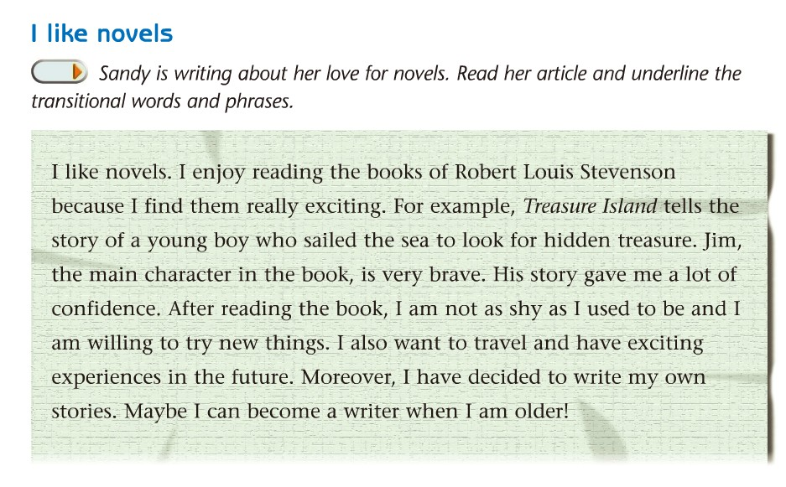

Slide 12
I like novels. I enjoy reading the books of
Robert Louis Stevenson because I find them
really exciting. For example, Treasure Island
tells the story of a young boy who sailed the
sea to look for hidden treasure. Jim，the main
character in the book, is very brave. His story
gave me a lot of confidence. After reading

Slide 13
the book, l ant not as shy as I used to be
and I am willing to try new things I also
want to travel and have exciting
experiences in the future. Moreover, I have
decided to write my own stories. Maybe I
can become a writer when I am older!

Slide 14
用适当的连接词完成下列句子。
(1)He checked the weather report ________
he went out.
(2)Most girls like reading novels __________ most of boys like reading science fictions．
(3) She has worked for seven hours. _______________,she was tired out.
(4) Too many cars have caused a lot of problems. ____________ ,people cannot find enough parking spaces．
(5)She saw a man behind her. __________ he was watching her strangely.
before
while
As a result
For example
Moreover

Slide 15
Homework:
1记忆词汇。
2理解并记忆本课时所学的连接词的用法，能力较强的学生可以适当补充。
3完成教师布置的相关练习。
4预习Task。

