Slide 1
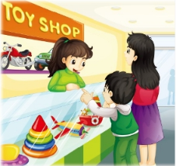
Unit2 Can I help you?
人教精通版五年级下册
WWW.PPT818.COM

Slide 2
>>Review
Let’s chant

Slide 3
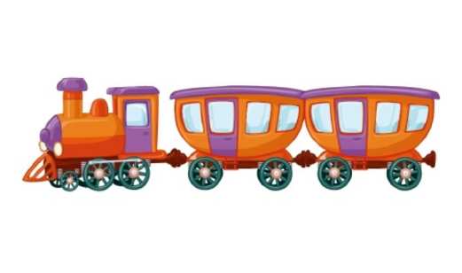
>>Review
Look and say
Can I help you?
Yes. I want a ...
￥68
￥56
￥45
￥30
How much is it?
It’s … yuan.

Slide 4
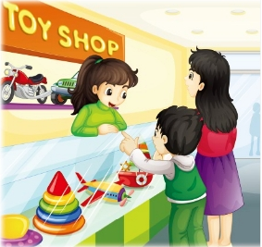
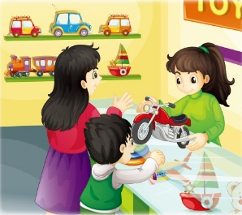
>>Presentation
Listen and say
Who are they?
What are they talking about?

Slide 5
>>Presentation
Listen and say
1. What does Yang Ming want to buy?
He wants to buy a motorbike.
2. What does the saleswoman
say?
What can I do for you?
( =Can I help you? 购物时售货员常用语)

Slide 6
>>Presentation
Listen and say
3. How about this motorbike?
It looks nice.
4. How much is it?
It’s eighty-five yuan.

Slide 7
>>Presentation
Look and read
OK. Choose one you like.
What can I do for you?
Mum, can I have a motorbike?
How about this one?
I want to buy a motorbike.

Slide 8
>>Presentation
Look and read
How much is it?
It’s eighty-five yuan.
We’ll take it.
It looks nice. I like it.
Here you are. Thanks. Bye!
Bye!
Bye!

Slide 9
>>Presentation
Listen and read
Just talk
 | Yang Ming: Mum, can I have a motorbike?
 | Mum: OK. Choose one you like.
 | Saleswoman: What can I do for you?
 | Yang Ming: I want to buy a motorbike.
 | Saleswoman: How about this one?

Slide 10
>>Presentation
Listen and read
 | Yang Ming: It looks nice. I like it.
 | Mum: How much is it?
 | Saleswoman: It’s eighty-five yuan.
 | Mum: We’ll take it.
 | Saleswoman: Here you are. Thanks. Bye!
 | Mum&Yang Ming: Bye!

Slide 11
>>Practice
Super Mary: 表演我最棒！
小组合作：
1.三人一小组
2.根据剧本分角色练习
3.适当加上一些动作辅助表演

Slide 12
>>Practice
活动1
学习用品小调查
以小组为单位，互相调查组内成员学习用品的种类、价格及其他特征，并完成这张调查表。
Things
Prices
Others(color, size…)

Slide 13
>>Practice
活动2
你问我答
根据这张表格并仿照本课对话，编写一段新的对话，并表演出来吧！
Things
Prices
Others(color, size…)

Slide 14
>>Summary
本课学到的重点句型是什么？
—What can I do for you?
—I want to buy a motorbike.
—How much is it?
—It’s eighty-five yuan.

Slide 15
>>Homework
1.观看课文动画，按照正确的语音、语调朗读课文对话。 2.根据本课对话以及你在生活中的购物经历，编写一段新的对话，要求不少于6句。
3.预习 Lesson10。

