Slide 1
Unit2 Vienna is the centre of European classical music.
WWW.PPT818.COM

Slide 2
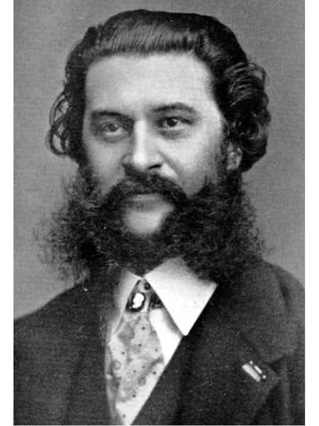
Who is he?
n. 华尔兹舞（曲）
He is Johann Strauss the elder. He wrote and played music for traditional dances, called the waltz.

Slide 3
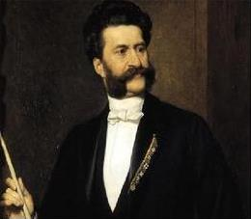
Who is he?
He is Johann Strauss the younger. He wrote The Blue Danube waltz.

Slide 4
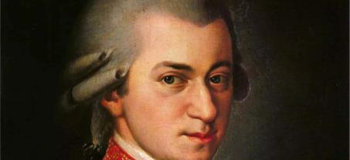
Who is he?
n. 作曲家
He is Mozart. He was a very important composer. He wrote hundreds of wonderful pieces of music.

Slide 5
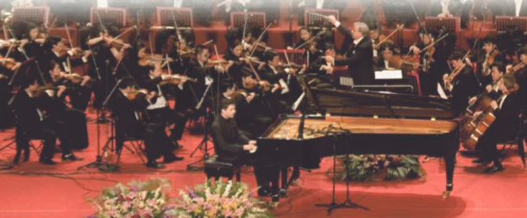
1
Describe the picture. Use the words from the box to help you.
n. 乐手，音乐家
concert musician piano violin

Slide 6
2
Read the passage and check (√) the true sentences.
1
2
1. Many musicians came to study and work in Vienna.
2. Strauss the younger played the piano, the violin and the drums at the age of six.
3. Mozart’s family took him around Europe.
4. The father, Johann Strauss, died in 1791.
5. Mozart wrote The Blue Danube.
√
4
6
√

Slide 7
Complete the sentences.
His dance music made him _________ all over the Europe.
Mozart was another very important_________.
3. Before he was six, he played not only the piano but also the _______.
4. His family took him around Europe and he gave ________ in many cities.
famous
composer
violin
concerts

Slide 8
3
Answer the questions.
1. Where is Vienna?
Vienna is on the River Danube in the centre of Europe.
2. What music did Johann Strauss the elder write?
He wrote music for traditional dances, called the waltz.
3. How many waltzes did Johann Strauss the younger write?
He wrote over 150 waltzes.

Slide 9
4. When was Mozart born?
He was born in Austria in1756 .
5. How old was Mozart when he died?
He was only thirty-five.

Slide 10
[观察1] It’s the capital city of Austria and the centre of European classical music. 它是奥地利的首都和欧洲古典音乐的中心。
Britain is in Europe and it is a European country.
英国在欧洲，它是一个欧洲国家。
[探究] European作形容词，意为“欧洲的”，其名词形式为________，意为“欧洲”。European是以辅音音素开头的单词，该词前面表示“一个”时，要用不定冠词________。
Europe
a

Slide 11
[拓展] European还可用作________ (词性)，意为“欧洲人”。例如：
His best friend is a European. 他最好的朋友是一个欧洲人。
名词

Slide 12
活学活用
1．Mike travelled to several ________ countries last year. He visited ________ European museum.
A．Asia; a B．European; an
C．African; an D．European; a
D

Slide 13
[观察2] The father, Johann Strauss the elder, wrote and played music for traditional dances, called the waltz.
父亲，老约翰·施特劳斯创作并演奏了传统舞蹈——华尔兹的伴奏曲。
He has an elder brother. 他有一个哥哥。
[探究] elder指“年长的”，多用于家庭成员之间。

Slide 14
[辨析] elder与older
elder | 只用于指人，多指兄弟姐妹之间年纪较长的。elder只用作定语，不用作表语，也不能与than连用。
older | 是old的比较级形式，可用于指人或物。指人时，指实际年龄较大的；指物时，意为“较旧的”。该词既可以作定语和表语，也可与than连用。

Slide 15
His elder sister went to Canada last year.
他姐姐去年去了加拿大。
I am two years older than my brother.
我比我弟弟大两岁。
This book is older than that one.
这本书比那本旧。

Slide 16
活学活用
2．(1)我哥哥比我大两岁。
My ________ ________ is two years ________ than me.
(2)我们应该向长辈学习。
We should learn from ________ ________．
elder brother
older
the/our elders

Slide 17
[观察3] Mozart was another very important composer.
莫扎特是另一位很重要的作曲家。
I don’t like this one. Could you show me another?
我不喜欢这个。你能再给我拿一个吗？

Slide 18
[辨析] another, other, the other, others与the others
another | 表示“又一个；再一个”，指三者或三者以上不定数目中的另一个人或物。
other | 表示“别的，其他的”，指不确定的其他的(人或物)；不可单独使用，后面需加名词。
the other | 表示“另一个”，指两者中的另一个，或两部分之中的另一部分；常用结构为one…， and the other…，意为“一个……，另一个……”。

Slide 19
others | 表示“其他的/别的/其余的人或物”，指在无明确范围情况下所剩余的人或事物；常用结构为some…，and others…，意为“一些……，其余的……”。
the others | 意为“其余的/剩余的人或事物”，指在明确的范围中，除去一部分后其余全部的人或事物。

Slide 20
I don’t like the colour of this jacket. Please show me another.
我不喜欢这件夹克的颜色，请给我拿一件别的(颜色的)看看。
Other people went to the supermarket. 其余的人去了超市。
He has two sisters. One is a doctor, and the other is a teacher.
他有两个姐姐。一个是医生，另一个是老师。

Slide 21
There are lots of people in the park. Some are boating, some are dancing, and others are playing chess.
公园里有许多人，一些在划船，一些在跳舞，其余的在下国际象棋。
There are ten cars here. Six (of them) are red, and the others are black.
这儿有10辆小汽车，6辆是红色的，其余的是黑色的。

Slide 22
[拓展] another还可用作形容词，意为“再一的，又一的”；用于单数可数名词前时，名词前不再使用冠词、物主代词、指示代词等。 another也可以用于“数词＋复数可数名词”前，表示“又……个……”。

Slide 23
活学活用
3．(1)2017·呼和浩特 There are fifty students in Class One. Twenty of them are boys; ________ are girls.
A．the other B．the others
C．others D．another
B

Slide 24
(2)2019·云南—I like the coat but not the colour. Have you got ________ one?
—Yes, I'll show you.
A．other B．others
C．the other D．another
D

Slide 25
[观察4] His dance music made him famous all over Europe.
他的舞曲使他闻名于全欧洲。
[探究] make在该句中用作使役动词，此时它的用法主要有以下两种：(1)make sb./sth. do sth. 意为“让某人/物做某事”。例如：
The boss made him work for 12 hours every day.
老板让他每天工作12个小时。

Slide 26
(2)“make sb./sth.＋adj.”意为“使某人/物……”例如：
The music made us relaxed.
音乐使我们感到放松。

Slide 27
活学活用
D
1．—Who made him________the classroom?
—His teacher.
A．cleaning B．cleaned
C．to clean D．clean

Slide 28
[观察5] Before he was six, he played not only the piano but also the violin.
在六岁之前，他不但会弹钢琴，而且会拉小提琴。
[探究]该句中的not only…but also…意为“不但……而且……”，连接的并列成分要保持一致。该短语在连接并列主语时，谓语动词的单复数应与离其最近的主语保持一致，即遵循“就近原则”。

Slide 29
活学活用
2．2017·长沙 Not only my parents but also my sister ________ crazy about the TV play In the Name of People.
A．is B．are C．have been
A

Slide 30
4
Complete the passage with the correct form of the words from the box.
another elder European perfect poor popular
Both Strauss the (1) ______ and Strauss the younger wrote some very (2) _______ music. (3) _______ successful composer from Vienna was Mozart, but he became very (4) ______ and died at the age of thirty-five. Many people think Mozart’s music is (5) _______. All three were great (6) _________ musicians.
elder
popular
Another
poor
perfect
European

Slide 31
Summary
centre
Vienna: the 1. of European classical music
The Strauss family: Johann Strauss the elder—his 2. music made him famous all over 3. ; Johann Strauss the younger—wrote the famous The Blue Danube waltz
dance
The city of music
Europe
hundreds
Mozart: worte 4. of wonderful pieces of music; became very 5. and died in 1791
poor

