Slide 1
Unit1 They don't sit in rows
WWW.PPT818.COM

Slide 2
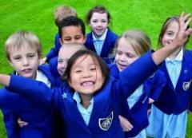
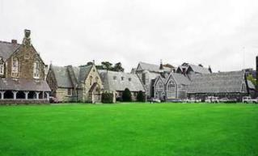
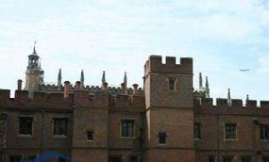
What do you think the English school could be?

Slide 3
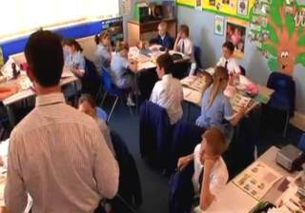
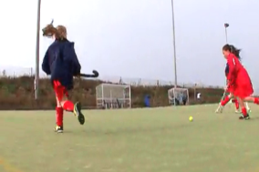
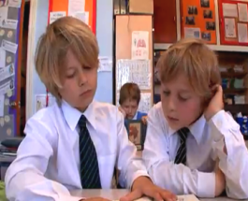
sit around tables
play hockey
wear ties

Slide 4
How do you feel about them?
What words can you think of to describe “school”?
campus
homework
subject
exam
school
classroom
club
teacher
friend

Slide 5
1
Work in pairs, and talk about your school.
—What do you like best about our school?
— I like...

Slide 6
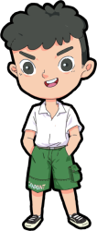
What do you like best about our school?
I like the reading room best, because I can read a lot of books there.

Slide 7
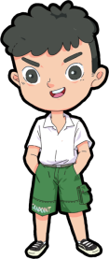
I like laboratory best. Because I can do physics experiments in it.
What do you like best about our school?

Slide 8
2
Listen and complete the sentences.
1) The weather was ______ when Tony was in London.
2) Tony played football with_____________________.
3) Daming is surprised to hear that Tony
_______________________.
4) Tony didn’t go to lessons. He was ________________.
nice
Susie’s classmates
went to school on his holiday
just visiting

Slide 9
3
Listen and read.
First listen
When you listen to the recording for the first time, try to note down the key information. Your notes will then help you retell the main information.

Slide 10
Listen and answer the questions
1.How many pupils are there in Susie’s school?
2.Is everyone sitting around tables or sitting in rows in England?
3.Does every student wear school clothes in England?
4.What kind of sports do students in England like?
700 pupils.
Sitting around tables.
Yes, they do.
They like playing football.

Slide 11
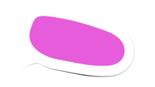
Role-play
Betty: Hey, Tony! Did you enjoy yourself in London?
Tony: Yes! I went to see my friend Susie. And I visited her school.
Betty:What are English schools like?
Tony: Here are a few photos. I took them myself.
Daming: Let’s have a look.
Tony: So this is Susie’s school. It’s got about
700 pupils, like most schools in England.
Betty: How many pupils are there in a class
in England?

Slide 12
Tony: About thirty.
Daming: We have forty in our class. So ours is a bit bigger. Look, everyone is wearing a jacket and tie!
Tony: Yes, every student wears school clothes in England.
Daming: And everyone is sitting around tables in the classroom.
Tony:That’s right. They don’t sit in rows. Look at the swimming pool and the huge sports ground.
Most English schools have sports grounds.
Kids there really enjoy playing football.

Slide 13
Daming: We like playing football too. And we also have an excellent swimming team.
Betty: I hope I can visit Susie’s school one day. It looks really great.
Tony: Our school is great too, and we have more students here. This means more people to play with.
Betty: And more friends too.

Slide 14
Now complete Susie's column in the table.
 | Susie’s school | Your school
Number of pupils in the school
Number of pupils in a class
Arrangement of seats in the classroom
Sports areas
About 700 pupils.
About 30 pupils.
Pupils sit around tables.
Sports grounds.

Slide 15
4
Answer the questions.
1. Who did Tony visit in London?
2. How did Tony get the photos of Susie’s school?
3. Which class is a bit bigger, Susie’s or Daming’s?
4. What does Betty hope to do one day?
He visited his friend Susie in London.
He took the photos of Susie’s school.
Daming’s class is a bit bigger.
She hopes she can visit Susie’s school one day.

Slide 16
[观察1]Ours is a bit bigger. 我们的（学校）大一点儿。[探究]ours是名词性物主代词，可以单独使用，不能修饰名词，相当于“形容词性物主代词____________＋名词”。如：
This is ____ classroom. 这是我们的教室。
This classroom is ______. 这间教室是我们的。
Their house is just like our house, but _______ (we) has a bigger balcony.
our
our
ours
ours

Slide 17
[观察2] Her mother feels a bit/a little better today.
她母亲今天感觉好一些。
Please give me a bit of paper.
请给我一点纸。
[探究]（1）a bit与a little都可用作程度副词，表示“稍微，有点儿”，修饰动词、形容词或副词比较级等，二者可互换。
（2）a little可以直接修饰不可数名词，而a bit修饰不可数名词时，只能用_________.
a bit of

Slide 18
活学活用
1.Keep quiet！ I think it is _________ noisy.
A.a little of B.a bit
C.a bit of D.a few
B
[解析]考查短语辨析。a little不与of搭配；a bit后加形容词；a bit of后加名词；a few修饰可数名词复数。空后的noisy是形容词，故只能用a bit修饰。

Slide 19
[观察3]Look, everyone is wearing a jacket and tie！
看，每个人都穿着夹克，戴着领带！
[探究]wear作动词，意为“穿；戴”，其过去式为______过去分词为______。
wore
worn

Slide 20
[辨析]wear, put on, dress与be in
词条 | 用法 | 含义 | 宾语
wear | 表示状态 | 穿着，戴着；留着 | 衣服、鞋帽、首饰、眼镜、胡须等
put on | 表示动作 | 穿上，戴上 | 衣服、鞋帽等
dress | 表示动作 | 给某人穿衣服 | 反身代词或其他表“人”的词
be in | 表示状态 | 穿着 | 衣服、颜色

Slide 21
[拓展]（1）put on 的反义短语是take off； put on还可译为“上演”，take off还可译为“（飞机）起飞”。
（2）be dressed in＝be wearing＝be in 穿着；get dressed 穿戴好；dress up（as）装扮成；dress oneself自己穿衣服。

Slide 22
活学活用
用wear, dress, put on 或in 填空
（1）I don't like the girl ________ white.
（2）Why does your maths teacher often________ dark sunglasses？
（3）His father________ his coat and hat and went out.
（4）Lucy, help me __________ your little brother.
in
wear
put on
dress

Slide 23
[观察4] Look， everyone is wearing a jacket and tie！
看，每个人都穿着夹克，戴着领带！
[探究]tie在本句中作名词，意为“领带”，其复数形式为_______。
[拓展]tie作动词，意为“（在线、绳上）打结，系扣；（用线、绳等）系，拴，捆，绑”，其现在分词为______。
Mrs Li is helping her husband _____ his ______.
李女士正在帮她丈夫打领带。
ties
tying
tie
tie

Slide 24
[观察5] They don't sit in rows. 他们不是成排地坐着。
[探究] in rows意为“成排；成行”
[拓展]stand in a row站成一排 in Row Five在第五排
The students are standing ______ ______ on the playground.
学生们正一排排地站在操场上。
in rows

Slide 25
[观察6] Kids there really enjoy playing football.
那里的孩子真的喜欢踢足球。
[探究] enjoy doing sth.意为“____________”，其中enjoy表示“享受……的乐趣；欣赏”。如：
My sister enjoys reading picture books.
我的妹妹喜欢看图画书。
[拓展]enjoy oneself 意为“玩得开心；过得愉快”，相当于have fun/have a good time。如：
Jane ______________ at the party. 简在聚会上玩得很开心。
喜欢做某事
enjoyed herself

Slide 26
[观察7] I hope I can visit Susie's school one day.
我希望有一天能参观苏茜的学校。
[探究] 本句中含有“hope＋（that）从句”句型，意为“希望……”。如：
I hope (that) we can win the football match.
我希望我们能赢得这场足球比赛。
I _______ you can give up smoking.
我希望你能戒烟。
hope

Slide 27
[拓展]hope的常见用法：_______________希望做某事；hope for sth.期望某事发生。如：
He hoped to visit our school again.
他希望再次参观我们的学校。
We're ________ ______ good weather this weekend.
我们期望着这个周末有个好天气。
hope to do sth.
hoping for

Slide 28
5
Complete the passage with the correct form of the words in the box.
enjoy pool row tie wear
Pupils in England do not sit in (1)_____ in the classroom. They sit around tables. Everyone (2)_______ a jacket and (3)____. Most schools have sports grounds, and English children (4)______ playing
rows
wears
tie
enjoy

Slide 29
Stress 重读
英语句子一般由多个单词构成，这些单词的重读一般遵循以下规律：名词、形容词、数词、动词、副词、代词和表达强烈思想感情的感叹词需要重读；人称代词、连词、冠词、介词、以及少数系动词和助动词等主要起语法作用的单词一般不重读（当然有少数例外）。

Slide 30
6
Read and predict which words the speaker is likely to stress.
Betty: Hey, Tony! Did you enjoy yourself in London?
Tony: Yes! I went to see my friend Susie. And I visited her school.
Betty: What are English schools like?
Tony: Here are a few photos. I took them myself.
Now listen and check.

Slide 31
7
Work in pairs. Read the conversation in Activity 6 aloud.
8
Now work in pairs and compare your school with Susie's school. Say:
what both schools have
what one school has but the other does not

Slide 32
Exercise
1.Please ___ your coat. It’s very cold outside.
A. dress B. be in
C. put on D. wear
2.I like places where the weather is always warm. I hope __________Hawaii someday.
A.visiting B.to visit
C.visited D.visit
C
B

Slide 33
根据语境从方框中选择恰当的单词填空，有的需要变换形式
pool row tie ours
1. This is not our classroom. ________ is on the second floor.
2. The size of the ________ is fine, but I don’t like the colour.
3. There are three ________ of low houses behind the hospital.
4. Look! Some boys are swimming in the________ now.
Ours
tie
rows
pool

