Slide 1
Unit 3
Could you please tell me where the restrooms are?
Section A Grammar Focus
WWW.PPT818.COM

Slide 2
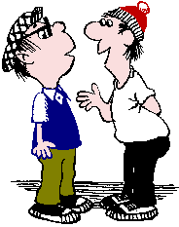
Review
Make a dialogue, asking and giving direction.

Slide 3
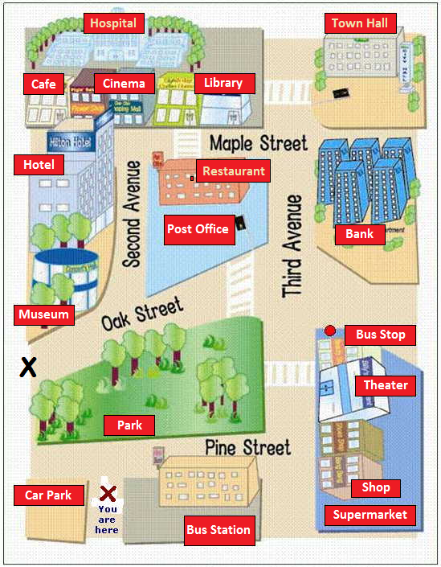
A: Excuse me, could you please tell me how to get to / where is …?
B: Sure, just …

Slide 4
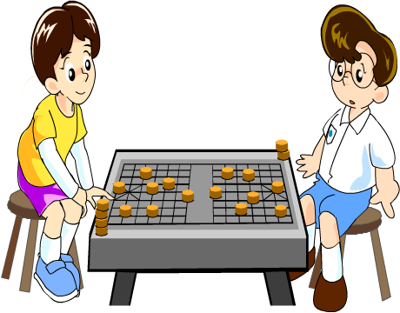
What do you often do with your friend at the weekend?
Could you please tell me what you often do with you friend at the weekend ?

Slide 5
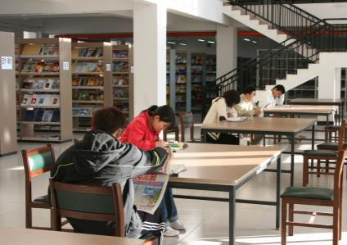
What do you often do with your friend at the weekend?
Could you please tell me what you often do with you friend at the weekend ?

Slide 6
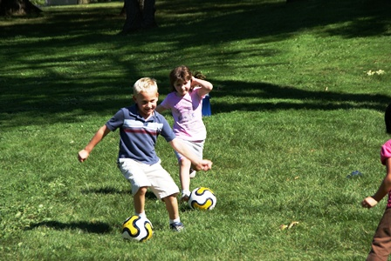
What do you often do with your friend at the weekend?
Could you please tell me what you often do with you friend at the weekend ?

Slide 7
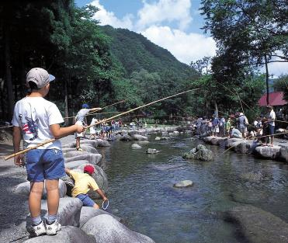
What do you often do with your friend at the weekend?
Could you please tell me what you often do with you friend at the weekend ?

Slide 8
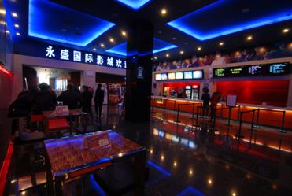
What do you often do with your friend at the weekend?
Could you please tell me what you often do with you friend at the weekend ?

Slide 9
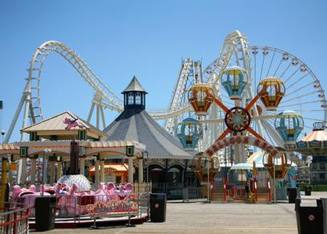
What do you often do with your friend at the weekend?
Could you please tell me what you often do with you friend at the weekend ?

Slide 10
Grammar Focus
Excuse me, do you know where I can buy some medicine? | Sure. There’s a supermarket down the street.
Could you please tell me how to get to the post office? | Sorry, I’m not sure how to get there.
Can you tell me when the band starts playing this evening? | It starts at 8:00 p.m.
I wonder where we should go next. | You should try that new ride over there.

Slide 11
一、宾语从句的概念
Review
在句子中起宾语作用的从句叫做宾语从句。
We know Mr Green teaches English.
She asked if these answers were right.
二、宾语从句三要素
引导词（连接词）
语 序
时 态

Slide 12
特殊疑问词引导的宾语从句
特殊疑问词引导的宾语从句
当宾语从句是特殊疑问句时，用疑问词作引导词。特殊疑问词引导宾语从句时，特殊疑问词不可省略，而且宾语从句要用陈述句语序。

Slide 13
Where will we have a meeting?
我们将在哪儿开会？
— Could you please tell me where we will have
a meeting?
您能告诉我我们将在哪儿开会吗？
What should I do next?
下一步我该做什么？
— I wonder what I should do next?
我想知道下一步我该做什么？

Slide 14
2. 含宾语从句的复合句与简单句的相互转换
含有疑问词引导的宾语从句的主从复合句中，若主句的主语或宾语与从句的主语一致，则宾语从句可以变成“疑问词+动词不定式”的形式。
I don’t know how I should do it next.
I don’t know how to do it next.
我不知道下一步应该怎样做。

Slide 15
3. 改写宾语从句的三个关键点：
(1)确定从句的引导词：宾语从句的引导词要根
据从句句式来确定，其对应情况如下表：
从句句式 | 引导词
陈述句 | that
一般疑问句 | if 或whether
特殊疑问句 | 特殊疑问词
(2)确保从句语序正确：无论原句是何种句式，宾语从句要用陈述语序。

Slide 16
(3)确定从句时态：在主句时态确定的情况下，
宾语从句的时态对应如下：
主句的时态 | 从句的时态
 | 变为宾语从句前 | 变为宾语从句后
一般现在时 | 时态保持不变
一般过去时 | 一般现在时 | 一般过去时
 | 一般过去时 | 一般过去时
 | 一般将来时 | 过去将来时
 | 现在进行时 | 过去进行时
 | 现在完成时 | 过去完成时

Slide 17
►I don’t know where he lives.
我不知道他住在哪里。
►I believe that they will come soon.
我相信他们很快会来。
►He asked me whether I was a teacher.
他问我是否是老师。
►The teacher said that the earth goes round
the sun.
老师说地球围着太阳转。（从句为客观真
理，不受主句时态限制）

Slide 18
巧学妙记
宾语从句用法
宾语从句需注意，几点事项应牢记。
一是关键引导词，不同句子词相异。
陈述句子用that；一般疑问是否（if, whether）替；
特殊问句更好办，引导还用疑问词。
二是时态常变化，主句不同从句异。主句若为现在时，从句时态应看意；主句若为过去时，从句时态向前移。
三是语序要记清，从句永保陈述序。

Slide 19
4a Rewrite the questions to make them
more polite.
Where can I buy some grapes or other fruit?
Excuse me, could you please tell me where
I can buy some grapes or other fruit?
How does this CD player work?
Excuse me, could you please tell me how this
CD player works?

Slide 20
3. How do I get to the Central Library?
Excuse me, could you please tell me how to get
to the Central Library?
Is the Italian restaurant nearby open on
Mondays?
Excuse me, could you please tell me if the
Italian restaurant nearby is open on Mondays?

Slide 21
4b What should each person ask in the
following situations?
1. Tim is very hungry.
Could you tell me where I can get something
to eat?
Excuse me, would you mind telling me how I
can get to a nearby restaurant?
Pardon me, do you know if there’s a restaurant
around here?

Slide 22
Sally needs to mail a letter.
Excuse me, could you tell me how I can get to the post office?
Excuse me, could you tell me if there’s a post office near here?
Excuse me, do you know if there’s a post office near here?

Slide 23
3. Helen needs to know when the bike shop closes.
Could you tell me when the bike shop closes?
Excuse me, do you know when the bike shop closes?
4. Ben is wondering if there’s a bank in the shopping center.
Excuse me, could you tell me if there’s a bank in the shopping center?
Pardon me, do you know if there’s a bank in the shopping center?

Slide 24
4c Write four questions that a tourist might
ask about your town/city. Then role-play
conversations with your partner.
A: Excuse me, could you please tell me where
the nearest bank is?
B: Sure. You go east along this street ...
1. Excuse me, could you please tell me if there’s
a restaurant around here?
2. Excuse me, could you please tell me where
the restrooms are?

Slide 25
3. Excuse me, could you please tell me if
there is a bus stop around here?
4. Excuse me, could you please tell me how I
can get to a hotel?
5. Excuse me, could you please tell me where
is the famous park?

Slide 26
Explanation
-Where did you go on vacation ?
-I went to New York City.
(1) where did you go…?是一般过去时的疑问
句，did是助动词.
(2) went是 go 的过去式，实义动词的过去式
没有人称和数的变化。
(3) 实义动词一般过去式的一般疑问句以助动
词did开头。如：

Slide 27
I. 单项选择。
— Could you tell us how long ___?
— About three days.
A. does the sports mooting last
B. the sports meeting will last
C. the sports meeting last
D. will the sports meeting last
B

Slide 28
2. (2013 •天津) — I don't know______.
— Because he has to look after his mother.
A. why he is leaving
B. why is he leaving
C. whether lie is leaving
D. whether is he leaving
A

Slide 29
3. (2013 •泰安) —Excuse me, could you tell me where_____?
— Sure, sir. You can try www.taobao.com.
A. can I join in the group-buying
B. did I join in the group-buying
C. I can join in the group-buying
D. I joined in the group-buying
C

Slide 30
4. (2013 •黄冈) —Do you know___?
—He is a dentist.
A. where he is from
B. where is he from
C. what does his father do
D. what his father is
D

Slide 31
5. (2013 •北京）I don’t remember _____ the
book yesterday.
A. where I put B. where did I put
C. where will I put D. where I will put
6. Mom, I don’t know ____ next.
A. what I do B. what to do
C. what shall I do D. what I to do
A
B

Slide 32
7. (2013.徐州) — Could you tell me _____
yesterday?
— Because my bike was broken on my
way here.
A. why you came late
B. why do you come late
C. why you come late
D. why did you come late
A

Slide 33
8. (2013.威海) — Excuse me. Could you
tell me___ get to the nearest post office?
— Sorry, I am new here.
A. how can I
B. how I could
C. How to
D. what I can
C

Slide 34
II. 合并句子.
1. I don’t know.
Where is the post office?
2. Can you tell me?
Why was Susan late yesterday?
I don’t know where the post office is.
Can you tell me why Susan was late
yesterday?

Slide 35
3. I want to know.
Are there good movies?
4. Could you tell me?
When did he start playing football?
I want to know if there are good movies.
Could you tell me when he started
playing football?

Slide 36
III. 把以下句子翻译成英语。
1.你能告诉我哪里可以找到一本字典？
2.你能告诉我怎么到那里么？
3.一直向前走。
Can you tell me where I can get a dictionary?
Could you please tell me how to get there?
Go straight ahead.

Slide 37
4. 你知道我在哪里可以买到洗发水吗？
5.药店在家具店和书店的中间。
6. 你能告诉我怎么到邮局吗？
Do you know where I can buy shampoo?
The drug store is between the furniture store
and the bookstore.
Could you tell me how to get to the post
office?

Slide 38
7. 坐扶梯到二楼然后右拐。
8. 你知道我在哪里可以存钱吗？
9. 银行在你的右边。
Take the escalator to the second floor
and turn right.
Do you know where I can save money?
The bank is on your right.

Slide 39
Homework
Master what you have learned
In this lesson. Learn to ask for
information politely.

