Slide 1
Unit 3
Online tours
Reading Ⅰ
WWW.PPT818.COM

Slide 2
Revision
用所给词的适当形式填空。
1. Daniel keeps two white _____ (mouse) as pets.
2. I ________ (receive) an email from my cousin two days ago.
3. I ________ (see) this movie before.
mice
received
have seen

Slide 3
4. They used a knife ______ (open) the door.
5. This old man can use a computer _____ (do) word processing.
6. I don’t like watching football games. Let’s ______ (change) a channel.
to open
to do
change

Slide 4
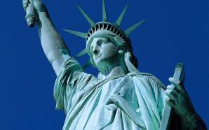
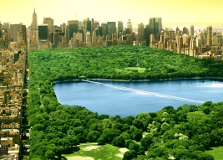
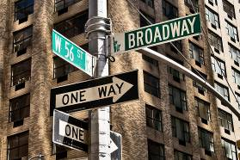
Free talk
Do you like travelling?
Do you know these places?

Slide 5
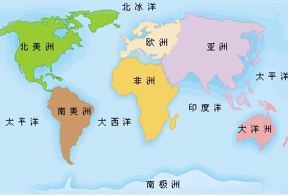
America
Europe
Asia
Africa
A map of the world

Slide 6
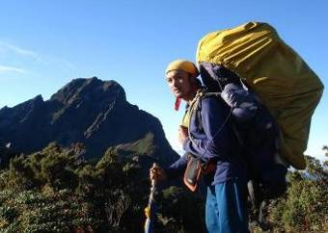
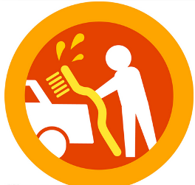
New words
guide n.
导游，向导
icon n.
图标

Slide 7
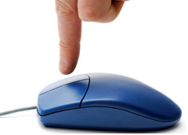
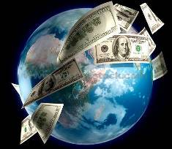
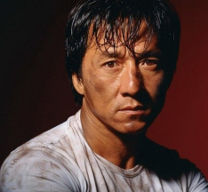
click v. 点击
world-famous adj.
举世闻名的
trade n. 贸易
international adj. 国际的

Slide 8
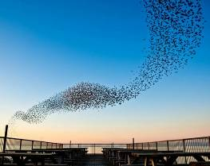
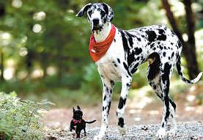
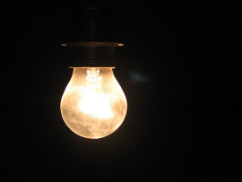
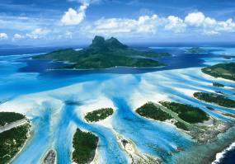
gather v.
聚集，集合
huge adj.
巨大的
darkness n. 黑暗
island n. 岛屿

Slide 9
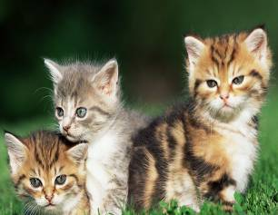
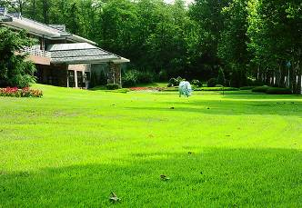
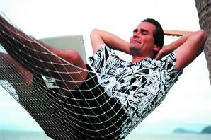
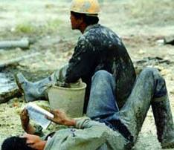
several det.
几个，数个
lawn n.
草坪
relax v. 放松，休息
hard adj. 艰难的

Slide 10
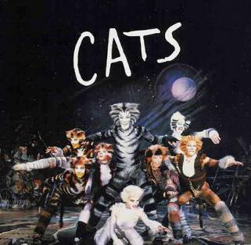
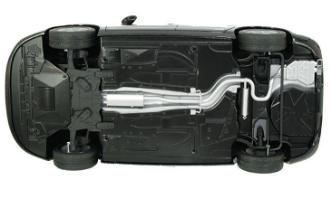
musical n.
音乐剧
bottom n.
底，底部

Slide 11
A fun way to travel
Daniel does not know the meanings of some words on the web page. Help him match the words on the left with the meanings on the right. Write the correct letters in the blanks.

Slide 12
1. trade
2. international
3. gather
4. huge
5. several
6. relax
7. century
8. musical
f
a. a play filled with many songs
b. rest after work
c. come together
d. a period of 100 years
e. more than two
f. the activity of buying and selling
g. two or more countries
taking part
h. very large
____
g
____
c
____
h
____
e
____
b
____
d
____
a
____

Slide 13
Now, let's go travelling!

Slide 14
Skimming
Answer the questions.
Where do we visit following the guide?
New York.
How many places are mentioned(提到)
in the article?
Four.

Slide 15
Pre-travelling
Answer the questions.
What’s the guide’s name?
How can we start out tour?
How long will it take us to travel around the world?
Where are we going to visit?
Robin.
Click on the "Tour" icon at the top of the page.
In eight hours.
New York, the biggest city in the USA.

Slide 16
While travelling
1. What places of interest are mentioned in
this article?
2. Where is the Wall Street？
3. What can we see in Wall Street? Why?
Wall Street, Times Square, Central Park
and Broadway.
It is at the southern end of Manhattan Island.
We can see many big companies and
international banks. Because it is the
world-famous trade centre.

Slide 17
4. What will happen in Times Square
on New Year’s Eve?
Thousands of people gather there and they feel excited when they see the huge glass ball falling through the darkness.

Slide 18
5. What’s in the park?
6. What can people do in the
Central Park?
Several lakes, hills and a large green lawn.
Relax.

Slide 19
7. What is the Broadway famous for?
8. How long has it been famous?
It is famous for its theatres.
Since the early twentieth century.
9. Where does the famous song "Memory"
come from?
It comes from the famous Broadway
musical Cats.

Slide 20
Post travelling
Answer the question:
How can we start out new tour?
Click on the “Back” icon at the
bottom of the page.

Slide 21
Daniel is introducing the website to Millie. Millie is trying to find out what people can see in New York. Help her fill in the blanks below.

Slide 22
Try to remember
New York
Wall
Street
Times
Square
Central
Park
Broadway
⁽¹⁾_______
⁽²⁾_______
a world
-famous
people
gather there
lakes, hills and a large green
famous for
its
trade
centre
New
Year's Eve
⁽⁴⁾_______
⁽⁵⁾____
theatres
⁽³⁾________
lawn
⁽⁶⁾_______

Slide 23
Amy is also interested in travelling around the world. She is telling her mum about the website. Check whatever she says is correct or not. Write a T if a sentence is true or an F if it is false.

Slide 24
1. The website helps people buy tickets
to different places. ____
2. There is a “Tour” icon at the bottom of
the page. ____
3. New York is also called
“the Big Apple”. ____
4. Wall Street is at the northern end
of Manhattan Island. ____
F
F
T
F

Slide 25
5. A big apple falls from the sky on New
Year’s Eve at Times Square. ____
6. There are no hills or lakes in
Central Park. ____
7. The song “Memory” comes from
the musical Cats. ____
8. Click on the “Back” icon and you can
start a new online tour. ____
F
F
T
T

Slide 26
Kitty also wants to know the website. She is asking Daniel about it. Complete their conversation below.

Slide 27
Kitty: Daniel, what's the website called?
Daniel: It’s called “(1) ________________
_____________”.
K: It gives people (2) _____ tours, right?
D: Yes. It can show you cities in (3) ____, Africa, (4) ______, America and other places.
K: Can we find more information about
a city?
Around the World
in Eight Hours
online
Asia
Europe

Slide 28
D: Of course. Look, here’s New York,
and here’s Wall Street.
K: I see. Wall Street is on Manhattan
Island. There are many big (5)
_________ and (6) __________________ there.
D: Yes, and Times Square is another great place to visit. Every year, many people gather there to welcome the (7) ______.
companies
international banks
new year

Slide 29
K: That sounds great. Look! That’s Central Park. People like to (8) ____ there after work.
D: Yes, and don’t miss Broadway. It has been famous for its theatres since the early (9) _______________.
relax
twentieth century

Slide 30
Read aloud the article and underline the difficult parts.
2. Remember the new words in this lesson.

