Slide 1
Unit 3 What Will You Do This Summer?
Lesson 16 Li Ming’s Summer Holiday
WWW.PPT818.COM

Slide 2
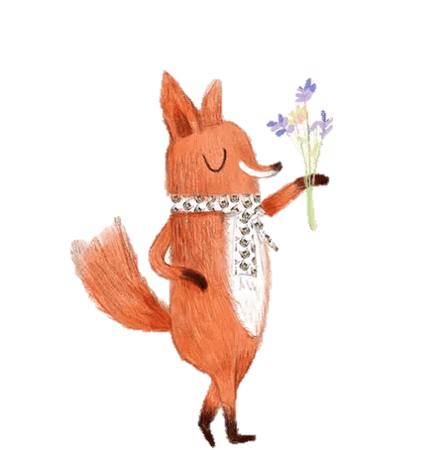
Warm-up
Greetings!
Good morning, boys and girls.
Good morning, Miss…
How are you?
Fine, thank you. And you?
Fine, too. Let’s play a game.

Slide 3
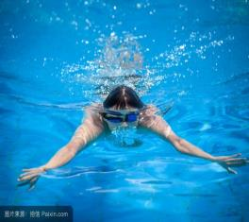
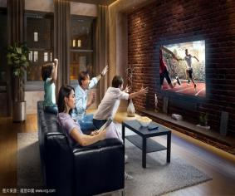
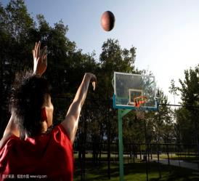
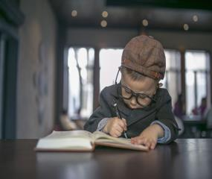
Review
What will you do for the summer holiday?

Slide 4
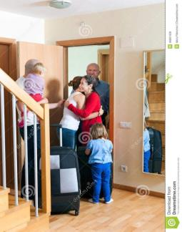
Presentation
What will Li Ming do for the summer holiday?
He will visit his cousin, aunt and uncle.

Slide 5
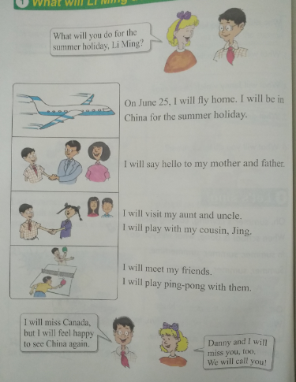
What will Li Ming do this summer?

Slide 6
Questions:
When will Li Ming fly home?
He will fly home on June 25.
What will he say to his parents?
He will say hello to his mother and father.

Slide 7
What does he do in the summer?
He will be in China for the summer holiday.
How will he will to see China again?
He will feel happy to see China again.
What will he do with his friends?
He will meet his friends and play ping-pong with them.

Slide 8
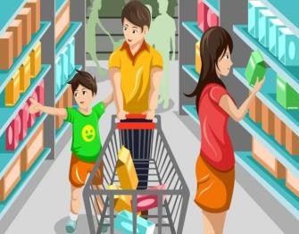
Practice
Let’s play! What will you do?
I will go to the supermarket with my parents.

Slide 9
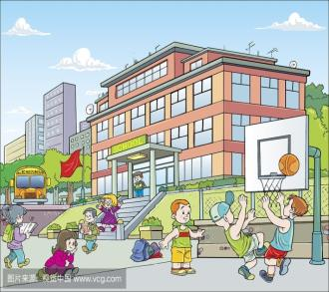
I will fly a kite in the park.
I will go to school.

Slide 10
Homework
1.学生扮演小记者，采访同学周末打算做什么。
2.做完相应的配套练习题。

Slide 11
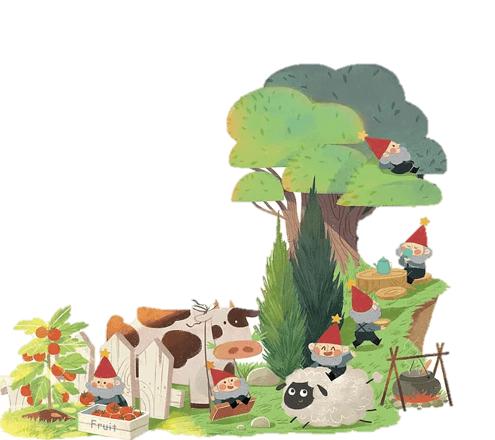
THANK YOU!

