Slide 1
Section C Developing ideas & Presenting ideas & Reflection
外研版高中英语必修二
Unit 2 Let’s celebrate!
WWW.PPT818.COM

Slide 2
Ⅰ
Ⅱ
Ⅲ
Ⅰ.知识体系图解
occasion
editor
embrace
admit
effort
loss
eve
software
adult
process
retired

Slide 3
Ⅰ
Ⅱ
Ⅲ
exist
overseas
global
citizen
nationality
audience
interact
joy
phenomenon

Slide 4
Ⅰ
Ⅱ
Ⅲ
喜爱
到外面吃饭
和……一样
与……有关系
在……看来
想要;感觉像
期望;期盼
不但……而且……
而不是
与……相互影响

Slide 5
Ⅰ
Ⅱ
Ⅲ
Ⅱ.释义匹配
1.editor A.the physical or mental energy that is needed to do something
2.embrace B.the sets of programs that tell a computer how to do a particular job
3.effort C.to happen or be present in a particular situation or place
4.software D.to put your arms around someone and hold them in a friendly or loving way
5.exist E.the person who is in charge of a newspaper or magazine
答案:1.E 2.D 3.A 4.B 5.C

Slide 6
Ⅰ
Ⅱ
Ⅲ
Ⅲ.介(副)词填空
1.He has always been very keen doing physical exercises.
2.As far as I am concerned,the preparations dinner are hard work.
3.Many people volunteered to clean the beaches.
4. my opinion,my best friend changed my attitude towards life.
5.He was looking forward working with the new manager.
on
for
up
In
to

Slide 7
重点词汇
重点句式
高分写作
随堂练习
1.occasion n.场合,时刻
【词汇精讲】occasion是可数名词,意为“场合,时刻”。
She had met Zahid on an earlier occasion.
她早些时候曾见过扎希德。
【词汇拓展】

Slide 8
重点词汇
重点句式
高分写作
随堂练习
On one occasion,she called me in the middle of the night.
有一次她深更半夜打电话给我。
As he works in a remote area,he visits his parents only occasionally.
因为他在一个偏远的地区工作,所以他只能偶尔回去看望他的父母。
There were occasions when we made mistakes.
有时候我们也会出错。
【温馨提示】occasion作先行词,其后跟定语从句时,如果引导词在定语从句中作状语表示时刻,应用关系副词when;若表示场合,应用关系副词where。

Slide 9
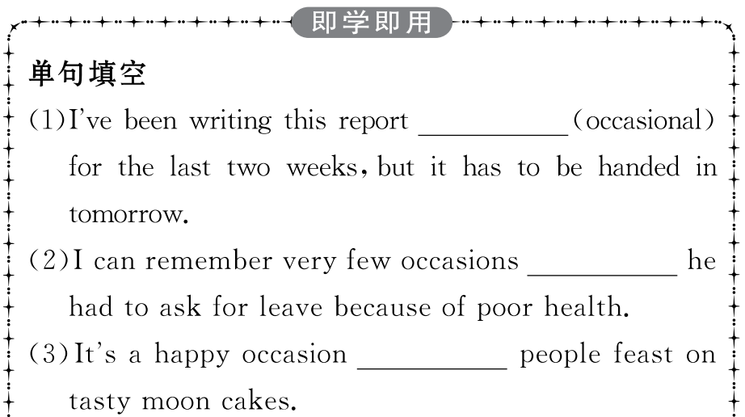
重点词汇
重点句式
高分写作
随堂练习

Slide 10
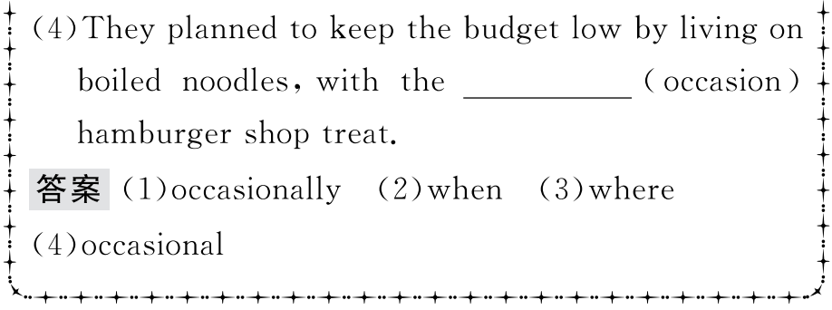
重点词汇
重点句式
高分写作
随堂练习

Slide 11
重点词汇
重点句式
高分写作
随堂练习
2.admit v.(不情愿地)承认
【课文原句】Can’t they admit that the preparations for the dinner are hard work?
他们不承认晚餐的准备工作很辛苦吗?
【词汇精讲】句中的admit是及物动词,意为“承认”,admit还有“接纳;容纳”的意思。
Only after the teacher told him did he admit his mistakes.
只有当老师告诉了他以后,他才承认了自己的错误。
She admitted taking my dictionary by mistake.
她承认误拿了我的字典。

Slide 12
重点词汇
重点句式
高分写作
随堂练习
【词汇拓展】
The classroom can admit 60 students.
这个教室能容纳60名学生。
How many students have been admitted into/to the school this year?
今年这所学校有多少学生入学?

Slide 13
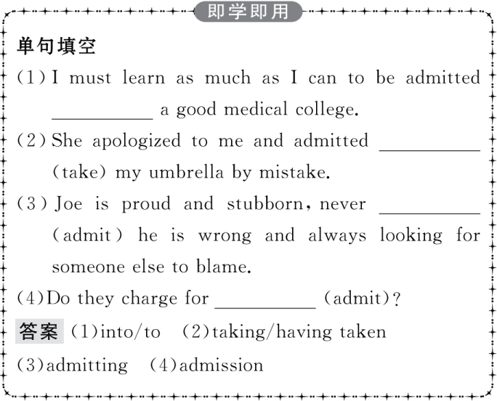
重点词汇
重点句式
高分写作
随堂练习

Slide 14
重点词汇
重点句式
高分写作
随堂练习
3.effort n.力气,精力
【课文原句】I really don’t think it’s worth the effort of spending so much time preparing for a single meal,and then another hour cleaning up the mess after it’s over.
我真的认为花那么多时间准备一顿饭,然后吃完饭后再花一个小时清理打扫是不值得的。

Slide 15
重点词汇
重点句式
高分写作
随堂练习
【词汇精讲】effort是名词,意为“力气,精力,努力”,effort表示一般性的努力(即表泛指意义),通常是不可数名词。若强调一次一次具体的努力,通常是可数名词,尤其与all,these等修饰语连用时。
The film industry should make greater efforts to attract more viewers.
电影业要尽最大的努力吸引更多的观众。
Parents arrange everything for their children and spare no effort to pave the way for their success.
父母为孩子安排好一切,不遗余力地为他们的成功铺路。

Slide 16
重点词汇
重点句式
高分写作
随堂练习
【词汇拓展】
No pains,no gains.I am sure that with your great efforts,you will enjoy a colourful and fruitful life here.
不劳无获。我确信只要你们付出巨大努力,你们就会在这里享有一种丰富多彩、充实的生活。

Slide 17
重点词汇
重点句式
高分写作
随堂练习

Slide 18
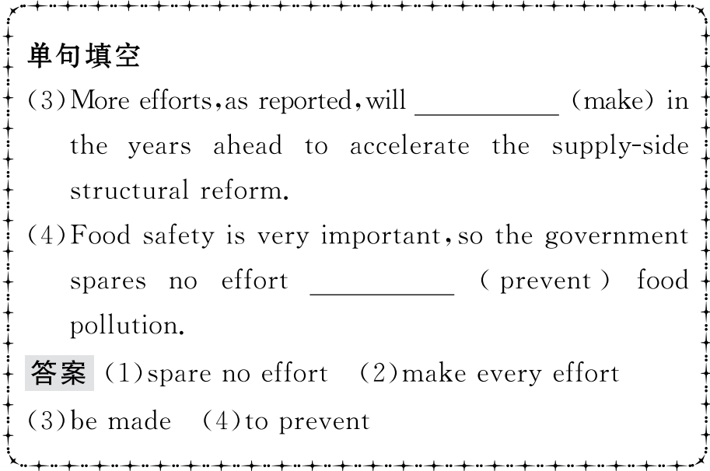
重点词汇
重点句式
高分写作
随堂练习

Slide 19
重点词汇
重点句式
高分写作
随堂练习
4.exist v.存在,实际上有
【课文原句】A fact is something that exists or has happened,for example,an object,event or experience.
事实是存在或已经发生的事情,例如,一个物体、事件或经历。
【词汇精讲】句中的exist是不及物动词,意为“存在,实际上有”。
If it weren’t for Rachel Carson,the environmental movement might not exist today.
如果没有蕾切尔·卡逊的话,环保运动今天可能就不存在。
Does life exist on other planets?
其他行星上有生命吗?

Slide 20
重点词汇
重点句式
高分写作
随堂练习
【词汇拓展】
Nowadays,there are still many people wondering when the earth came into existence.
现在仍有许多人想知道地球是何时诞生的。
As is known to us,there exists a generation gap between the young and the old.
众所周知,年轻人和老年人之间存在代沟。

Slide 21
重点词汇
重点句式
高分写作
随堂练习
【温馨提示】(1)exist只用作不及物动词,因此没有被动语态,且通常不用于进行时。
(2)There exist(s)...表示“存在……”“有……”,there不要换成it。

Slide 22
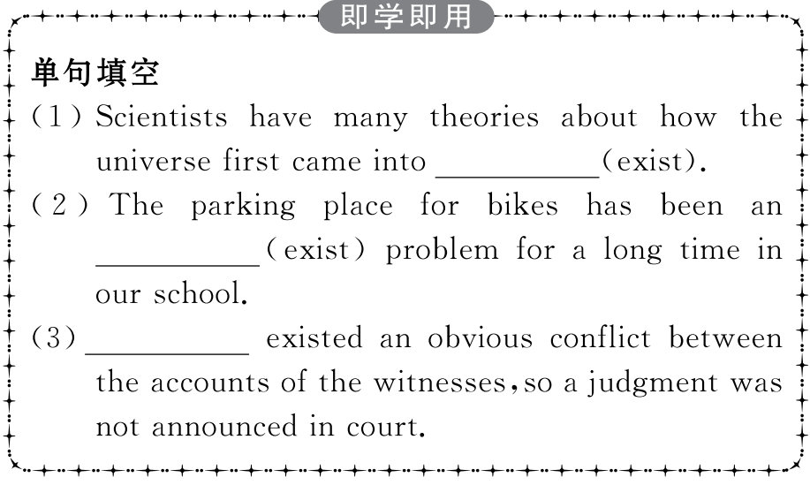
重点词汇
重点句式
高分写作
随堂练习

Slide 23
重点词汇
重点句式
高分写作
随堂练习
It was not only for the delicious food that we seldom got to eat,but for the opportunity to have our whole family gathered together.
不仅是为了我们不常吃到的美食,而是为了整个家庭聚在一起的机会。
【句式剖析】
not...but...意为“不是……而是……”,在句中连接同等成分。not后接被否定的内容,but后面接被认可的事实。
She is not playing computer games but eating chocolate.
她不是在玩电脑游戏,而是在吃巧克力。
It was not what you did but what you said that made her angry.
不是你做的事情,而是你说的话使她生气。
She is not a doctor but an actress.她不是医生而是演员。

Slide 24
重点词汇
重点句式
高分写作
随堂练习
【温馨提示】用在某些否定语后,表示“只……” 。
He eats nothing but hamburgers.他只吃汉堡包。
She knows no one but you.她只认识你。
【句式拓展】

Slide 25
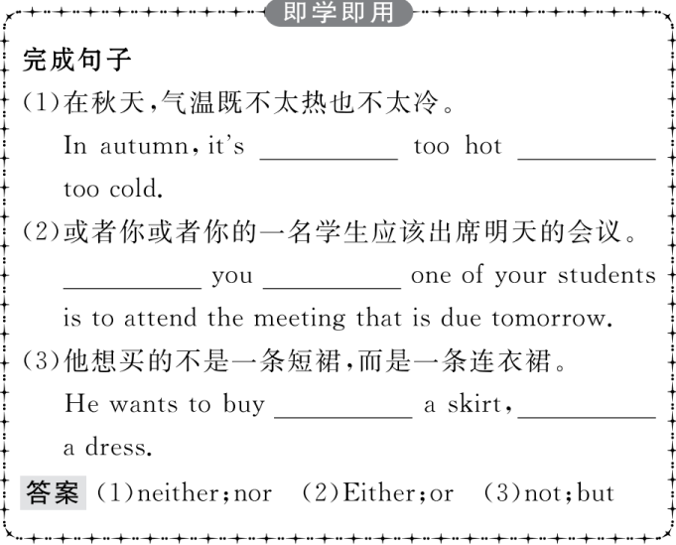
重点词汇
重点句式
高分写作
随堂练习

Slide 26
重点词汇
重点句式
高分写作
随堂练习
假如你叫李华,你的美国笔友Tom给你发来一份电子邮件,表示对中国的传统节日非常感兴趣。他想请你介绍你最喜欢的一个节日,如端午节、中秋节、春节,你通常是怎么庆祝的,以及你喜欢这个节日的原因。请你根据他的问题回复邮件。
提示词语:
注意:1.开头语已给出;
2.词数:100词左右。

Slide 27
重点词汇
重点句式
高分写作
随堂练习
Hi! Tom,
I’m glad to hear that____________________________________
________________________________________________________________________________________________________________
Yours,
Li Hua

Slide 28
重点词汇
重点句式
高分写作
随堂练习
一、审题定调
1.确定体裁:本单元的写作是回复一封邮件,内容是自己所喜欢的节日。根据写作材料,该类短文可使用说明文的形式,属于逻辑顺序说明文。
2.确定人称:由于是介绍节日,所以主要人称为第三人称。
3.确定时态:由于所介绍的是节日的情况,所以主要时态用一般现在时。
二、谋篇布局
本文可以按照逻辑顺序来写作,分为三个段落。
第一段: 首先表明自己所喜欢的节日(中秋节)。
第二段: 中秋节的时间及风俗。
第三段: 喜欢中秋节的原因。

Slide 29
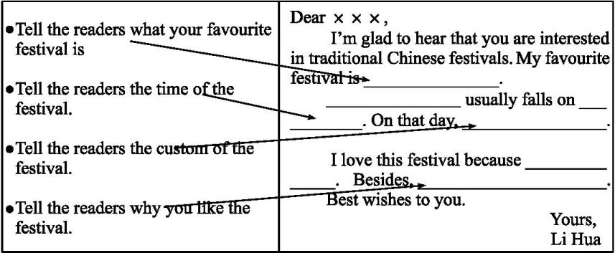
重点词汇
重点句式
高分写作
随堂练习
三、短文模板

Slide 30
重点词汇
重点句式
高分写作
随堂练习
四、组织语言
1.常用语块

Slide 31
重点词汇
重点句式
高分写作
随堂练习
2.遣词造句

Slide 32
重点词汇
重点句式
高分写作
随堂练习
五、连句成文
参考范文
Hi! Tom,
I’m glad to hear that you are interested in traditional Chinese festivals.Of all the Chinese festivals,the one I like best is the Mid-Autumn Festival.
The Mid-Autumn Festival usually comes in September or October,when our family usually get together and have a nice meal.After that,I always sit in the open air,admiring the moon and sharing mooncakes with my family.

Slide 33
重点词汇
重点句式
高分写作
随堂练习
I love this festival because I like eating mooncakes,which are in the shape of a full moon.They carry people’s wishes to the families they love and miss.In short,the Mid-Autumn Festival is a special day of pleasure and happiness.I hope that my letter will help you know more about Chinese festivals.
Best wishes to you.
Yours,
Li Hua

Slide 34
重点词汇
重点句式
高分写作
随堂练习
Ⅰ.选词填空
1.Before they parted,they and promised to keep in touch.
答案:embraced
2.I am willing to that I have made a mistake.
答案:admit
3.This kind of illness causes blindness or serious of vision.
答案:loss
4.Her novel is in the of being turned into a television series.
答案:process
5.Some species in this small area of forest and nowhere else on the earth.
答案:exist
admit,embrace,loss,exist,process

Slide 35
重点词汇
重点句式
高分写作
随堂练习
Ⅱ.语篇填空
The Dragon Boat Festival,also called the Duanwu Festival,is a
1. (tradition) holiday observed annually over 2,000 years in China 2. memory of Qu Yuan,an ancient Chinese patriotic poet.Originated from south China,the Dragon Boat Festival enjoys higher 3. (popular) in southern areas,such as Jiangsu,Zhejiang,Guangdong and Fujian Provinces.Defined by Chinese lunar calendar,the date of the Dragon Boat Festival 4.______ (fall) on the 5th day of the 5th lunar month according 5. lunar calendar.
traditional
in
popularity
falls
to

Slide 36
重点词汇
重点句式
高分写作
随堂练习
Many traditional customs and 6. (activity) are held on the specified day by people in China and even by people in neighbouring Asian countries.Dragon boat racing and eating zongzi are 7. central customs of the festival.In some regions in China,people also wear a perfume pouch(香袋),tie five-colour silk thread and hang mugwort(艾蒿) leaves on 8. (they) doors.
activities
the
their

