Slide 1
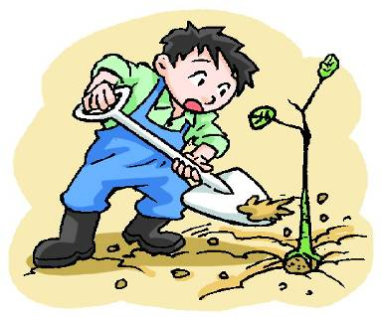
11
Trees
WWW.PPT818.COM

Slide 2
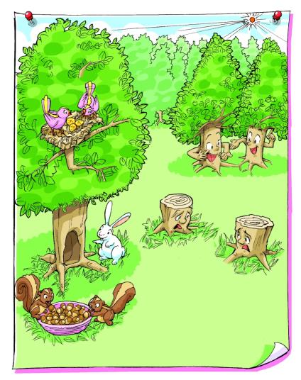
What can trees do?
Trees make our city beautiful.
We get a lot of things from trees.
Trees can keep the air clean.

Slide 3
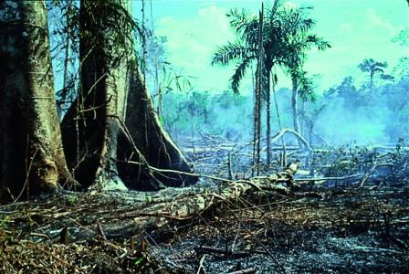
Discuss
How can we protect trees in danger?
We should …
We shouldn’t …

Slide 4
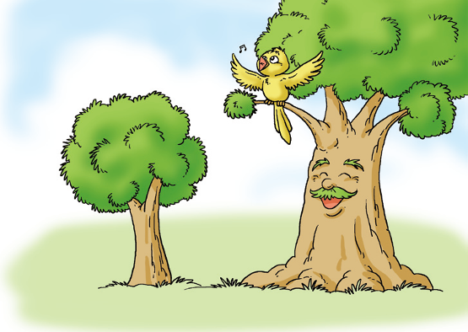
The bird and the tree
The bird and the tree are friends.
The bird often sings songs in the tree.

Slide 5
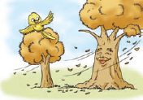
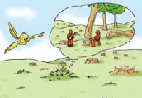
The bird and the tree
Autumn comes.
The bird has to fly to the south.
Bird: See you next spring, Mr Tree.
Tree: See you, Miss Bird. I’ll miss you.
Spring comes. The bird comes back, but she cannot see the tree.
Bird: Where’s Mr Tree?
Grass: Some workers cut him down and
took him to a factory.

Slide 6
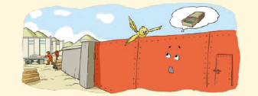
The bird and the tree
The bird flies to the factory.
Bird: I’m looking for my friend Mr Tree.
Where is he?
Gate: The workers cut him into wood. They
used the wood to make matches. Then they took the matches to a village.

Slide 7
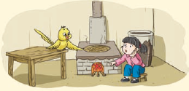
The bird and the tree
The bird flies to the village and sees a girl beside a fire.
Bird: Hello! Are there any matches in your home?
Girl: There were many matches, but now there aren’t any. I used the last one to make the fire.

Slide 8
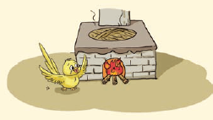
The bird and the tree
The bird sings a sad song to the fire and then flies away.

Slide 9
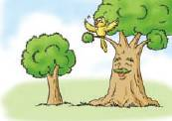
The bird and the tree

Slide 10
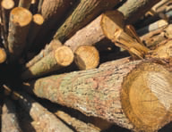
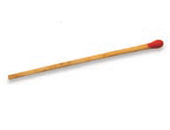
Review the words
wood
match

Slide 11
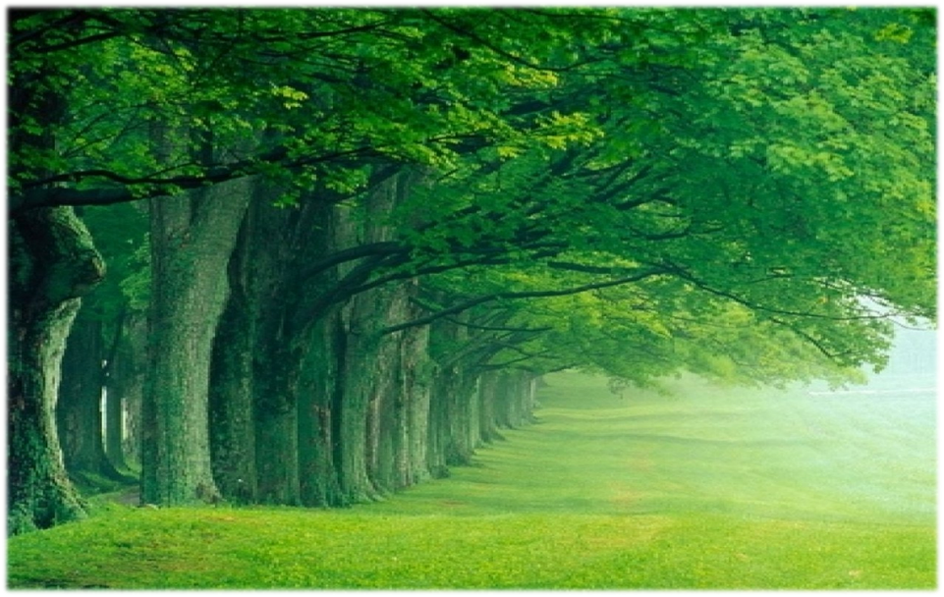
Think and say
Why are trees important?

Slide 12
Brainstorm
keep the air clean
make our city beautiful
keep out wind and dust
important
trees
?
give us wood
cool the air
give us fruit

Slide 13
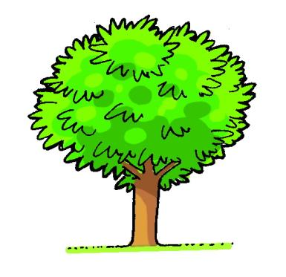
Think and say
Do we need trees or not? Talk in groups and tell your classmates why.
Yes.
No.

Slide 14
Reasons to plant trees:
Trees make streets more _________.
Trees make streets less __________.
Trees make our air _________.
Trees make our air _________.
5. Trees give us a lot of ________ things.
beautiful
noisy
clean
cool
useful

Slide 15
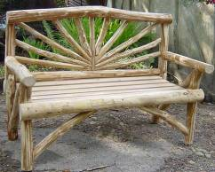
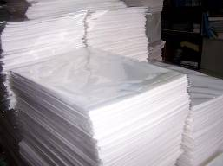
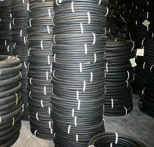
Think and say
What can we get from trees?
What can we usually make from trees?

Slide 16
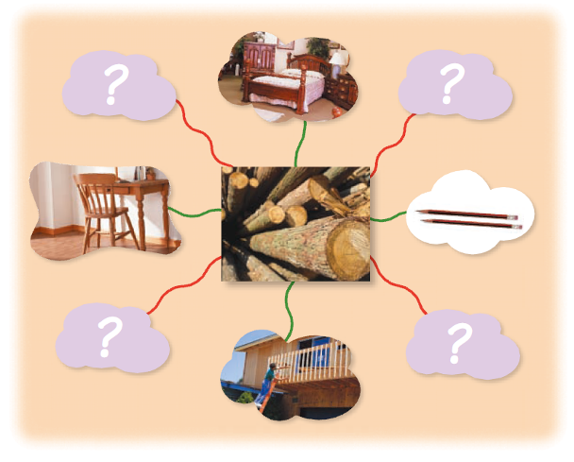
We get wood from trees. What do we use wood for? Give a report.

Slide 17
Give a report.
We get wood from trees.
We use wood to make a lot of things.
We use wood to make …
We also use wood to make …

Slide 18
Do a survey. What can these trees give us? Complete the form.
Kinds of trees | Things for us
apple tree
rubber tree
cocoa
pine
olive
…

Slide 19
Check the answers.
Kinds of trees | Things for us
apple tree | apples
rubber tree | rubber
cocoa | coconut
pine | furniture
olive | olive oil
… | …

Slide 20
Think and say
What can we get from the trees? Complete the spidergram below.
use
things we get from trees
eat
drink
wear

Slide 21
Give a report
use
things we get from trees
eat
drink
wear
We get … from trees.
We ...
We …
We …

Slide 22
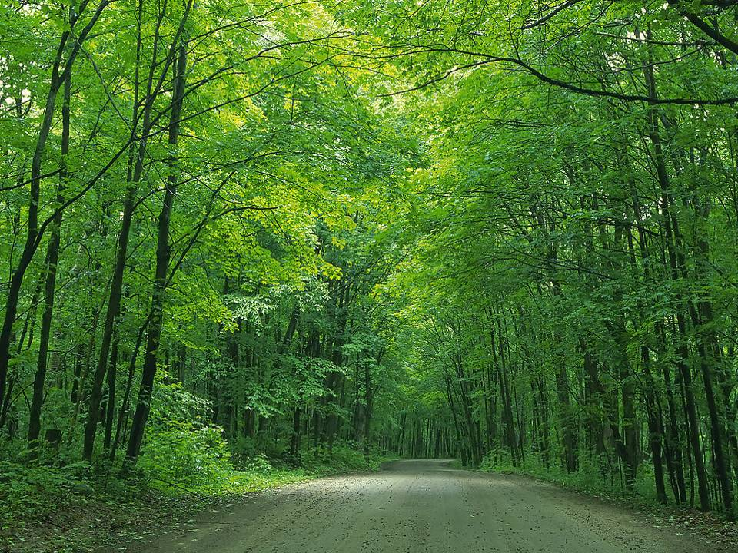

Slide 23
tree
try
tr
train
trousers
traffic
triangle

Slide 24
dress
drop
dr
dry
drive
drink
draw

Slide 25
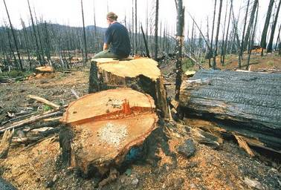
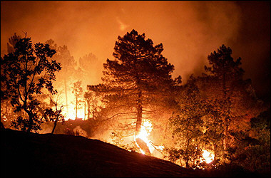
Think and say
Trees are in danger. Why?

Slide 26
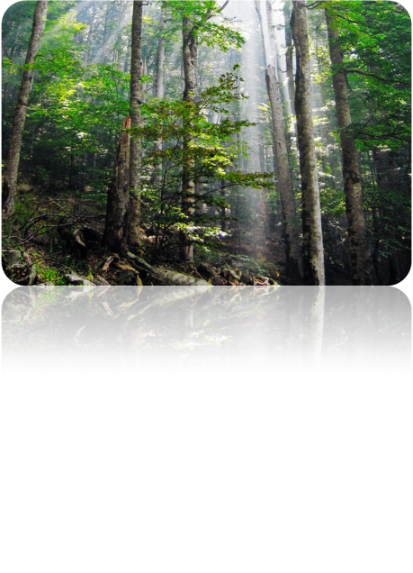
Think and say
What will our Earth be like if there are no trees?
What should we do to protect our Earth?

Slide 27
Think and write
We can …
Things we can do

Slide 28
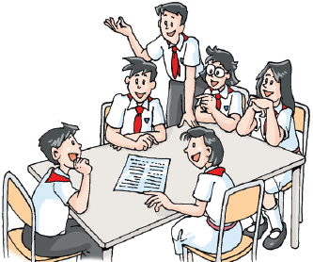
Think and discuss
In groups, talk about what you can do to save trees.
Things we can do

Slide 29
Our promises
Things we can do
write on both sides of the paper
do not cut down trees
plant more trees
do not use throwaway chopsticks
…

Slide 30
Look and read
Proverbs
One tree does not make a forest.
As the tree, so the fruit.
Like tree, like fruit.
A tree is known by its fruit.
A tall tree catches the wind.
Do not cut down the tree that gives you shade.
A tree falls the way it leans.

Slide 31
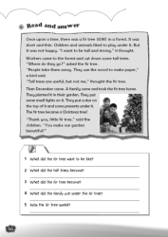
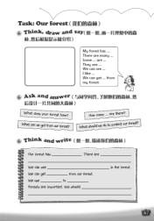
Homework
1. Read Student’s Book pages 78 and 79.
2. Talk about things we get from trees.
3. Finish Workbook pages 66 and 67.

