Slide 1
Unit 2 Let’s play sports! Reading (II)
WWW.PPT818.COM

Slide 2
Revision
Li Hua
Age
Comes from
Lives in
Job
Club
Hobby
Dream
Li Hua is 22 years old.
22
Guangdong
comes from
He comes from Guangdong but now lives in Beijing.
Beijing
He is a football player.
player
Football player
He is a member of Huanghe Football Club.
a member of
Club
Huanghe Football Club
In his free time, he studies English.
He also enjoys listening to music.
In his free time
English, Listening to music
enjoys
His dream is to play in the next World Cup.
dream
Play in the next World Cup
comes true
I hope his dream comes true.
hope

Slide 3
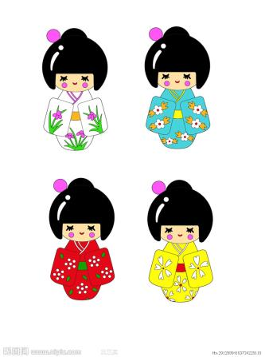
come from… = be from … 来自……, ……地方人
We are from China. Where do they come from?/
Where are they from?
They are from Japan.
He is from the USA.
He is from the UK.
He comes from the UK.
They come from Japan.
He comes from the USA.

Slide 4
player 运动员
Li Hua is a football player. He has some friends. What are they? What are they good at?
Yao Ming is a basketball player.
Lin Dan is a badminton player.
Feng Kun is a volleyball player.
She is good at playing volleyball.
He is good at playing basketball.
He does well in playing badminton.

Slide 5
a member of ... ……的一员
He is a member of Huanghe Football Club.
= He is in Huanghe Football Club.
= He plays for Huanghe Football Club.
米莉想要成为校排球俱乐部的一名新成员。
Millie wants to be a new member of the school volleyball club .
姚明为火箭队效力。
Yao Ming plays for Rocket.

Slide 6
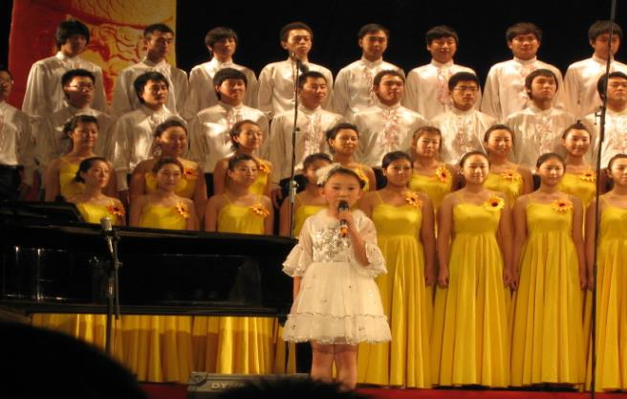
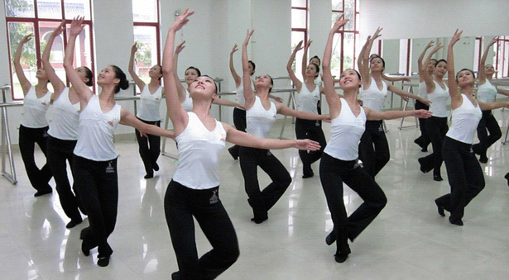
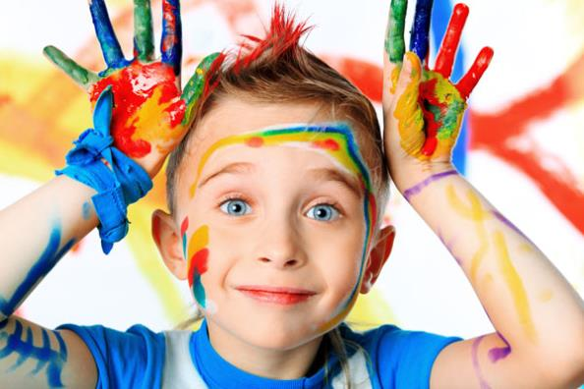
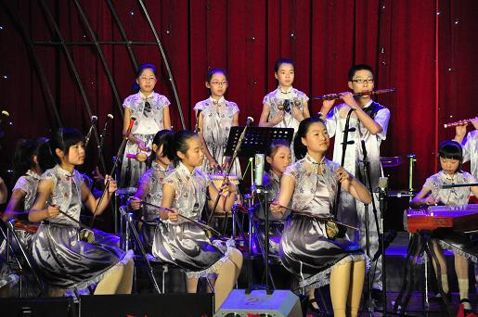
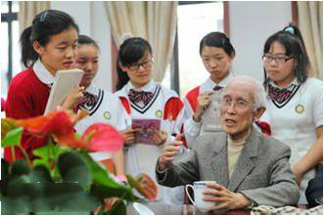
club 俱乐部
Are you a member of any club in our school?
Literature Club（文学社）
Music Club
Drawing Club
Dancing Club
Singing Club

Slide 7
in one’s free time = when somebody is free
在某人的空余时间，当某人有空的时候
你空闲的时候通常干什么？
What do you usually do in your free time?
= What do you usually do when you are free?
我们有空的时候去舞蹈俱乐部。
We go to the Dancing Club in our free time.
= We go to the Dancing Club when we are free.

Slide 8
free 空闲；自由；免费
If you want others to help, and you don’t know if they are busy or not, you can ask:
Are you free now?
The holiday is coming. The students are very happy because:
They are going to be free.
You are very lucky today because you can get the lunch without (不) paying for it. That means:
You can get the lunch for free.

Slide 9
enjoy 喜爱，享受
enjoy something
enjoy doing
= like doing
= love doing
米莉业余时间喜欢弹钢琴。
Millie enjoys playing the piano in her free time.
= Millie likes playing the piano when she is free.
= Millie loves playing the piano in her free time.

Slide 10
listen to … 听……
听我说。
Listen to me.
我爷爷每天早晨听广播。
My grandpa listens to the radio every day.
你喜欢听音乐吗？
Do you enjoy listening to music?

Slide 11
dream
(cn.) 梦；梦想
五彩缤纷的梦想
colourful dreams
(v.) 做梦
我经常梦到我爷爷。
I often dream of my grandpa.

Slide 12
hope
(v.) 希望
hope to do
她希望明年夏天去北京。
She hopes to go to Beijing next summer.
hope + 句子
我希望你会喜欢这个礼物。
I hope you (will) like this present.
注意: 英语中没有hope somebody to do sth. 的用法。

Slide 13
hope
(n.) 希望
没有梦想，就没有希望。
There is no hope without a dream.

Slide 14
come true 实现
true VS real
true 真实的；真诚的
一位真诚的朋友
a true friend
真的还是假的？
True or false?
real 真材实料的
一只是纸老虎，另一只是一只真老虎
One is a paper tiger, and the other is a real tiger.

Slide 15
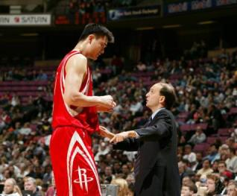
look
look + adj.
Yao Ming looks tall, and the man on the right looks short.
look at … 看……
老师欣慰地看着我们。
The teacher looks happily at us.
请仔细看黑板。
Please look at the blackboard carefully.

Slide 16
make somebody + adj. 使某人……
这个故事使我们感到悲伤。
The story makes us sad.
make somebody do something 使某人做某事
不要让她一直站着。
Don’t make her stand all the time.
make somebody not do something 使某人不要做某事
让这个宝宝不要哭。
Make the baby not cry.

Slide 17
Li Hua is Simon’s _________ football star.
Li Hua is a new ________ of Huanghe Football Club.
Li Hua plays football __________.
Li Hua _______ English in his free time.
Li Hua also _______ listening to music. It makes him ______.
Li Hua has a _______. He wants to play in the _____ World Cup.
favourite
member
very well
studies
enjoys
happy
dream
next

Slide 18
Exercises
1. Eddie often eat five _____ (time) a day.
2. We hope your dream _____ (come) true.
3. Sandy enjoys _________ (swim) very much.
4. Ronaldo is a famous football ______ (play).
times
comes
swimming
player

Slide 19
5. 课堂上我们必须认真听老师讲。
We ______________________ carefully
in class.
6. 什么使你高兴? What _______________?
7. 谁是你最喜爱的网球运动员？
Who _____________________?
8. 他哥哥看上去强壮。
His brother ______________.
must listen to the teacher
makes you happy
is your favourite player
looks strong

Slide 20
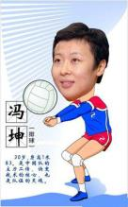
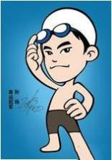
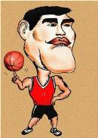
Group work
the name of your favourite player
Age
Comes from
Lives in
Job
Club
Hobby
Dream

Slide 21
Group work
Our group’s favourite player is ...
...
...

Slide 22
Homework
1. Recite the article about Li Hua.
2. Review the words, phrases and language points.
3. Write an article about your favourite player and
share it with your friends.

