Slide 1
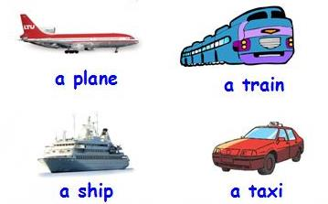
Unit 2
How do you come to school?
第一课时
WWW.PPT818.COM

Slide 2
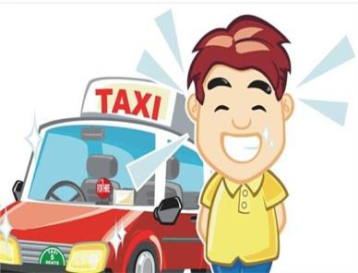
Introduce
--Where does Liu tao live? How does he come to school? --He lives on Park Street, and he comes to school by taxi, because his father is a taxi driver.

Slide 3
Words
traffic [ˈtræfɪk]
名词，意为：“交通，运输”
常用搭配：heavy traffic 车水马龙
小练习：汉译英：交通标志
traffic sign
拓展：traffic / tr/ 含有tr发/tr/的单词如下：true, try, tree, trouble
小练习：辨音：train drink
× train / tr / drink / dr /

Slide 4
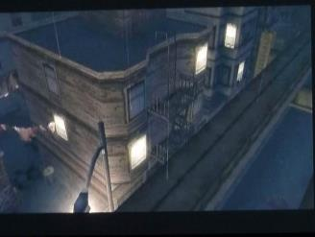
Words
street [stri:t]
名词，意为：“街道”。
常用短语：on the street 在街上
小练习：用所给词的适当形式填空：
He is____（in / before）the street
in
拓展：street指的是两边有商铺，建筑和树木的街道。
road 意为：“道路，公路”。
way指的是城镇里道路的一条小岔路

Slide 5
Words
through [θru:]
介词，意为：“穿过”。
eg：He walked through the street. 他走过街道。
小练习：选择合适的介词填空 ：
We drive (across / through)London.
through
拓 展：through表示“穿过”的意思，即是从一头贯穿到另一头。
across表示“横穿、横过”

Slide 6
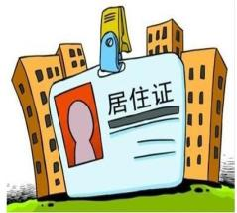
Expressions
Where+do+非第三人称单数+live?
由where引导的特殊疑问句，意为：“ 表示某人居住在哪里 ”。
eg：Where do they live? They live near school.
他们住在哪里？ 他们住在学校附近。
小练习：用所给词的适当形式填空：
--Where do you live?
-- We_____(live) near our school.
live

Slide 7
Expressions
How+do+非三单主语+come to school?
由How引导的特殊疑问句，意为：“某人怎么来学校”。
eg：How do you come to school? I come to school by bus.
你怎么来学校？我乘公共汽车来学校的。
小练习：句型转换：They go to school by taxi.对划线部分提问
How do they go to school？
拓展：How还可以询问某人的身体状况
eg： How are you ? 你身体如何？

Slide 8
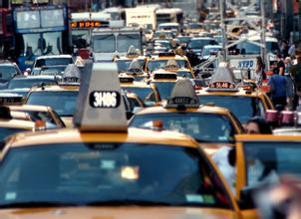
Dialogue
Traffic, traffic,on the street.
交通，交通，在街道上。
Beep,beep,beep,beep.
嘟嘟响，嘟嘟响。
Trains, trains, through the trees.
火车，火车，穿过树木。
Choo choo, choo choo !
出 出 出 出（火车发出的声音。）

Slide 9
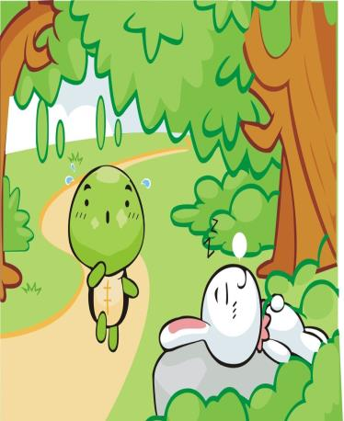
Expand
经典寓言故事
The hare and the tortoise
The hare was once boasting of his speedbefore the other animals. "I have never been beaten," he said, "when I run at full speed, no one is faster than me."
The tortoise said quietly, "I will race with you." "That is a good joke," said the hare. "I could dance around you the whole way."

Slide 10
Expand
经典寓言故事
The race started. The hare darted almost out of sight at once. He soon stopped and lay down to have a nap.
The tortoise plodded on and on. When the hare awoke from his nap, he saw the tortoise was near the finish line, and that he had lost the race.

Slide 11
Summary
traffic
street
through
Where+do+非第三人称单数+live?
How+do+非三单主语+come to school?

Slide 12
Homework
Make up a conversation about transportations.

