Slide 1


Unit 1
What are those farmers doing?
WWW.PPT818.COM

Slide 2
其他的、别的
m
other
f
极少、几乎没有
new
a few 几（个、条）
glass
gr
草、草地

Slide 3
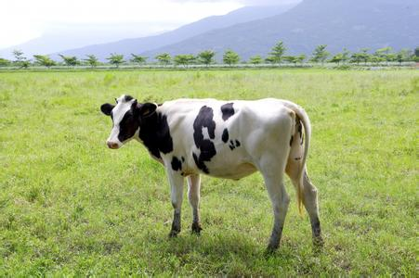
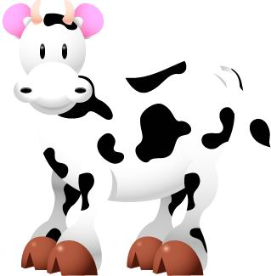
cow [kaʊ]
奶牛；母牛

Slide 4
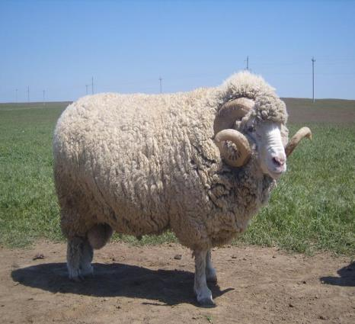
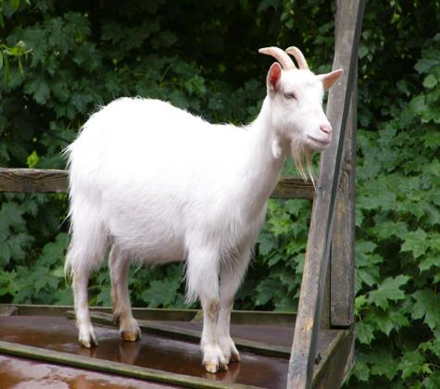
sheep [ʃi:p]
绵羊
goat [gəʊt]
山羊

Slide 5
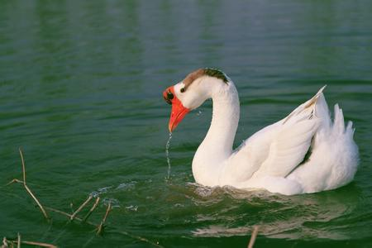
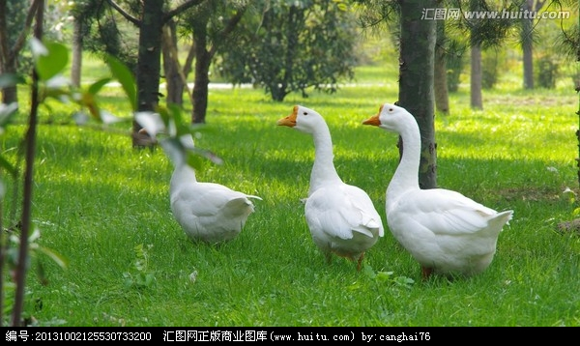
goose 鹅
[guːs]
geese 鹅
[giːs]

Slide 6
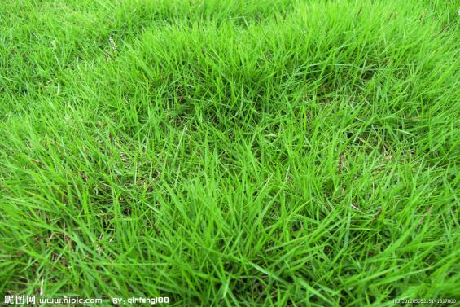
grass [ɡrɑːs] 草、草地

Slide 7
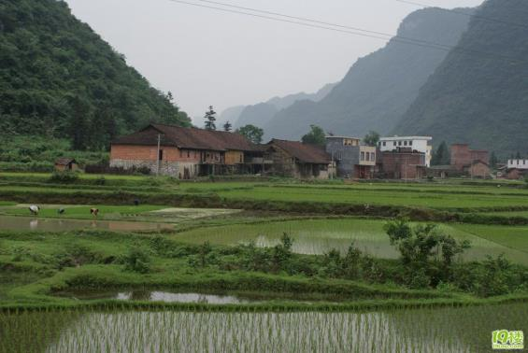
country [‘kʌntri] 农村
field [fiːld]田

Slide 8
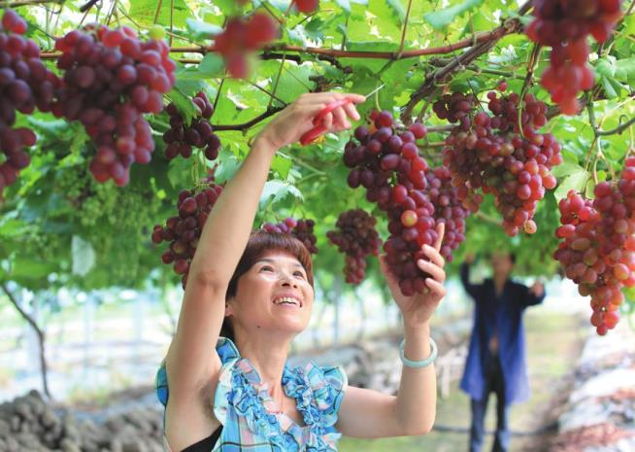
pick [pɪk] 摘

Slide 9
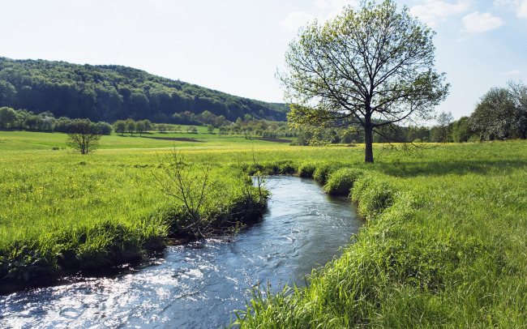
river [‘rɪvə] 江、河

Slide 10
1. What fruit can Ben pick from the trees?
He can pick some oranges and apples.
2. What are the farmers doing?
They are cutting grass to feed the animals.
3. What animal do Uncle Chen have
on the farm?
He has goats, pigs and some geese
on his farm.

Slide 11
Homework
1. 抄写单词 、课文
2. 读、背 Unit 1 单词、课文。

