Slide 1
Lesson 46:
Protect Our Environment
WWW.PPT818.COM

Slide 2
Teaching Aims:
Know about the pollution in our country.
We all should take care of our environment.
Teaching Important Points and difficult Points:
How do you think the pollution in our country?
What should we do to stop pollution?

Slide 3
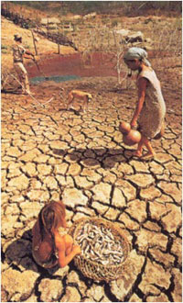
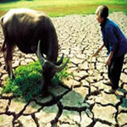
Warming up
dry

Slide 4
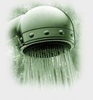
shower

Slide 5
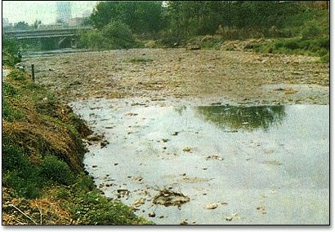
Water pollution

Slide 6
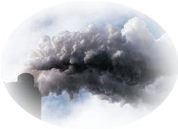
Air pollution

Slide 7
New Words
leak tap
beer truck
factory unlike

Slide 8
Think About It !
How often do you take a shower?
Why should we take short showers?
What can you do to save water?

Slide 9
Let’s Do It !
What good things has Katie done for the environment?
Do you feel the same or different about the environment as Katie? Why?

Slide 10
Language
Points

Slide 11
I try to save water in many ways.
我用很多方式试着节约用水。
try to do sth. 意为“尽力做某事”。
如：
I will try to learn English well.
我将尽力学好英语。
They tried not to disturb him.
他们试图不去打扰他。

Slide 12
辨析：too many, too much, much too
too many的中心词是many，用法与many相同，用来修饰复数可数名词。如：
He's got too many questions to ask you.
他有很多问题要问你。

Slide 13
(2) too much的中心词是much，用法与much相同，用来修饰不可数名词。如：
I'm afraid that I've given you too much trouble. 恐怕我太麻烦你了。

Slide 14
(3) much too的中心词是too，用法与too相同，用来修饰形容词原级或副词。如：
It's much too cold outside. You'd better put on your overcoat. 外面太冷了，你最好把大衣穿上。

Slide 15
Exercises

Slide 16
I. 根据句意及所给汉语提示，完成单词。
1. A bike doesn't make any ________ (污染).
2. He bought many ______ (罐头) from the shop yesterday afternoon.
3. They put other garbage in their ______ (塑料的) bags.
4. It's our duty to protect the ___________ (环境).
5. There are many big ________ (工厂) in my hometown.
pollution
cans
plastic
environment
factories

Slide 17
II. 翻译下列短语
1. 照顾 ____________
2. 担心，忧虑 ____________
3. 制造污染 ____________
4. 短时间的淋浴 ________________
5. 骑自行车 ____________
take care of
worry about
make pollution
take a short shower
ride a bicycle

Slide 18
III. 根据提示翻译下列句子，每空一词。
1. 你应该照顾好这个婴儿。
You should ______ ______ ______ ______ the baby.
2. 我们应该尝试更多的方法去减少污染。
We must ______ ______ ______ to make less pollution.
3. 这些玻璃被制成新的东西。
This glass ______ ______ ______ new things.
4. 我认为这些男生浪费的纸张最多。
I think these boys waste ______ ______ paper.
5. 他昨天晚上洗了个淋浴。
He ______ ______ _______ last night.
take good care of
try more ways
is made into
the most
took a shower

