Slide 1
Unit 4 Why don’t you talk to your parents?
Section B 1a—1e
WWW.PPT818.COM

Slide 2
Lower stress
listen to beautiful
music or songs
go to dance with
my friends

Slide 3
go shopping with my friends
watch movies

Slide 4
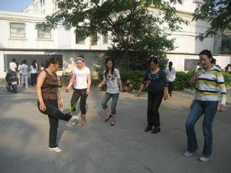
play sports
get enough sleep

Slide 5
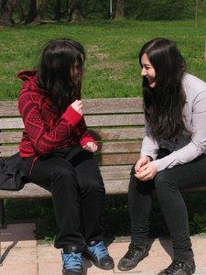
spend time alone
talk to my good friends

Slide 6
Lower stress
Order the activities:
____ play sports
____ hang out with friends
____ talk to parents or other family members
____ spend time alone
____ play computer games
____ read books
____ watch movies
____ other: _____________

Slide 7
1c Listen and check the problems Wei Ming talks about.
___ My parents give me a lot of pressure
about school.
___ I don’t get enough sleep.
___ I don’t have enough free time.
___ I had a fight with my parents.
___ I have to compete with my classmates at
school.

Slide 8
1d Listen again. Fill in the blanks.
Although you may be ________ with your parents, you should talk to them. Ask them why they give you so much ________ .
Life shouldn’t just be about ________ . Free time activities like ________ and hanging out with friends are important, too.
You shouldn’t ________ with your classmates to get better grades. You should all be ________ each other to improve.

Slide 9
1e Pairwork
A: I think Wei Ming should …
B: Why?
A: Because …

Slide 10
Homework
If you have a lot of pressure, what do you like to do to lower your stress? Please write a short passage about this. (at least 50 words)

