Slide 1
Unit 3 Topic 2
Some things usually have different meanings in different cultures.
Section A
WWW.PPT818.COM

Slide 2
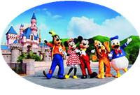
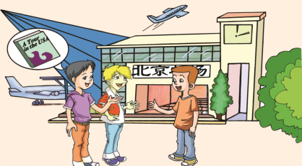
Where is Wang Junfeng going tomorrow?
He is going to Disneyland.
What are Kangkang and Michael doing at the airport?
They are seeing Wang Junfeng off.
see sb. off 为某人送行
Who is he traveling there with ?
He is traveling there with his parents.
He is boarding in an hour.
v. 上(船、火车、飞机) 等

Slide 3
Listen to 1a and choose the best answer.
Who is meeting them tomorrow?
B
( ) 1. What does Michael see a stranger doing?
( ) 2. Who is meeting them tomorrow?
( ) 3. What is Wang Junfeng worried about?
A. Waving his hand excitedly.
B. Putting out his hand with his thumb raised.
C. Shaking hands with others.
C
A. His friend. B. His aunt. C. His uncle.
A
A. His English. B. where to buy the guidebook. C. How to ask for help.

Slide 4
put out his hand with his thumb raised
means
ask for a ride

Slide 5
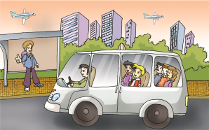
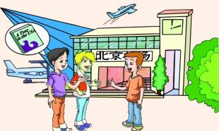
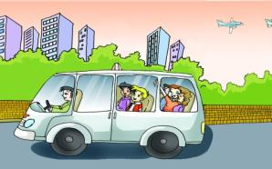
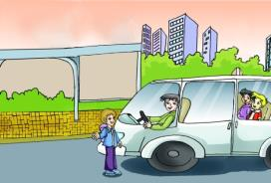
1b Listen to 1a and number the following pictures.
( )
②
( )
④
( )
( )
③
①

Slide 6
1C
Read 1a and Mark True (T) or False (F).
( ) 1. Michael and Kangkang are going to see
Wang Junfeng’s family off at a bus station.
( ) 2. Wang Junfeng’s family and the stranger
are leaving for Disneyland.
( ) 3. The driver stops the minibus and gives the
stranger a ride.
( ) 4. Michael tells Wang Junfeng to send him an e-
mail or call him if he needs any help.
F
F
T
T

Slide 7
Fill in the blanks according to 1a.
Wang Junfeng is very excited because he is ______to Disneyland with his parents. His friends Kangkang and Michael are going to _______ them _____.On their way to the _______, there is a ________ asking for a ______.Then they drive there together. Wang Junfeng’s ______ is at 5 o’clock and his uncle is ________ him. But he is still ________about his English. His friends give him some advice. _____________he needs help, he can read the_________, A Tour in the U.S.A, and send an email ________ help.
flying
see
off
airport
stranger
ride
flight
meeting
worried
Whenever
guidebook
for

Slide 8
Group Work
Retell the dialogue according to the key words in 1a.
fly, see…off, airport, stranger, with his thumb raised, ride, flight, meeting, worried, whenever, guidebook, send an email for help.

Slide 9
Language points
1.Michael and Kangkang are going to see them off. 迈克尔和康康去给他们送行。
see sb off
送别，给某人送行
今天早上他们去火车站给朋友送行。
e.g. They went to the train station
_______their friends ______ this morning.
to see
off
2. Michael sees a stranger putting out his hand with his thumb raised.迈克尔看见一个陌生人正伸着他的手，大拇指朝上。
with his thumb raised
with结构作伴随状语
e.g. The teacher came in with a cup in his hand.
The thief stood there with his arms tied behind his back.
他没关灯就离开了教室。
with the light on
e.g. He left the classroom _______________ .

Slide 10
Language points
3. Whenever you need help, send me an e-mail or call me.
无论你什么时候需要帮助，给我发邮件或打电话。
这是由连词whenever引导的让步状语从句，在这样的句型中Whenever = no matter when 无论什么时候，相似的用法还有：
wherever = no matter where 无论在哪儿
however = no matter how 无论怎样
whoever = no matter who 无论是谁
whatever = no matter what 无论什么
无论谁给我打电话，告诉他我不在。
e.g. No matter who calls me, tell him I’m out.
无论你有多生气，请保持冷静。
e.g. No matter how angry you are, please
keep calm.

Slide 11
Study the sentences carefully and pay attention to the verbs and the time. Then choose the correct answers to complete the sentences.
3
1. When is Bob going to London?
He is going to London next Sunday.
2. When is Wang Junfeng’s uncle meeting him?
He is meeting him tomorrow.
3. When is Wang Junfeng leaving?
He is leaving in an hour.
am moving
I __________ ( move/am moving) to Shanghai next month.
They _________ (start/are starting) at 8:00 a.m. tomorrow.
We are traveling to Beijing _____________ (next Sunday/
on Sunday).
are starting
next Sunday

Slide 12
现在进行时表将来：
going \ coming
leaving \ arriving
位移动词
driving
starting \ beginning
traveling \ flying
```
am/is/are+ doing
seeing \ meeting
sleeping
changing
非位移动词
working
eg:
```
1. The summer holidays are coming.
2. I am arriving home in twenty minutes.
3. My uncle is seeing (meeting) me tomorrow.

Slide 13
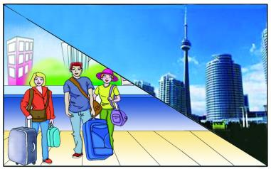
4.
Make up conversations in pairs by following the example.
Example:
A: When are you traveling to Canada?
B: I’m traveling tomorrow.
A: Who are you going with?
B: I’m going with my friends.
Travel to Canada/tomorrow/go with

Slide 14
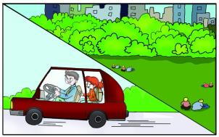
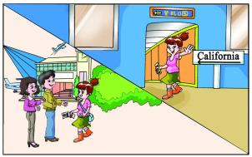
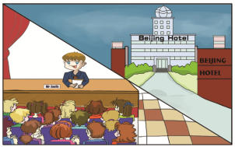
Pair Work
go to the central park/
this weekend/give… a ride
board/
in several minutes/pick…up
arrive at/at 7 ’clock
/give…a speech

Slide 15
2
Listen to the passage and choose the correct answers.
( ) 1. Where does Bob come from?
A. London. B. America. C. Australia.
( ) 2. When is he going to London?
A. On Sunday. B. Next Saturday. C. Next Sunday.
( ) 3. How many people are going to see him off?
A. Two. B. Three. C. Four.
( ) 4. Who is meeting Bob at the airport?
A. His uncle. B. His aunt. C. His classmate.
C
C
C
A

Slide 16
Exercises
Choose the best answer.
B
( )1.—Where is my father, Mom?
—He is __ home.
A. by the way B. on the way
C. in this way D. to the way
( ) 2.They say they __ China for Japan next week.
A.are leaving B. would leave
C.leave D. were leaving
( )3.The engineer is returning from Hong Kong _____ a few
days.
A. since B. for C. in D. after
A
C

Slide 17
( )4.The winter holiday will begin soon. John _____ to
stay with us.
A. will be coming B. comes
C. came D. is coming
( )5._____ you do, I will be on your side.
A. Whenever B. Whatever
C. However D. Wherever
( )6. Although we have learned English for 3
years, we still have trouble _____ the new words.
A. learn B. to learn
C. learning D. of learning
D
B
C

Slide 18
Summary:
We learn:
1. Some words: stranger, thumb, minibus, flight,
guidebook, whenever, board
2. Some phrases: see…off, put out, ask for a ride, give sb.
a ride, get on, with his thumb raised,
have difficulty in doing sth.
3. Some sentences:
(1)Michael sees a stranger putting out his hand with his thumb raised.
(2)Whenever you need help, send me an e-mail or call me.
We can:
Show the future by present continuous.
(1) I’m flying to Disneyland!
(2) My uncle is meeting us tomorrow.

Slide 19
Assignment
Read 1a.
Memorize the useful expressions and key sentences which we learn today.
Finish Section A in your workbook.
Preview Section B.

