Slide 1
人教精通版四年级上册
This is my new friend
WWW.PPT818.COM

Slide 2
Review
Guess! What does he do?

Slide 3
Look! This is my family!

Slide 4
Who’s this man? Do you know? Yes, he’s my father.
Do you know what he does?
He’s a driver. He can drive cars very well.

Slide 5
driver
She is a driver.

Slide 6
She is my mother. Is she a driver, too?
She works in a hospital. What does she do?

Slide 7
nurse
My mother is a nurse.

Slide 8
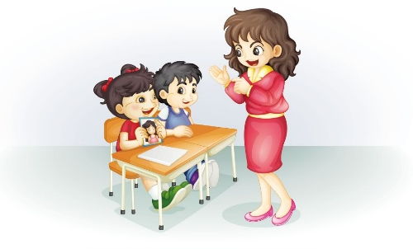
听对话，回答问题：
Is the girl’s mother a doctor?
Look! This is my mother.
Oh, she’s beautiful!

Slide 9
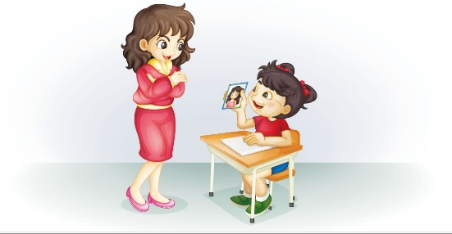
What does your mother do?
She’s a doctor.
Oh, great!

Slide 10
doctor
She’s a doctor.

Slide 11
观看动画用学过的表示职业的单词回答：What does your mother do?

Slide 12
Practice
四人一组，小组内同学各拿一张信息卡（如下图）左边同学询问右手边同学姓名、父母职业。依次交换手中的卡片，继续练习。
Name: Tom
Father: Mother:

Slide 13
Language use
假设这是一个“介绍我的爸爸、妈妈”的活动，学生拿出自己的家庭照片，介绍照片上人物以及他们的职业。
例如：Hello. My name is… This is a photo of my father. He’s a… This is my mother. She’s a…

Slide 14
