Slide 1
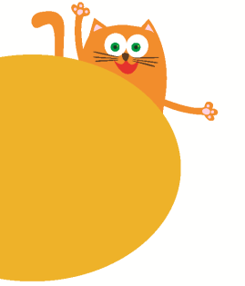
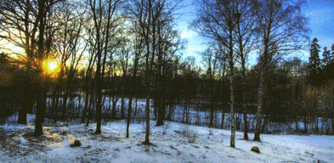
The four seasons
12
12
第二课时
WWW.PPT818.COM

Slide 2


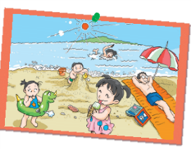
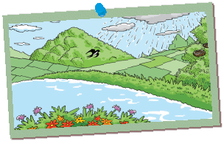
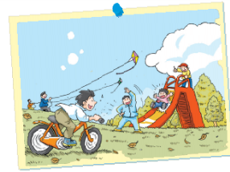
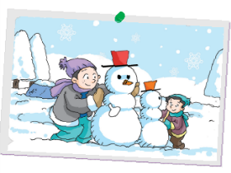
Look and chant
Spring, spring,
Nice and warm.
Spring, spring,
I like spring.
____, _____,
____ and ____.
____, _____.
I like _____.
nice and warm
cloudy and cold
sunny and hot
windy and cool
Notes:
2

Slide 3


…
seasons
colours
weather
Quick response
sunny
hot
green
golden
winter
spring
cloudy
cold
rainy
orange
black
summer
cool
autumn
yellow
warm
windy
red
blue
white
Notes:
3

Slide 4


Look and guess
What season is it?
spring
It is nice and warm.
It rains a lot.
Notes:
4

Slide 5
Look and guess
What season is it?
summer
It is sunny and hot. The sun shines in the sky.
Notes:
5

Slide 6


Look and guess
What season is it?
Autumn
It is windy and cool.
The wind blows a lot.
Notes:
6

Slide 7

Look and guess
What season is it?
It is cloudy and cold.
winter
Snowflakes dance in the air.
Notes:
7

Slide 8

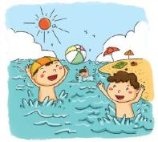
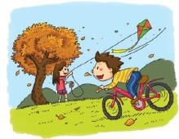
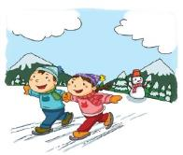
Think and chant
Spring comes before summer.
Summer comes before _______.
Warm spring, hot summer.
Cool autumn, cold winter.
Spring comes before _______.
Autumn comes before _______.
_______ comes before _______.
Notes:
8

Slide 9



Look and learn
What do you see in spring?
I see _____.
tree
Trees , flowers and grass are plants.
flower
grass
Notes:
9

Slide 10





Look and learn
The plants .
grow and grow

Slide 11

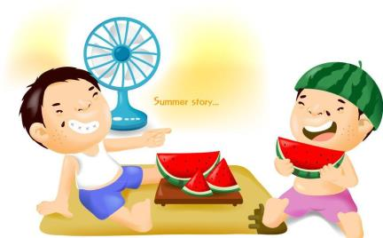
Look and learn
What do you see in summer?
I see _____.
the sun
Notes:
11

Slide 12

Look and learn
The sun shines and shines.
It’s very hot.

Slide 13
Look and learn
What do you see in autumn?
I see _____.
Notes:
13

Slide 14
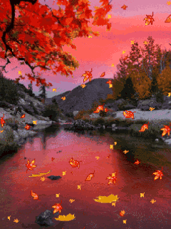

Look and learn
The leaves .
fall and fall
a leaf
leaves

Slide 15
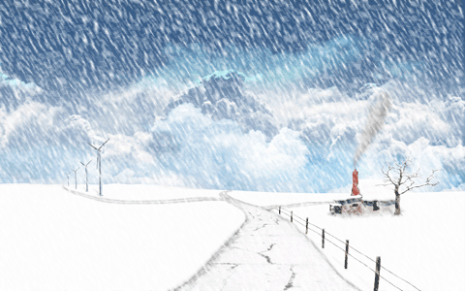

Look and learn
What do you see in _______?
I see _____.
snowman
snow
Notes:
15

Slide 16
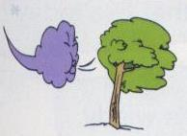
Look and learn
The wind .
blows and blows
wind

Slide 17
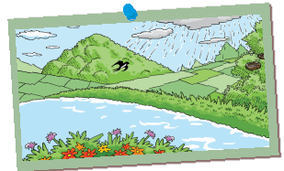
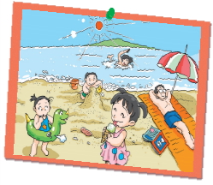
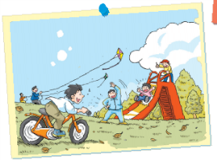
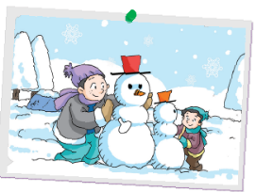
Look and chant
In spring, it is warm.
The plants grow and grow.
In summer, it is hot. The sun shines and shines.
In autumn, it is cool. The leaves fall and fall.
In winter, it is cold. The wind blows and blows.

Slide 18
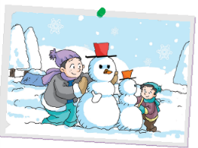



What’s your favourite?
What can you do?
Look and say
I like winter.
I can make a snowman in winter.
look, it’s funny!
What’s your favourite season?
What can you do ?
Notes:
18

Slide 19

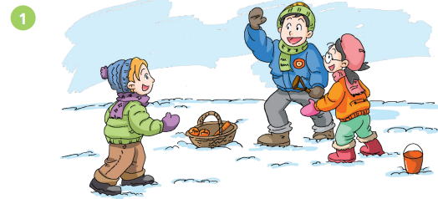
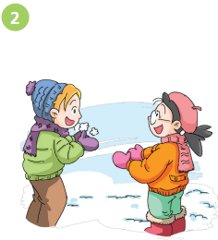
Hello, _____ ?
Peter
It’s ______.
cold
_____, it is.
Yes
Hi, Ben! ________ ?
Hi, Kitty

Slide 20
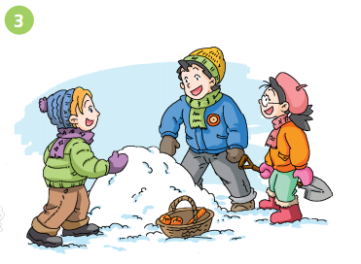
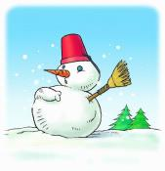
________ the snow. Let’s
make a _________, Peter.
Look at
snowman
make a snowman
OK.
Notes:
20

Slide 21
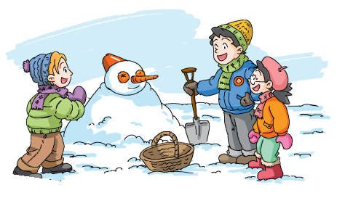
nose
Look at its _______.
It’s funny!

Slide 22
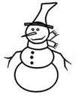



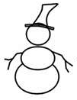
Look and draw
Look at the snowman.
Its nose is very long.
It’s funny!

Slide 23
Role-play the story

Slide 24
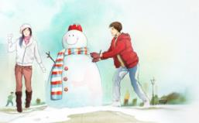
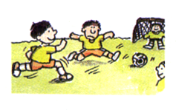
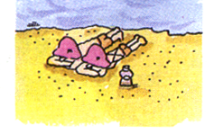
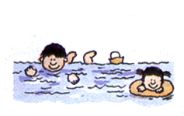
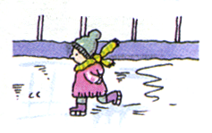
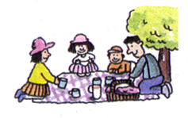
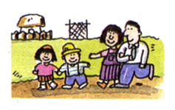
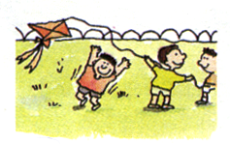
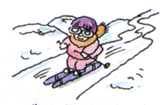
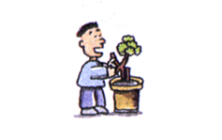
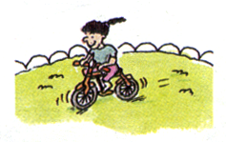
Look and say
We do different things
in different seasons.
K
F
D
H
I
C
J
L
G
E
make a snowman
play football
ride a bike
fly a kite
swim
skate
go to the beach
have a picnic
plant flowers
go to the park
ski
We can ________ in ______.

Slide 25
Group work
What can you do in ______?
Name | spring | summer | autumn | winter
swim
fly a kite
eat ice cream
go hiking
ride a bicycle
make a snowman
plant trees
play football
ski
have a picnic
skate

Slide 26
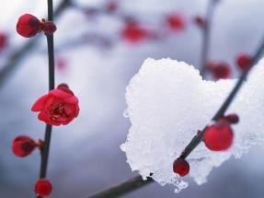

If winter comes,
can spring be far behind?

Slide 27
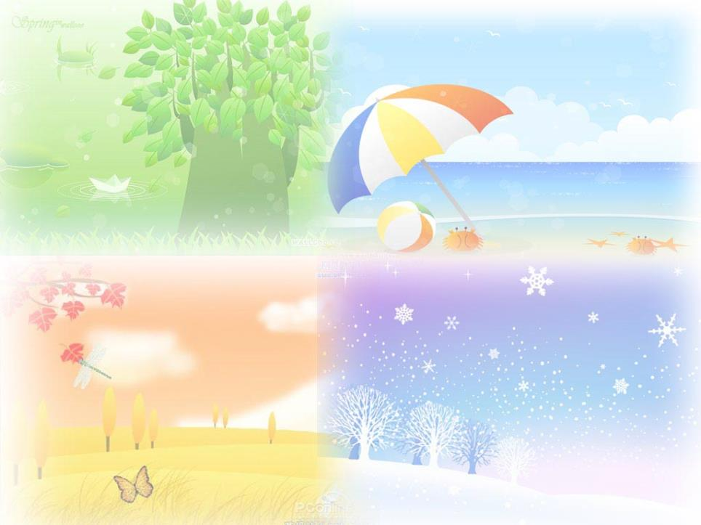
Homework
1 Listen and read Page 60.
2 Copy the sentences of Page 59.
3 Write something about activities in seasons.

