Slide 1
Module6
Unit2 The Lodon Eye is on your right
WWW.PPT818.COM

Slide 2
Learning aims
1. Get information from the reading material about some famous places in London.
2. To learn more expressions of giving directions.

Slide 3
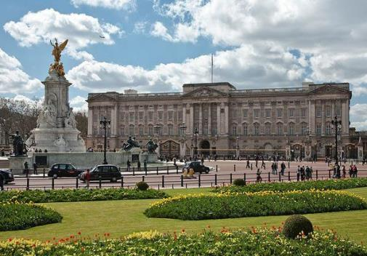
Activity 1 introduce some pictures
Buckingham Palace is the London residence and administrative headquarters of the monarch of the United Kingdom.
Buckingham Palace

Slide 4
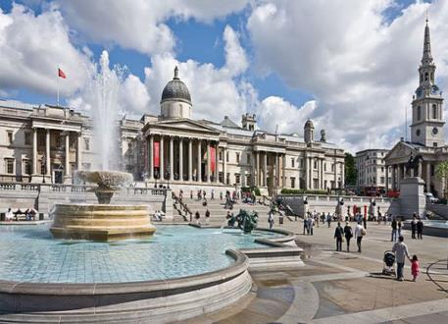
The National Gallery is an art museum in Trafalgar Square in the City of Westminster, in Central London. Founded in 1824, it houses a collection of over 2,300 paintings dating from the mid-13th century to 1900
National Gallery

Slide 5
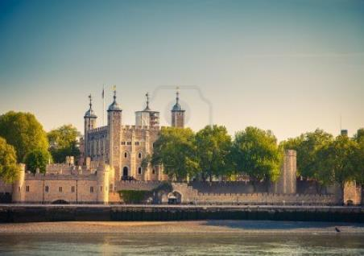
Tower of London is a historic castle located on the north bank of the River Thames in central London.
Tower of London

Slide 6
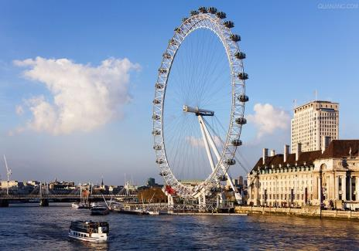
The London Eye, known for sponsorship reasons as the Coca-Cola London Eye, is a giant Ferris wheel on the South Bank of the River Thames in London.
The structure is 443 feet (135 m) tall and the wheel has a diameter of 394 feet (120 m). When it opened to the public in 2000 it was the world's tallest Ferris wheel.
London Eye

Slide 7
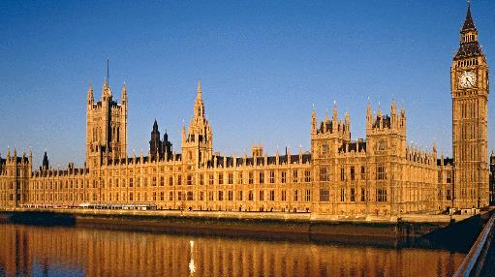
Houses of Parliament

Slide 8
Match the places with the pictures
e
c
b
d
a

Slide 9
Time for reading
第一遍，解决陌生词汇
第二遍，划出文中的方位介词短语，翻译文章

Slide 10
Time for reading
第三遍，再次读课文，然后完成课本Activity 3和学历案的思维导图

Slide 11
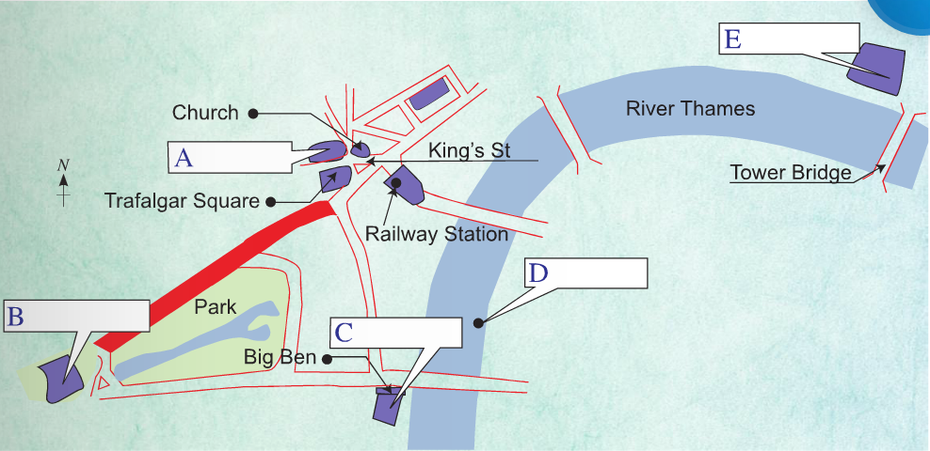
Tower of London
National Gallery
London Eye
Buckingham Palace
Houses of Parliament

Slide 12
left
boat
boat
past
left
red street

Slide 13
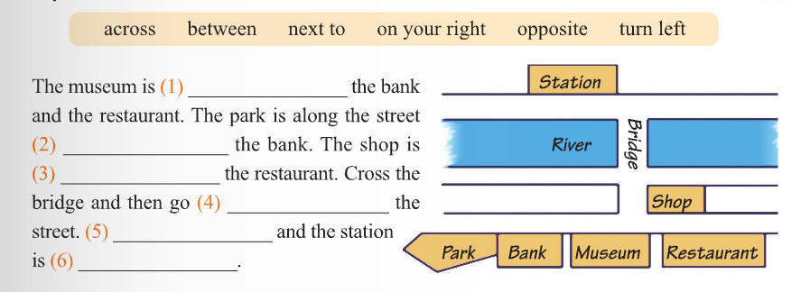
between
next to
opposite
across
Turn left
on your right

Slide 14
THANK YOU!

