Slide 1
Unit 8 Fashion Reading (I)
WWW.PPT818.COM

Slide 2
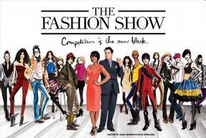
Free talk
1. Do you like watching a fashion show?
2. Do we need a host or a hostess and models at the fashion show?
Notes:
2

Slide 3
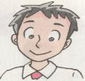
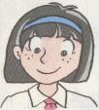
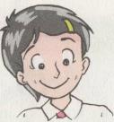
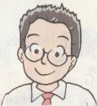
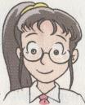
Speak out
a fashion show
hostess
models
clothes
Notes:
3

Slide 4
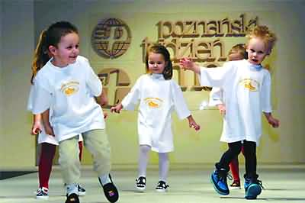
Clothes for a fashion show
a white T-shirt
a pair of black
trousers
a pair of trainers

Slide 5
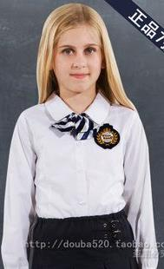
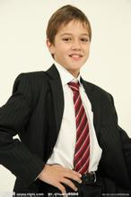
Clothes for a fashion show
blouse
shirt
tie
be made of
cotton

Slide 6
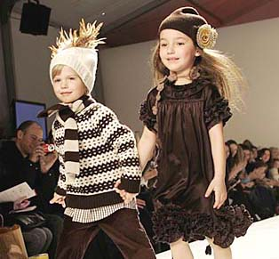
Clothes for a fashion show
sweater
dress
pl. dresses
wool
silk
scarf
pl. scarves

Slide 7
Clothes for a fashion show
a pair of boots

Slide 8
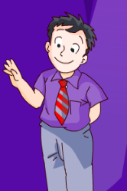
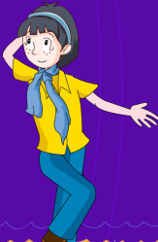
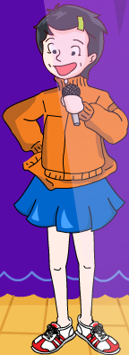
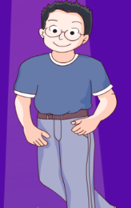
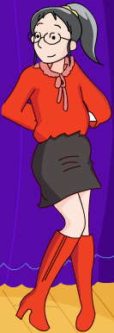
Guess: What will they wear for the fashion show?
Notes:
8

Slide 9
Fast reading
1. Where do they hold the fashion show?
They hold the fashion show at the school
hall.
2. How many students are mentioned in the
passage? Who are they?
There are 5. They are Millie, Simon,
Amy, Daniel and Sandy.
3. Who is the hostess?
Millie is the hostess.
Notes:
9

Slide 10
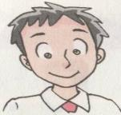
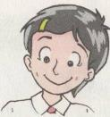
Detail reading
Read and judge
T
F
T
T
T

Slide 11
Detail reading
Read and answer
What are popular among young people?
Trainers are popular among young people.
2. What is Simon wearing?
A purple shirt, a pair of grey trousers and a red and grey tie.
3. What do young people really like?
Young people really like jeans.

Slide 12
Detail reading
Read and answer
4. What is Sandy wearing?
She is wearing red silk blouse, a black wool skirt and a pair of red boots.
5. How does Sandy look?
She looks modern and beautiful.

Slide 13
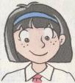
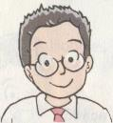
Detail reading
Read and fill in the blanks
Names | Clothes | Trousers | Scarves
a yellow cotton blouse
blue jeans
a blue scarf
a blue T-shirt
blue jeans
Both Amy and Daniel wear jeans.

Slide 14
Group work
Act it out!
(hostess): Good morning, …. Welcome to …. I’m Millie from ….
Today we are going to …. Look at me. I am wearing ….
Here comes Simon.
: I’m Simon. I am wearing …. I look ….
: Now Amy and Daniel are coming.
: I’m Amy. I am wearing … I look …
: I’m Daniel. I am wearing …. I look …
: Look! Here comes Sandy.
: I’m Sandy. I am wearing …. I look …
: That’s all ….

Slide 15
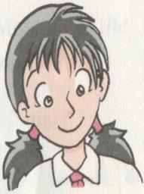
Who is the best designer?
Kitty wants to go to the fashion show.
What is Kitty wearing?
What are her clothes made of?
What colour are her clothes?
How does she look?

Slide 16
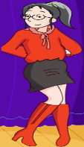
Conclusion
Fashion is a way of expressing oneself
Fashion is a way of life
Notes:
16

Slide 17
Homework
Read the new words and phrases carefully.
2.Design clothes for yourself if you want to go
to the fashion show. Write a passage about
what you will wear.
Notes:
17

