Slide 1
Unit 7 What’s the highest mountain in the world?
Section A 3a—4c
WWW.PPT818.COM

Slide 2
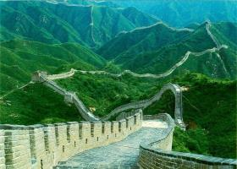
A report: Which is your favorite place?
Name | Country | Famous places | Information
Tom | China | The Great Wall | 21，196.18 meters kilometers long

Slide 3
Achieve 实现

Slide 4
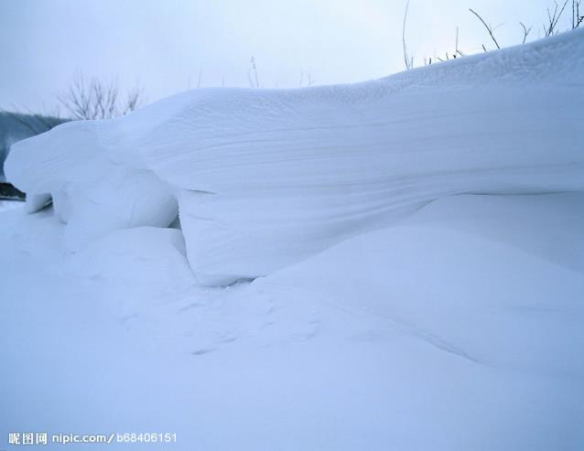
thick 厚的

Slide 5
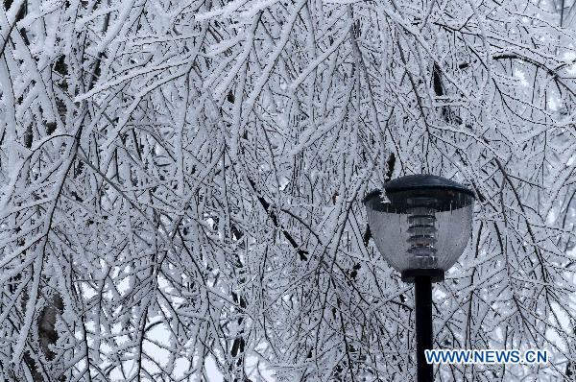
freezing 寒冷的，结冰的

Slide 6
succeed 成功，实现目标

Slide 7
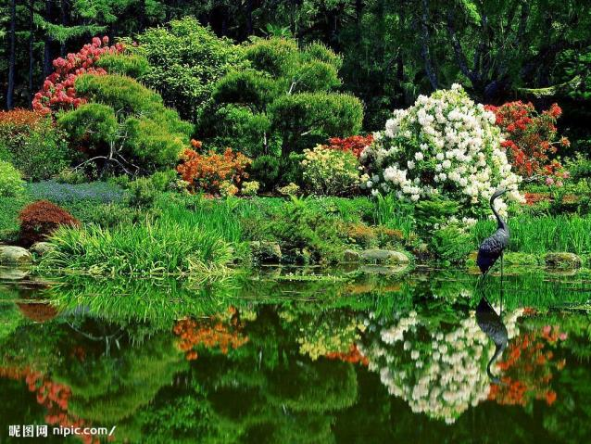
nature 自然，自然界

Slide 8
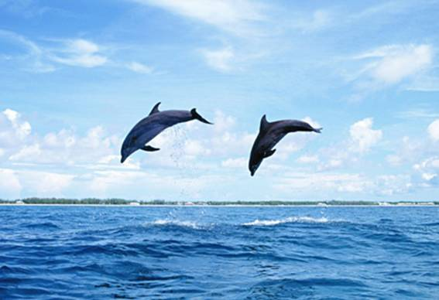
ocean 大洋，海洋

Slide 9
Do you remember the words?
1. 厚的 2. 包括 3.实现目标，成功 4.达成，完成，成功
5. force 6. nature 7. ocean 8. challenge
答案：1.thick 2. include 3. achieve 4. succeed
5. 力量 6.自然，自然界 7. 大洋，海洋 8. 挑战

Slide 10
3a
Read the article and match each paragraph with the main ideas.

Slide 11
Read the article careful. And then try to finish these questions.
( ) 1.The Himalayas run along the northwestern part of China.
( ) 2.Even though there are thick clouds on the top of the mountain, but no freezing weather conditions and heavy storms.
( ) 3.The first woman to climb was Junko Tabei from Japan in 1953.
( )4.The spirit of these climbers shows us that we shouldn’t give up trying to achieve our dreams.
答案：FFFT

Slide 12
language points
(1) mountain climbing 登山运动
Mountain climbing is very dangerous.
登山运动是非常危险的。
(2) run along 延伸到
The Himalayas run along the southwestern part of China.
喜马拉雅山脉一直延伸到中国的西南部。
(3) include 包括
The most famous singers include Lady Gaga, Katy Perry and Lisa.
最流行的歌手里包括嘎嘎女士，凯蒂和丽萨。
(4) take in 吸入
On the top of the mountain, it’s very difficult to take in air.
在山顶上，吸入空气是非常困难的。

Slide 13
(5) the first to do sth. 第一个做某事的人
He is always the first to finish homework.
他总是第一个完成家庭作业。
(6) risk one’s life 冒着生命危险
The climbers risk their lives to climb the Qomolangma.
登山者们冒着生命危险攀登珠穆朗玛峰。
(7) challenge 挑战
He takes part in the team to challenge himself.
他加入这支队伍是为了挑战自己。
(8) give up doing 放弃做（某事）
I will never give up studying.
我将永远不会放弃学习。
(9) achieve our dreams 实现我们的梦想
We should do our best to achieve our dreams.
我们应该进我们最大的努力去时间我们的梦想。

Slide 14
3b
Read the article again and complete the chart.
most famous
most popular place
even more serious difficulties
Snow
Freezing weather condition
Heavy storms
1960- The first Chinese team reached the top.
1975-The first woman to succeed was Junko Tabei from Japan.

Slide 15
Grammar Focus
A: | B:
How deep it the Caspian Sea? | It’s 1,025 meters deep.
Which is the longest river in the world? | The Nile is the longest river in the world.
Did you know that China is one of the oldest countries in the world? | Yes, I did. It’s much older than the US.
What’s the longest river in China?” | The Yangtze River.

Slide 16
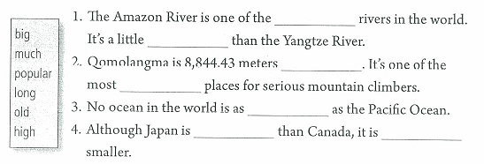
4a
Fill in the blanks with the correct forms of the words in the box.
longest
longer
high
popular
big
older
much

Slide 17
Do a survey
Ask about our city
The most famous mountain | Ermei Mountain
… | …

Slide 18
Homework
Do a survey about your favorite city.
Pay attention to the nature facts around it.
When? Where? Why? How?

