Slide 1
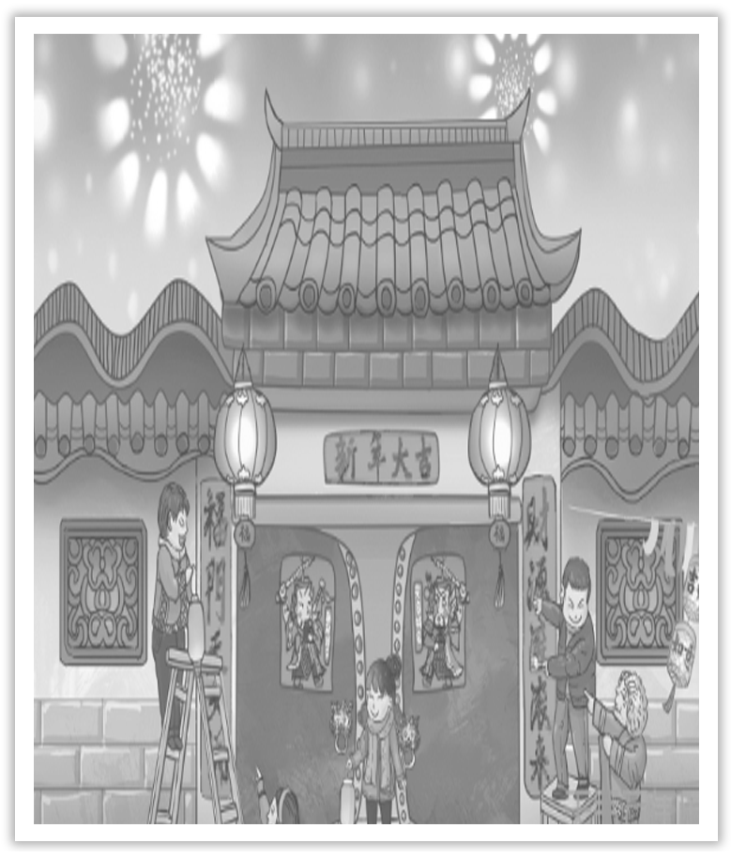
Unit 1 Festivals And Celebrations
Section Ⅵ The Rest Parts of the Unit(P_{8～12})
WWW.PPT818.COM

Slide 2
Ⅰ.单词语境记忆——根据英汉提示写出单词的适当形式
1.Each of the U.S.states has an ____________(自治的) government.
2.The warm ____________(地区) is crowded with birds.
3.Local businesses are well ____________(代表) on the committee.
4.He taught his little brother how to ____________(摔跤).
5.The dress is too ____________ (花哨的) for me.
autonomous
region
represented
wrestle
fancy

Slide 3
6.He thought for a ____________(片刻) and then spoke.
7.There was a ____________(短暂的) pause in the conversation.
8.The new teacher soon won the ____________(尊敬) of his students.
9.The label is on the ____________(in) side of the box.
10.All the car parks are ____________(absolute) full.
moment
brief
respect
inner
absolutely

Slide 4
Ⅱ.短语语境填空——根据汉语提示写出适当的短语
1.He proposed to ________________(动身) immediately.
2.We worked hard，but it ________________(值得).
3.People would gather ________________(从四面八方).
4.Our values and behaviour patterns ________________(不同于) yours.
5.________________(起初)，he was against our arrangement，but I managed to argue him round.
set off
was worth it
from near and far
are different from
At first

Slide 5
Ⅲ.句式语境仿写
1.After singing some songs，the competitors danced onto the green field，waving their arms in the air as if they were eagles.
唱了几首歌后，选手们在绿色的田野上跳起了舞，在空中挥舞着手臂，就像老鹰一样。
[仿写] 尽管他们第一次见面，他们交谈起来就像老同学一样。
Even though they met for the first time，they talked ___________________________.
as if they were old classmates

Slide 6
2.I’m finally back home now，feeling really tired，but celebrating Naadam with my friends was totally worth it.
现在我终于回家了，确实感到疲倦，但是和我的朋友一起欢度“那达慕”大会是完全值得的。
[仿写] 这张票花了我好几块钱，花得真不值得。
The ticket cost me a couple of skins and _____________________.
it was not worth it

Slide 7
记单词
Ⅰ.语境串记多义词
1.She treated her colleagues with respect and was respected in turn.
她很尊敬她的同事，反过来她也被同事尊敬。
2.When they were clapping，they would like their friends to hear their claps.
当他们正鼓掌的时候，他们想要他们的朋友听到他们的掌声。

Slide 8
Ⅱ.构词法助记派生词
名词后缀：－ing，－er
wrestle(v.)→wrestling(n.)
wrestle(v.)→wrestler(n.)
wed(v.)→wedding(n.)
句型公式
1.as if意为“似乎；好像”，相当于as though，引导方式状语从句。
2.be worth it常用来表示某事值得做。

Slide 9
1.represent vt.象征；代表；相当于；表现；描绘；正式提出
...and it is represented by three events：horse racing，wrestling，and archery，which are all so exciting to watch! (教材P₈)
它由三个项目所代表：赛马、摔跤和射箭，这些观看起来都非常令人兴奋！
[合作探究] 体会represent的用法和意义
①By way of example，he represented his own experience to us.
当作例子，他向我们____________了自己的经历。
讲述

Slide 10
②She represents the woman as the best mother in the world.
她把这个妇女描绘成世界上最好的母亲。
③He represents himself to be an expert on biology.
他____________生物学专家。
[自主发现]
④represent sth ____________ sb 向某人说明某事
⑤represent...____________ 把……描绘成
⑥represent ____________ to be... 自称是……
自称是
to
as
oneself

Slide 11
[词块积累]
represent the country代表国家
represent the past，present，and future 象征过去、现在和将来
represent the lives of ordinary people 表现普通人的生活
[巩固内化] 补全句子
①This idea ____________________________ all of us.
这个想法已经向我们所有人都说明了。
②The stranger ___________________________ a lawyer.
那个陌生人声称自己是律师。
has been represented to
represented himself to be

Slide 12
2.set off出发；动身；启程；使爆炸；引起
On the first day，I set off to the games early with my friend Burin.(教材P₈)
第一天，我和我的朋友Burin很早就出发去看比赛了。
①I set off for the company earlier in order to avoid the heavy traffic.
为了避开拥挤的交通，我早早就动身去公司了。

Slide 13
[短语记牢] 记牢下列短语
set out 动身；起程；开始做……
set about 着手做……
set aside 留出；对……置之不理
set down 写下；记下
set up 建立；创立；安排
②She sets aside a bit of money every month.她每月都存一点儿钱。
③He was asked to set down the facts just as he remembered them.
他被要求根据记忆把事实写下来。

Slide 14
[巩固内化] 单句语法填空
①A monument was set ____________ as a memorial to the dead soldiers.
②The moment she arrived home，she set about ____________ (clean) the house.
→The moment she arrived home，she set out ____________(clean) the house.
[思考] 表示“开始做某事”时set out和set about用法一样吗？
______________________________________________________________________
up
cleaning
to clean
表示“开始做某事”时，set out to do...＝set about doing...

Slide 15
3.After singing some songs，the competitors danced onto the green field，waving their arms in the air as if they were eagles.(教材P₈)唱了几首歌后，选手们在绿色田野上跳起了舞，在空中挥舞着手臂，就像老鹰一样。
【句式解读】 as if “好像；仿佛”，此处引导方式状语从句。
【用法总结】
(1)as if (though) 还可引导表语从句。引导表语从句时，可用于下面结构中：look/smell/taste/sound＋as if...“看起来/闻起来/尝起来/听起来好像(似)……”。
①It looks as if it is going to rain.
天看上去好像要下雨了。

Slide 17
[巩固内化] 补全句子
①She treats the young girl _____________________________.
她对待这个小女孩好像她是她自己的女儿一样。
②He opened his mouth _____________________________.
他张开嘴好像要说什么。
③She looks ____________________________.
她看起来好像年轻了10岁。
as if she were her own daughter
as if he would say something
as if she were ten years younger

Slide 18
④He talks about Rome ____________________________ before.
他说起罗马来好像他以前去过那里似的。
⑤Look at the clouds in the sky! It looks ______________________.Let’s hurry up.
看看天上的云彩！看起来要下雨。咱们快一点。
as if he had been there
as if it is going to rain

Slide 19
4.brief adj.简洁的；简单的；短暂的；简要的 briefly adv.短暂地；暂时地
Give a brief summary of the experience.(教材P₈)对这次经历做一个简短的总结。
[合作探究] 体会brief的用法和意义
①In brief，take no risks.
____________，不能冒险。
②To be brief，I’ll explain only the most important points.
____________，我只解释最重要的部分。
[自主发现]
③____________ brief 简言之；粗略地(着重突出重点)
④____________ brief 简而言之；长话短说
总之
简言之
in
to be

Slide 20
[词块积累]
give a brief report 做一个简短的报告
make a brief visit 作短暂的访问
[巩固内化] 补全句子
____________，I have made up my mind to perform in the concert.
→________________，I have made up my mind to perform in the concert.
简言之，我已经决定在音乐会上演出了。
In brief
To be brief

Slide 21
5.respect vt.& n.尊敬；尊重；敬意；方面
It is a day for people in China to show respect to seniors.(教材P₁₀)
在中国，这一天是人们尊敬老人的日子。
[合作探究] 体会respect的用法和意义
①We should have respect for our parents.
我们应该____________父母。
②He treats the boys with respect and teaches them to respect themselves.
他以尊重之心对待这些男孩，也教导他们尊重自己。
③Out of respect，we’d better ask him for advice on this matter.
____________，我们最好就此事征求他的建议。
尊敬
出于尊重

Slide 22
[自主发现]
④have respect ____________ sb＝show respect ____________ sb 尊重某人
⑤____________ respect 尊敬地；尊重地
⑥____________ respect 出于尊重
for
to
with
out of

Slide 23
[词块积累]
respect yourself尊重你自己
win the respect of his students 赢得学生们的尊重
respect the ideas of others 尊重别人的意见
[巩固内化] 补全句子
①If you want ______________________，you must ________________ first.
如果你想别人尊重你，那首先你必须尊重自己。
②As a general rule，always _____________________________ people older than you.
就一般而言，总要尊敬比你年长的人。
to be respected
respect yourself
show respect to/have respect for

