Slide 1
Module 12 Save our world
Unit 2 Repeat these three words daily:
reduce, reuse and recycle.
WWW.PPT818.COM

Slide 2
Words Review
china
divide
plastic
policy
reuse
bottle
throw away
n. 瓷；瓷器
v. 分开
n. 塑料
adj. 塑料的
n. 政策；方针
v. 再次使用；重复利用
n. 瓶
扔掉；丢弃

Slide 3
Words Review
repeat
reduce
cloth
ton
tons of
rubber
v.重说；重新做
v. 减少；减低；缩小
n. 布；布料
n. 吨
许多；很多
n. 橡胶

Slide 4
Words Review
recycling
rapid
step
grandson
granddaughter
n. 回收利用
adj. 快速的；迅速的
n. 步骤；措施
n. (外)孙子
n. (外)孙女

Slide 5


What does this symbol mean?
Recycling

Slide 6
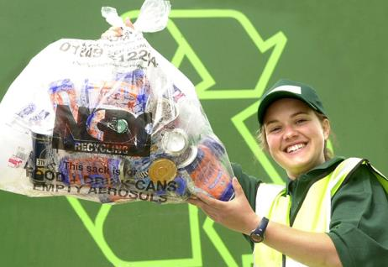
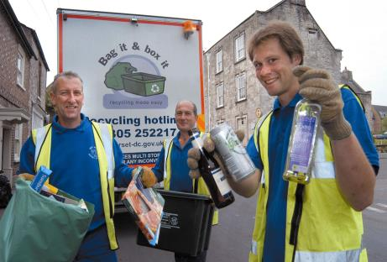
recycle bottles

Slide 7
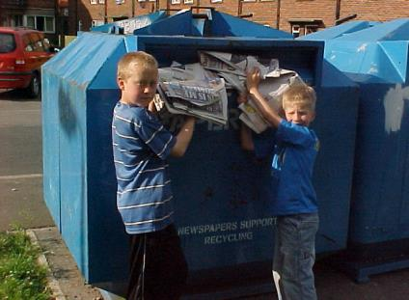
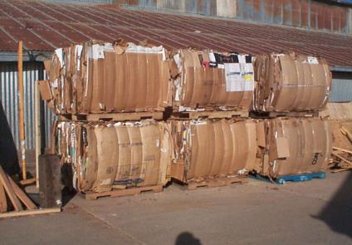
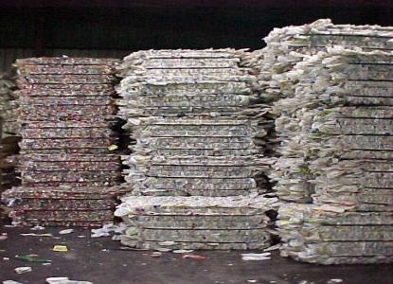
paper-recycling

Slide 8
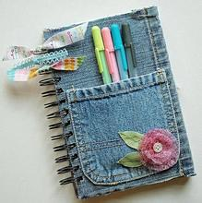
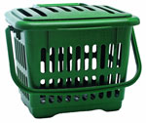
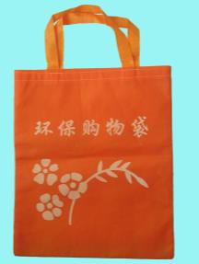

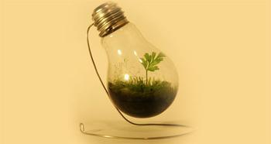
Reuse

Slide 9
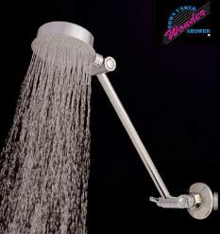
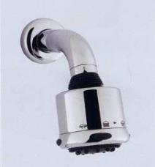
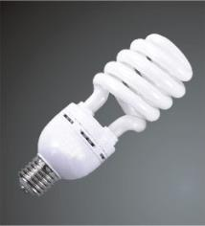

Reduce
Use low-flow shower heads.
replace
with
Use energy
saving light bulbs.

Slide 10

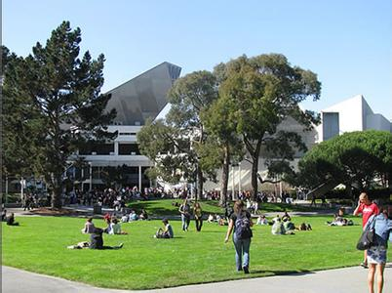
Remember these three words:
reduce
reuse
recycle

Slide 11



Objectives:
1. Understand the main idea of the passage and predict what the passage will include
2.To learn some key words and useful expressions about environment
3. To make suggestions and give reasons using because, so and so that

Slide 12

Words:
divide bottle repeat rubber rapid grandson/granddaughter
Phrases:
throw away take steps tons of
Patterns:
Look after them so that they will last.
It is better to use china cups and cloth bags because they can be used many times.

Slide 13
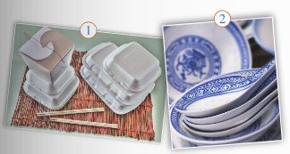
P98
1
Look at the pictures below and describe them. Say which ways are good for the environment and why.
These are some bowls and spoons made of china.
good for the environment
We can use them many times.
We shouldn’t use disposable food box or disposable chopsticks.

Slide 14
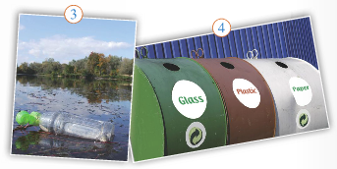
We can save energy.
good for the environment
Someone threw an empty bottle in a river.
There are three rubbish bins for recycling, so please divide the waste before you throw things into them.

Slide 15

P98
2
Look at the title of the passage. What suggestions do you think the passage will make? Use the words in the box to help you.
china divide necessary plastic policy reuse
How to be green

Slide 16
Possible answers:
☺It is better to use china cups and bowls because they can be used many times.
☺It is better to divide the waste into things to recycle and things to throw away.
☺It is necessary to use less plastic bags.
☺You should make a recycling policy for your classmates and yourself.
☺…

Slide 17
Task 1
Do a survey
* Do you walk or ride a bike to school?
* Do you buy new clothes just because they are modern?
* Do you turn off the lights when you leave the room?
* Do you take your own bag when shopping and not ask for a plastic bag?
* Do you buy drinks in bottles? And what do you do with the bottles when they are empty?
* Do you divide the waste into things to recycle and things to throw away?

Slide 18
P99
Task 2
4
Read the suggestions. Look through the passage and check(√) which suggestions are mentioned in the passage.
√
5. Repair things.
6. Divide rubbish into different groups.
7. Collect waste or rubbish to raise money.
8. Burn things to save money.
√
1. Order food that you can finish.
2. Use less electricity at home.
3. Learn ways to recycle rubbish.
4. Use paper cups and paper bags.
√
√
√
×
×
×

Slide 19
 |  | Reasons
Two things you should do
Two things you should not do
Task 3
Walking or riding a bike doesn’t burn oil or cause air pollution.
P99
Walk or ride a bike to school.
Use your answers to write sentences.
5
Find two things you should do and two things you should not do in the passage. Give reasons. Complete the table.
Use china cups and cloth bags.
China cups and cloth bags can be used many times.
For example:
We should recycle rubbish because it can help us protect the environment.
Buy new clothes just because they are modern.
Old things can be as good as new ones.
It’s better to change things into something else than throwing them away or burning them.
Throw things away without recycling.

Slide 20
divide granddaughter plastic policy rapid recycle repeat step ton
Task 4
P99
tons
We throw away (1) ________ of rubbish every year. If we want a clean world for our grandsons and (2) ____________, we have to reduce, reuse and (3) _________. (4) _________ these three words every day. The first (5) _________ is to use less. The second is to use things as long as possible. Then (6) ________ your rubbish into (7) _________, paper, rubber and glass. Finally, draw up a recycling (8) __________ for your community. We cannot hope for (9) __________ change, but every little bit helps!
6
Complete the passage with the correct form of the words in the box.
granddaughters
recycle
Repeat
step
divide
plastic
policy
rapid

Slide 21

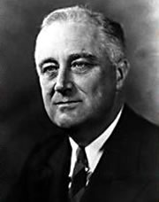
A nation destroying its
environment
destroys itself.
------ F.D. Roosevelt
（小罗斯福）

Slide 22
Language points
1. Do you divide the waste into things to recycle and things to throw away.
你们讲废物分成要回收的和需丢弃的吗？
throw away表示“扔掉；丢弃”。
你打算什么时候扔掉那些旧杂志？
When are you going to throw away those old magazines?
多年前我就把那些裤子扔掉了。
I threw those trousers away years ago.

Slide 23
divide…into…表示“把……分成……”。例如：
Divide the dough into four parts and make each into a ball.
把面团分成四部分，然后把每一部分弄成球状。
The book is divided into six sections.
这本书分为六部分。

Slide 24
2. Although is takes energy to change things into something else, it is better than throwing things away or burning them.
虽然把一种东西变成另一种东西会消耗能源，但是也比把它们扔掉或烧掉好。
change…into…表示“把……变成……”。例如：
You cannot change iron into gold.
你无法把铁变成金子。

Slide 25
3. We cannot hope for rapid change, but let’s take these simple steps today…
我们不能期待立竿见影的变化，但是让我们从今天开始采取这些简单的措施吧……
take steps的意思是“采取措施”。
我们需要采取一些措施来减少污染。
We need to take some steps to reduce pollution.

Slide 26
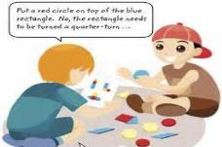
Make a list of things you can do to make your school greener.
Pair work
* Don’t throw bottles away.
* Write or print on both sides of the paper.
* Bring your own chopsticks from home and reuse them.
* Don’t use disposable cups or plates, either.
* Put paper, plastic, glass and metal in the recycling bins.

Slide 27
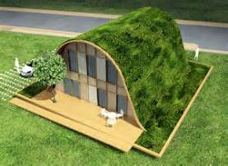

P99
8
Write a passage on how to make your school greener and give reasons. Use the list you have made in Activity 7 to help you. Use because, so and so that.
Don’t throw bottles away because it is a better to recycle them.

Slide 28
Possible answer
Help Make a Green School!
We can do many things to make our school green. Remember the three most important words: reduce, reuse and recycle!
Reduce
Many people waste paper because paper is cheap. But we should use less paper so that we can save trees. Make sure you write or point on both sides of the paper so that nothing is wasted. This simple tip will cut your paper usage in half!

Slide 29
Reuse
Many people like disposable cutlery because they don’t have to wash up. But these things aren’t green. Bring your own chopsticks from home and reuse them. Don’t use disposable cups or plates, either.
Recycle
We all eat and drink at school every day, so there are plenty of wrappers, bottles and cans to dispose of. But don’t just throw your bottles, wrappers and cans in the rubbish bin — support the school’s recycling programme! Put paper, plastic, glass and metal in the recycling bins.
Follow these steps and we’ll all have a green school!

Slide 30

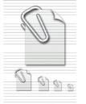
Quiz
注: word 文档
点击此处链接
Ⅰ.用方框中词的适当形式填空。
reuse plastic necessary reduce
1. It’s _________ to protect our earth right now.
2. — Let’s ________ these old newspapers to make some decorations.
— That’s a good idea.
3. We can all help _______ air pollution.
For example, walk or ride a bike to school.
4. ________ bags are bad for the environment for many reasons.
necessary
reuse
reduce
Plastic

Slide 31
Ⅱ. 根据提示翻译句子。
1. 他们正在使沙漠变为农田。(change… into)
______________________________________
____________________________
2. 我们一定要采取措施使这样的事不再发生。(take steps)
______________________________________
_____________________________
3. 电池能被回收，不要扔掉它们。(throw away)
_____________________________________
____________________________
They are changing desert into farmland.
We must take steps to prevent this from happening again.
Batteries can be recycled. Don’t throw them away.

Slide 32

Homework
1. Preview the rules of word building.
2. Read the articles in Learning English.

