Slide 1
Unit4 Do you like candy?
人教精通版三年级下册
WWW.PPT818.COM

Slide 2
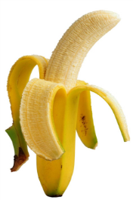
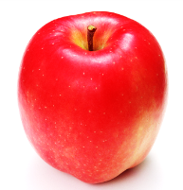
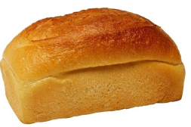
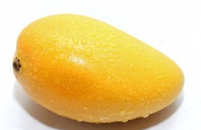
Warm-up
Let’s review
I like … / I don’t like …
What about you?

Slide 3
Presentation
Look and say
你能看出下面图形中的字母吗？

Slide 4
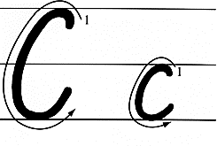
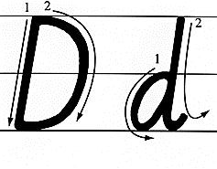
Presentation
Let’s learn

Slide 5
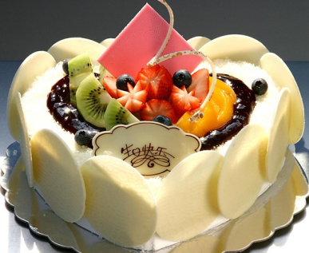
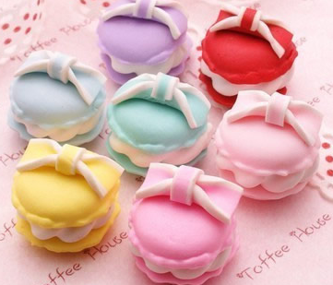
Presentation
Let’s learn
cake
cakes

Slide 6
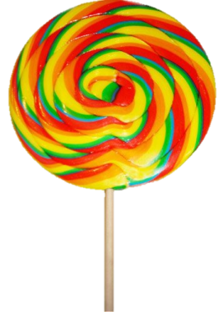
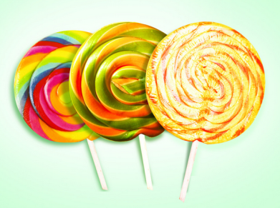
Presentation
Let’s learn
candy
candies

Slide 7
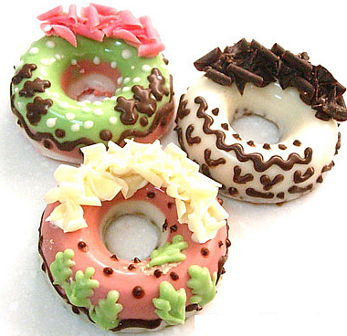
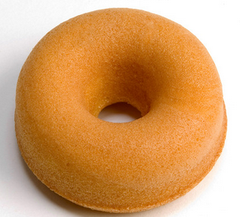
Presentation
Let’s learn
doughnut
doughnuts

Slide 8
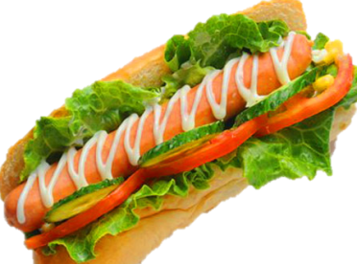
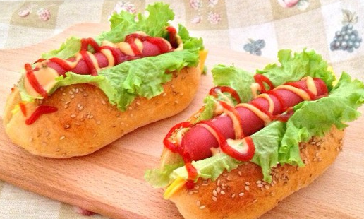
Presentation
Let’s learn
hot dog
hot dogs

Slide 9
Practice
Game1
大小声
cake candy doughnut hot dog

Slide 10
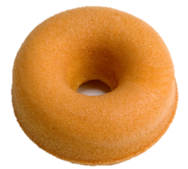
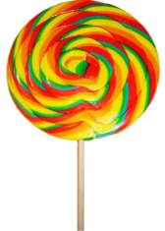
Practice
Game2
What’s missing?

Slide 11
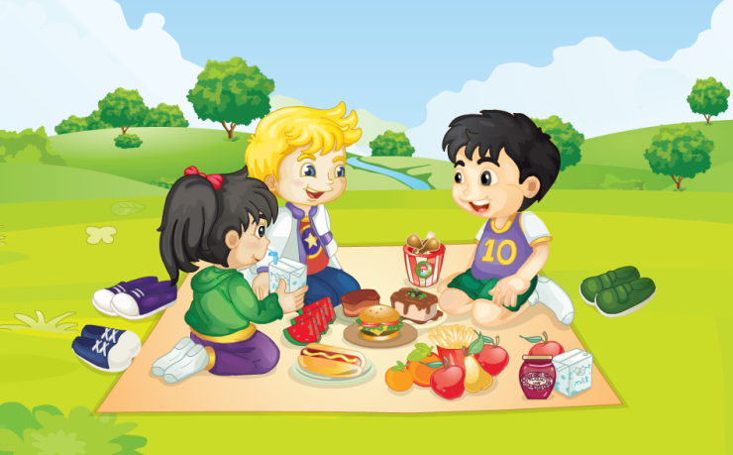
Presentation
Look and say
What are they talking about?

Slide 12
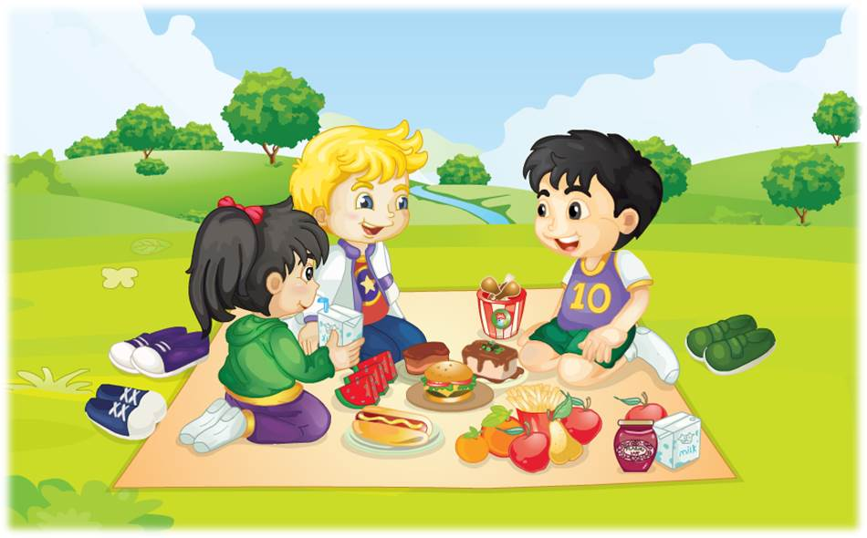
Presentation
Let’s learn
No, thanks. I don’t like cakes. I like hot dogs.
Have a cake, Gao Wei.

Slide 13
Presentation
Let’s learn
Thanks.
OK. Here you are.

Slide 14
Presentation
Key points
让某人吃点东西可以说：
Have a / some …
把某物给某人可以说：
Here you are.

Slide 15
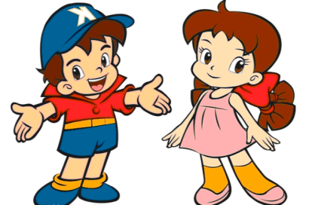
Practice
Role play
三人一组练习Just talk部分对话，随后表演出来吧！

Slide 16
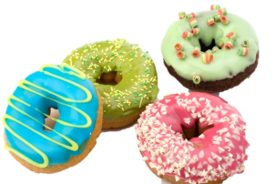
Practice
看图对话
A: Have ____ ________.
B: No, thanks. I don’t like
________. I like ____.
A: __________.
B: Thank you.
some
doughnuts
doughnuts
cakes
Here you are

Slide 17
Practice
Let’s chant

Slide 18
Summary
本课学到的重点单词：
cake candy doughnut hot dog
本课学到的重点句型：
—Have a cake, Gao Wei.
—No, thanks.

Slide 19
Homework
1. 跟读课文Just talk部分的录音，注意语音、语调。
2. 熟练背诵并书写字母 Aa 至 Dd。
3. 把学会的食品名称说给爸爸、妈妈或朋友听。
4. 预习本单元Lesson 21的内容。
Close

