Slide 1
Unit 5 I Love Learning English!
A Phone Friend
WWW.PPT818.COM

Slide 2
Learning targets
1. Be able to use the words: foreign, could, loudly, understand, cartoon, Canadian, no problem, have a good talk, ask sb.to do sth., by oneself
2. Learn to make a call in English and learn how to practice English
3. Learn some key sentences:
(1)Can I speak to Jenny, please?

Slide 3
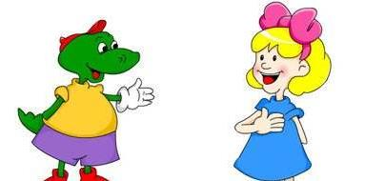
(2)Could you speak more loudly？
(3)Now I understand.
(4)I practice by myself a lot.
(5)Jenny and Li Jing have a good talk.
(6)Jenny asked me to speak more loudly.

Slide 4
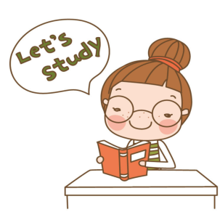
Lead in
Do you like to phone friends?
Can you phone your friends in English?
How do you practice your English?
PPT模板：www.1ppt.com/moban/ PPT素材：www.1ppt.com/sucai/
PPT背景：www.1ppt.com/beijing/ PPT图表：www.1ppt.com/tubiao/
PPT下载：www.1ppt.com/xiazai/ PPT教程： www.1ppt.com/powerpoint/
资料下载：www.1ppt.com/ziliao/ 范文下载：www.1ppt.com/fanwen/
试卷下载：www.1ppt.com/shiti/ 教案下载：www.1ppt.com/jiaoan/
PPT论坛：www.1ppt.cn PPT课件：www.1ppt.com/kejian/
语文课件：www.1ppt.com/kejian/yuwen/ 数学课件：www.1ppt.com/kejian/shuxue/
英语课件：www.1ppt.com/kejian/yingyu/ 美术课件：www.1ppt.com/kejian/meishu/
科学课件：www.1ppt.com/kejian/kexue/ 物理课件：www.1ppt.com/kejian/wuli/
化学课件：www.1ppt.com/kejian/huaxue/ 生物课件：www.1ppt.com/kejian/shengwu/
地理课件：www.1ppt.com/kejian/dili/ 历史课件：www.1ppt.com/kejian/lishi/

Slide 5
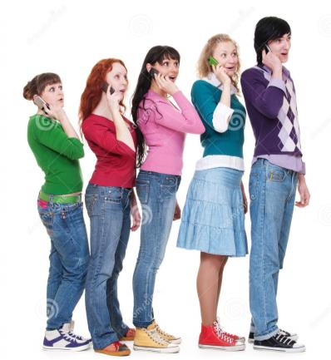
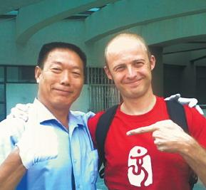
phone friend
foreign friend

Slide 6
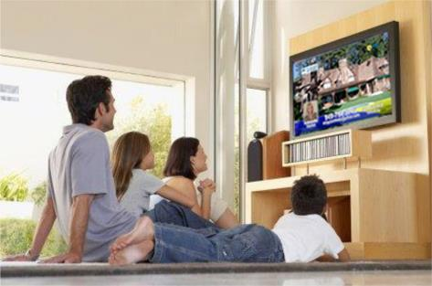
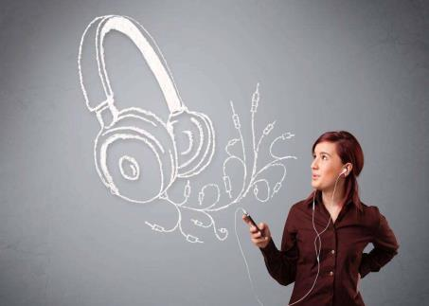
watch English TV shows
listen to English songs

Slide 7
Words and expressions
foreign
could
loudly
understand
cartoon
Canadian
no problem
have a good talk
ask sb.to do sth.
by oneself
adj. 外国的
v. aux. 能；可能
adv. 高声地，大声地；吵闹地
v. (understood/understood) 懂得；理解
n. 动画片；漫画
adj. 加拿大(人)的 n. 加拿大人
没问题
好好谈一谈
叫某人做某事
单独地，亲自

Slide 8
Presentation
Li Jing is learning English. She wants to practice her English with a foreign friend, but she doesn't have any. So Li Ming calls Jenny.
Li Ming：Hello. Can I speak to Jenny, please?
Jenny：Yes. This is Jenny speaking. Is that you, Li
Ming？How are you?
Li Ming：Good！Are you free now？My cousin, Li
Jing, would like to speak to you.
Jenny：OK! No problem!

Slide 9
Li Jing：Hello, Jenny！This is Li Jing. I'm happy to
talk with you.
Jenny：Hi, Li Jing！I'm sorry. I can't hear you very
well. Could you speak more loudly?
Li Jing：Sorry, I can't follow you. Please say that again.
Jenny：OK. Could you speak more loudly?
Li Jing：Yes. Now I understand.
Jenny：Good！You speak English very well. Do you
like learning English?

Slide 10
Li Jing：Yes. I love learning English.
Jenny：That's great！How do you practice?
Li Jing：I practice by myself a lot.
Jenny：How do you practice by yourself?
Li Jing：I watch many English TV shows and
cartoons. I also listen to English music.
Jenny and Li Jing have a good talk. Now, Li Jing has a Canadian friend!

Slide 11
Task-Reading
Read and answer the questions.
1.Dose Li Jing have a foreign friend at first?
2.Can Li Jing follow Jenny when they are talking on
the phone?
3.How dose Li Jing practice her English?
No, she doesn't. /No, she dosen't have any.
No, she can’t.
She practices by herself a lot . she watches many English TV shows and cartoons. she also listens to English music.

Slide 12
Let’s Do It!
1. Listen and write true(T) or false(F).
1.Jenny calls Li Ming from Canada. （ ）
2.Li Jing is Li Ming's cousin. （ ）
3.Li Jing loves learning English. （ ）
4.Li Jing practices her English by speaking to Li
Ming. （ ）
F
T
T
F

Slide 13
2. Read the lesson and fill in the blanks. The first
letter is given.
I love learning English. I p________English every day by myself. But today I t________ to a foreign friend. Her name is Jenny. She is Li Ming's friend. At first, we couldn't u__________each other very well. Jenny asked me to s________ more loudly. And I couldn't f________her. But later, we h____a good talk. I have a Canadian friend now. I feel so happy.
ractice
alked
nderstand
peak
ollow
ad

Slide 14
3. Fill in the blanks with the correct forms of
the given words.
1. This work is too hard. I can't do it by _______ (me)．
2. Jenny comes from Canada. ________(she) friend, Li
Ming, is from China.
3. You can learn this song by ________(you)．
4. Jim is an American boy. But ________(he) Chinese is
very good.
5. How do you practice English by ________ (you)？
myself
Her
yourself
his
yourself

Slide 15
4. Work in pairs. How do you practice your
English？Make up a dialogue.
Example：
A：How do you practice your English？
B：I practice by myself.
A：How do you practice by yourself？
B：...

Slide 16
Grammar
一、情态动词can的用法
1．表示能力，意为“能，会”。
例：Can you drive？你会开车吗？
2．表示客观可能性，意为“会，可能”。
例：He can be very friendly at times.有时他会很友
好。

Slide 17
3．表示请求允许(和may意思相近)，意为“可以，
能够”。
例：Can I use your pen？我可以用你的钢笔吗？
4．表示惊异、不相信等(用于疑问句或否定句中)，
意为“会，可能”。其否定形式can't意为“不可
能”。
例：This can't be true. 这不可能是真的。
Xi’an—the Walled City

Slide 18
【学以致用】
1．—It's said that nuclear power will be used to
produce electricity in Xianning.
—However, nuclear power ________ be very
dangerous. (湖北咸宁中考)
A. can B. need C. must D. should
A

Slide 19
A
2．—________you tell me the differences between these two
photos?
—No. They look quite similar, nearly the same.
(四川乐山中考)
A. Can B. May C. Must
3．—We've ordered too much food. I________eat any more.
—Never mind. Let's take it home.(浙江温州中考)
A．can't B．mustn't C. needn't D. shouldn't
A

Slide 20
二、反身代词的用法
（一）反身代词是一种表示反射或强调的代词，意为“……自己”。反身代词与它所指代的名词或代词形 成互指关系，在人称、性质、数上应保持一致。
（二）反身代词的基本形式：
人称&数 | 单数 | 复数
第一人称 | myself | ourselves
第二人称 | yourself | yourselves
第三人称 | herself, himself, itself | themselves

Slide 21
（三）反身代词的用法：
1. 作宾语，表示主语和宾语是同一个(或一些)人或事
物。例：The child can dress himself.这个孩子能自
己穿衣服。
2. 作同位语，常用来加强语气。例：I can make
donuts myself now.现在我能自己做面包圈了。
（四）含反身代词的常用短语：
by oneself 独自；teach oneself 自学；enjoy oneself 玩
得开心，过得愉快；help oneself to 随便吃/用……

Slide 22
【学以致用】
1．—Did anyone call me when I was out?
—Yes. A man who called________Tom.
(浙江温州中考)
A．myself B．himself
C．herself D．yourself
2．Nowadays I can choose online courses and study
by________.(上海中考)
A．I B．me C．my D．myself
B
D

Slide 23
Language points
1. Can I speak to Jenny, please?
“Can I speak to..., please？”是电话用语，意思是
“请找……接电话，好吗？”。其中can 可以用may、could等替换。回答此句可用 “This is...speaking. /Speaking, please.”，意思是 “我就是……”；也可用“Hold on, please./ Wait a moment, please.”，意思是“等一等，别挂断”，或者用“Sorry, ...isn't in.”，意思是“对不起，……不在”。

Slide 24
2. Could you speak more loudly？
loudly作副词，意为“高声地；大声地；吵闹地”。more loudly 是loudly的比较级。
【辨析】loudly、aloud与loud
三者都可以表示“大声地”，但在用法上有区别。
① loudly 意为“响亮地”，其基本意义与 loud 相同，常与 ring、knock等动词连用。loudly 放在动词前后均可，暗含有“喧闹”或“嘈杂”的意味。例:Suddenly the bell on the wall rang loudly.突然，墙上的铃大声地响起来。

Slide 25
②aloud 强调发出的声音能被听见，意思是“出声地，大声地”，常与read、call等动词连用。例：Please read the text aloud. 请大声朗读课文。
③loud 意为“响亮地，大声地，高声地”，侧重于发出的声音大、传得远，一般多用来修饰 speak、talk、laugh等动词。例：Speak louder, please, or no one will hear you.请大声些，否则没人能听见你说话。

Slide 26
【学以致用】
They laughed so ________ that we couldn't do anything in the room.
A．aloud B．loud
C．loudly D．quietly
B

Slide 27
3. Now I understand.
understand在此处作不及物动词,意为“明白，理解，懂得”，不能用于进行时态。它还可作及物动词，其后可接名词、代词以及“疑问词＋从句/to do”作宾语。
例：I think you will understand at last.
我想你最终会明白的。
Do you understand what his meaning is？
你理解他是什么意思吗？

Slide 28
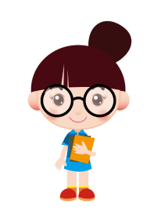
4．I practice by myself a lot.
(1)by oneself 意为“独自，单独地”, 在句中常作状语。(2)a lot作副词修饰动词，有两个用法：一是表示程度，意为“很、非常”等；二是表示频率，意为“经常”。它在该句中表示的是频率，意为“经常”。当它表示程度时，相当于very much。
例：He has helped me a lot. 他经常帮我。
She goes abroad a lot. 她常常出国。

Slide 29
【学以致用】
—Hi, guys. How was your party yesterday?
—Wonderful！We had a big meal and enjoyed
______.
A．themselves B．myself
C．yourselves D．ourselves
D

Slide 30
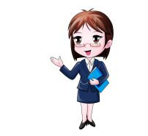
5. Jenny asked me to speak more loudly.
ask sb. to do sth. 叫某人做某事。其否定结构是在to前面加上not，即：ask sb.not to do sth.叫某人不要做某事。例：My parents often ask me not to swim in the river alone.我父母总是叫我不要一个人去河里游泳。
Xi’an—the Walled City

Slide 31
Exercises
Ⅰ. 选词并用其适当形式填空。
I foreign loud Canada understand
1. Jim is a _________, and he lives in Toronto(多伦多).
2. It’s very interesting to learn some ________words.
3. Our English teacher spoke very clearly, so we all
__________ him well.
4. I could go to school by ______ when I was seven years
old.
5. If you speak more _______, everyone can hear you.
Canadian
foreign
understood
myself
loudly

Slide 32
Ⅱ.翻译下列句子，每空一词。
1. 你能说得更慢点吗？
Can you speak _____ ______?
2. 我听不太清楚你说什么。
I can’t _____ you very _____.
3. 我们应该好好谈谈。
We should _____ a _____ _____.
4. 有些学生并不理解他们的父母。
Some teenagers don't __________ their parents.
more slowly
hear well
have good talk
understand

Slide 33
Summary
1. Learned to make a call in English and knew
how to practice English.
2. Be able to use the useful words : foreign,
could, loudly, understand, cartoon, Canadian,
no problem, have a good talk, ask sb.to do
sth., practice by oneself.

Slide 34
Homework
1.How do you usually practice your
English? Make up a dialogue
about it. Then talk about it with
your classmates.
2. Finish the exercises of this lesson.

