Slide 1
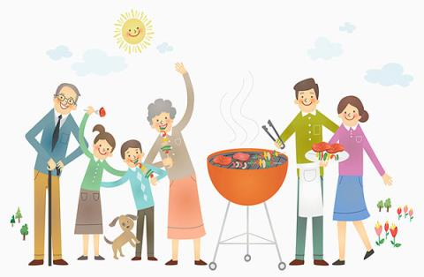
Unit 5
A party
第二课时
WWW.PPT818.COM

Slide 2
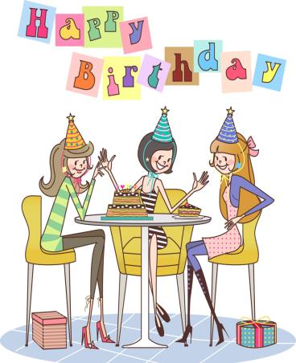
Introduce
T：Hello, boys and girls!
Ss: Hello, Miss Tang.
T: Nice to see you.
Ss: Nice to see you, too.

Slide 3
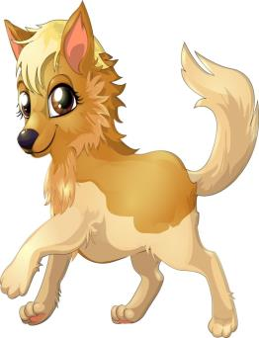
Words
lovely [ˈlʌvli]
基本意思是“可爱的,吸引人的”
eg：She is a lovely girl.
她是一个漂亮的女孩。
小练习：汉译英：
这个可爱的小男孩长着漂亮的金黄色卷发。
____________
The lovely boy has beautiful blonde curls.

Slide 4
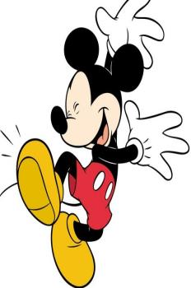
Words
snow [snəʊ]
名词，通常是不可数，意为“雪”；
形容词形式为snowy。
eg：We had a heavy snow last night.
昨晚下了场大雪。
In Canada, it often snows in March.
在加拿大，经常是在三月下雪。
There is lots of snow in winter.
【实践】汉译英：冬天有很多雪 ____________

Slide 5
Expressions
Look out of the window. 看窗外。
look out of 意为：看
eg：Don't look out of the window in class.
上课时别往窗外看。
小练习：汉译英：我从窗口往外张望时，
看到许多小孩一面玩耍一面叫嚷。
Look out of the window, I see a lot of children play and yell.
拓展：同义词组：look out at。
look out of 意思是透过什么往外看；look out at,是看外面的什么。

Slide 6
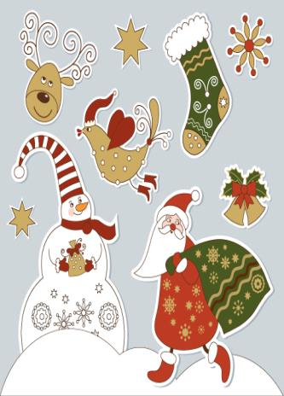
Dialogue
Look out of the window. At the lovely snow. Does anybody know why we have snow?
看窗外可爱的雪，有人知道为什么会下雪吗？

Slide 7
Summary
Look
Lovely
Snow
Look out of the window.
Does anybody know ?

Slide 8
Exercise
单项选择
（ ）1. There ______ a meeting tomorrow afternoon.
A. will be going to B. will going to be C. is going to be D. will go to be
（ ） 2. Charlie ______here next month.
A. isn’t working B. doesn’t working
C. Isn’t going to working D. won’t work
（ ） 3. He ____ very busy this week, he _____ free next week.
A. will be; is B. is; is C. will be; will be D. is; will be
C
D
D

Slide 9
Exercise
（ ） 4. There __ a dolphin show in the zoo tomorrow evening.
A. was B. is going to have C. will have D. is going to be
（ ）5. ________ you ________ free tomorrow?
No. I ________ free the day after tomorrow.
A. Are; going to; will B. Are; going to be; will
C. Are; going to; will be D. Are; going to be; will be
D
D

Slide 10
Exercise
把下列各句译成英语。
1.我叔叔今晚要来。
My uncle __________________．
2.他没有打算住那座小屋。
He _________________ in the small house．
3.我们要阅读这本书。
We __________________ this book．
4.你爸爸要去钓鱼吗?不，他要去游泳。
--______ your father ___________________________？
--No，he is ________________．
is going to come
isn’t going to live
are going to read
Is
going to go fishing, going to swim
going to swim

Slide 11
Homework
Go to a part!

