Slide 1
Unit 8 How do you make a banana milk shake?
WWW.PPT818.COM

Slide 2
Have a review
How many /How much
How many apples/oranges/bananas…
do you need?
I need three apples/oranges/bananas...
How much yogurt/water… do you need?
I need one teaspoon/cup of it.

Slide 3
1、How many + 可数名词复数形式 + -------？
eg. How many students are there in our class?
There are sixty one./ sixty one.
2、How much + 不可数名词 + -------？
eg. How much water do you drink every day?
I drink five glasses./Five glasses.
(注：回答不可数名词量多少时，数词后一定要有容器量词) e.g. a cup of tea two glasses of water three pieces of paper four teaspoons of cinnamon

Slide 4
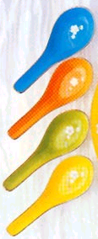
Practice:
A: How many bananas are there in the picture?
B: There are three ./Three.
A: How much milk are there in the picture?
B: There are two cups./Two cups.
A: How many watermelons do you eat every day?
B: I eat four./Four.
A: How much honey do you drink every day?
B: I drink four teaspoons./Four teaspoons.

Slide 5
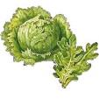
Group work
First ….
Next…
Next…
Then …
Finally…

Slide 6
turkey finally relish
tomato then put
Here’s a recipe for a great turkey sandwich!
put
First ____ butter on two slices of bread.
______ cut up one ________. Put the tomato
on the bread. Next, add two slices of ______.
_______ put two teaspoons of ______
on the turkey.
Then
tomato
turkey
Finally
relish

Slide 7
根据首字母填空。
1.Please p____ me an orange .
2.P____the bananas and ice cream into the b_______.
3.C____ up the vegetables and then put them in the bowl.
4.Please t_____ on the blender.
5.How do you make a banana milk s_______?
eel
ut
lender
ut
urn
hake

Slide 8
1 Number these instructions for making tomato
and eggs soup in the correct order. Then complete
the instructions with the words in the box.
First Next Then Finally
, mix everything together and serve it.
___ , cook for five minutes and add two eggs.
, cut up three tomatoes and put them into a pot.
, add some water, sugar and salt.
2
Next
4
Finally
1
First
3
Then

Slide 9
2 Write questions and answers using the words in brackets.
Q: _______________________________________
(how many / eggs / we / need / make /cake)
A: _____________________________________ (two)
Q: _______________________________________
( how much / milk / we / need)
A: ______________________________ (three cups)
Q: _______________________________________
(have to / add / sugar or honey)
A: _______________________________________
(can / add / two spoons)
How many eggs do we need to make cake?
We need two.
How much mild do we need?
We need three cups of milk.
Do we have to add sugar or honey?
Yes, we can add two spoons of honey.

Slide 10
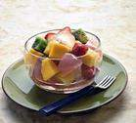
finally then next first
A: How do you make fruit salad?
B: ________ cut up three bananas ,three apples and a watermelon. _________put the fruit in a bowl. ________ put in two teaspoons of honey and a cup of yogurt. _______ mix it all up.
First
Next
Then
Finally

Slide 11
一、选词填空。
put turn on cut up pour mix up
I need some help. Can you _______
the tomatoes, please?
2. Next you need to _______ the
ingredients into a blender.
3. Then _______ hot water into the
blender.
cut up
put
pour

Slide 12
4. Add some honey and ________ the ingredients. 5. __________ the blender for about two minutes.
mix up
Turn on

Slide 13
二、用how much 或 how many填空。
1. ___________ hours are there in a day? 2. --____________ is the shirt? --$ 30. 3. ____________ pens do you have ? 4. ____________ butter do you need?
How many
How much
How many
How much

Slide 14
三、将下列名词归类 yogurt, teaspoon, watermelon, popcorn,
bread, banana, hamburger, strawberry,
tomato, carrot, water 1. countable nouns _________________________________ _________________________________ 2. uncountable nouns _________________________________
watermelon
banana
hamburger
strawberry
tomato
carrot
yogurt
popcorn
bread
water

Slide 15
四、单项选择。
1. How does he ______ milk shake? A. make B. made C. makes D. do 2. _______ milk do you need? A. How many B. How much C. How often D. How long 3. Turn on the blender _____ about two minutes. A. in B. at C. for D. to
A
B
C

Slide 16
4. Please ___the blender. Let’s taste it. A. turn on B. turn off C. turn up D. turn down 5. Then ____ peppers and ____on the cheese. A. cut up: put them B. cut up; put it C. cut in; put them D. cuts up; put it 6. Pour water ____ the blender. A. of B. into C. on D. up
B
A
B

Slide 17
7. How ____ bread do we need? A. many B. long C. often D. much 8.There are ___ and a cup of yogurt. A. two teaspoons of honey B. a teaspoon of honey C. two teaspoon of honey D. a teaspoons of honey
D
A

Slide 18
五、句型转换。
1. I need some help. （否定句）
I _____ ______ _____ help.
2.We need two teaspoons of honey.
（划线提问）
_____ ______ teaspoons of honey
_____ we need?
3. Put the pizza on the table. （否定句）
______ ______ the pizza on the table.
don’t need any
How many
do
Don’t put

Slide 19
4. There is only a little water in the bottle.（划线部分提问） _____ _____ water ___ _____ in the bottle? 5. There are some sandwiches on the plate.（改为一般疑问句） _____ _____ ____ sandwiches on the plate?
How much
is there
Are there any

Slide 20
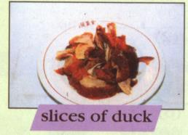
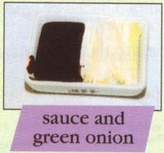
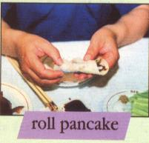
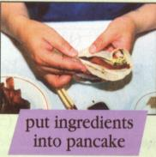
Homework
What is the correct way to eat Beijing Duck?
Look at the pictures for ideas and then write
down the instructions.

Slide 21
Thank you for your listening!

