Slide 1
Unit 7
Abilities
Main task
WWW.PPT818.COM

Slide 2
预习反馈
1.chairperson
2.madam
3.thoughtful
4.lose
5.act
6.housework
7.likely
8.whole
9.drama
[‘tʃeəpə:s(e)n] n.主席
[‘mædəm] n.女士
[‘θɔ:tful] adj.考虑周到的
[lu:z] v.丢失
[ækt] v.表演
[‘hauswə:k] n.家务活
[‘laikli] adj.可能的
[həul] adj.整个的
[‘drɑ:mə] n.喜剧

Slide 3
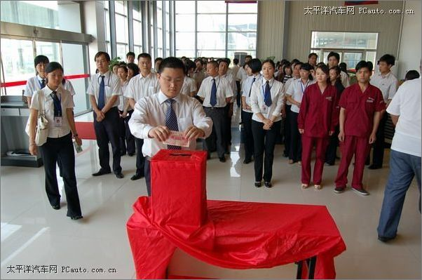
What is he doing?

Slide 4
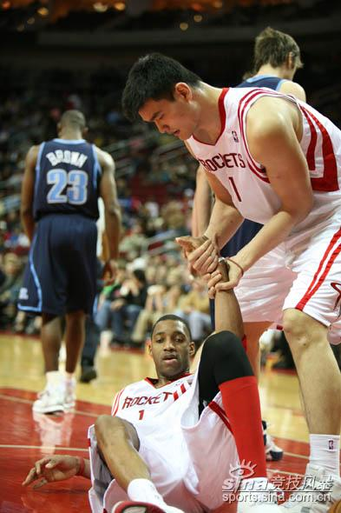
What is Yaoming doing?

Slide 5
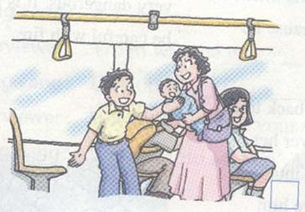
give a seat to someone on the bus

Slide 6
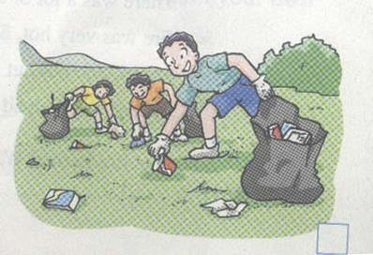
clean up the park

Slide 7
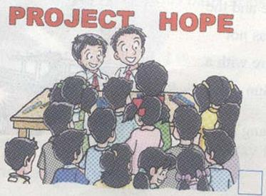
donate money,
collect things…

Slide 8
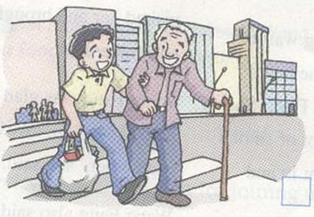
help an old man to cross the road

Slide 9
Listening
Why did Mr. Wu write this letter?
Mr. Wu wrote this ______ to __________ Daniel for this year’s _____ _____.
2. What kind of boy is Daniel?
Daniel is ____________.
Daniel is ____________.
Daniel is ____________.
letter
recommend
Youth Award
clever
thoughtful
kind

Slide 10
Daniel is …
1. clever
He can learn things __________ (quick).
He can use the computer __________ (good).
2. thoughtful
He thinks __________ (careful) when he works.
He plans everything __________ and works __________ in a team (good).
quickly
well
carefully
well
well

Slide 11
3. kind.
Last week, a 5-year-old boy ____________________（迷路）and cried in the street. Daniel ____________________（在去……的路上） the club. He_______ him______ the police station.(带……去……) He stayed with the boy and played with him ____________________两个小时）before the boy’s parents came.
lost his way
was on his way to
took
to
for two hours

Slide 12
Fill in the blanks with the right forms of the words given.

Slide 13
thoughtful
1. Kitty is my classmate. She is __________ because she can play everything well. (thought)
2. He was one of the greatest ____________ of the Helping Hands Club. (chairperson)
3. When you write a recommendation letter, you can greet with “Dear Sir/ ____________”. (madam)
4. I ______ my pen last Sunday. (lose)
5. We are looking forward to __________ a letter from you. (get)
chairpersons
madam
lost
getting

Slide 14
1. greeting (问候语) 2.message（正文 ）
3. closing（结束敬语）4.date （日期）
5. address of receiver（收信人地址）
6. address of sender（寄信人地址)
7. signature of sender（寄信人签名）
8. (name and) title of receiver
（收信人姓名或头衔 ）
9. name of sender（寄信人姓名）
10.subject （主题)
11.title of sender（寄信人头衔）

Slide 15
Explanation
An award for Daniel
Beijing Sunshine
Secondary School
Sunshine Town
Beijing
(6)
address of sender
(寄信人地址)
写在信的右上角

Slide 16
(4) date
15th June
Chairperson
Helping Hands Club
Sunny Street
Sunshine Town
(8) (name and) title of receiver
(收信人姓名或职务)
(5)address of receiver
（收信人地址）
写在信的左上方

Slide 17
(1) greeting 问候语
写在正文左上角
Dear Sir/Madam
Youth Award for Daniel
I would like to recommend Daniel for this year’s Youth Award.
Daniel is a clever young boy. He can learn things quickly. He can use the computer well. He often helps at the Helping Hands Club. He does the computer work and sometimes gets information from the internet for the club.
Daniel is thoughtful and thinks carefully when he works. He plans everything well and works well in a team. He looks after our children’s group on Sundays and all the children like him.
Last week, a 5-year-old boy lost his way and cried in the street. Daniel was on his way to the club. He took him to the police station. He stayed with the boy and played with him for two hours before the boy’s parents came. Daniel is really kind.
The members at the Helping Hands Club think that Daniel should get an award. We look forward to hearing from you soon.
(10) subject主题
写在正文位于正中
(2) message 信息

Slide 18
faithfully=sincerely=truly 真诚地,诚挚地
signature: 签名
Yours faithfully
Wu Bing
Wu Bing
Class 1, Grade 7 teacher, Beijing Sunshine Secondary School
(3) closing 结束敬语
(7) signature of sender 寄者签名
(9) name of sender
(11) title of sender
署名写在信正文结束后的左下方

Slide 19
How to write a recommendation letter
Recommendation letter
Introduction
The first paragraph tells the receiver what the letter is about.
Main body
The main body of the letter talks about different points in this order.
Paragraph 2: ability of your classmate
Paragraph 3: personality of your classmate
Paragraph 4: what your classmate did
Conclusion
The last paragraph states what you want from the receiver

Slide 20
Please write a letter to recommend a student in your class for the Most Helpful Student Award.

Slide 21
Nanjing Starry Secondary School
Star Town , Nanjing
21st September
Chairperson
Helping Hands Club
Starry Street
Star Town
Dear Sir/Madam
The Most Helpful Student Award for this year’s Youth Award.
I’d like to recommend_____________________ ______________________________________
Yours faithfully
Amy
Class 10,Grade 8 student , Nanjing Starry Secondary School

Slide 22
测测你的记忆力：
1.learn…quickly
2.get information from
3.be thoughtful
4.plan…well
5.a 5-year-old boy
6.cry in the street
7.stay with
8.get an award
9.look forward to
10.hear from
1.学习…很快
2.从…得到信息
3.考虑周到的
4.把…计划得很好
5.一个5岁的男孩
6.在街上大哭
7.和…待在一起
8.得到一个奖
9.期待做某事
10.收到…的来信

Slide 23
Many thanks !
Bye-bye!

