Slide 1
Unit7 May I have some grapes？
Module 4 Fruits
WWW.PPT818.COM

Slide 2
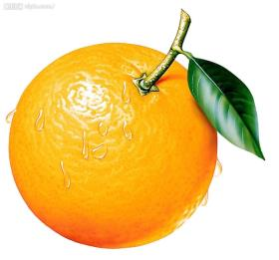
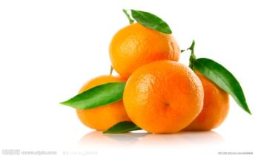
an orange
some oranges

Slide 3
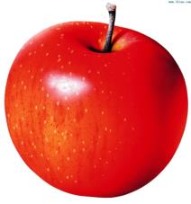
some apples
an apple

Slide 4
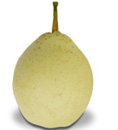
a pear
some pears

Slide 5
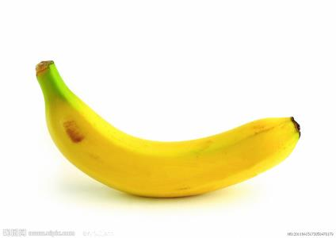
a banana
some bananas

Slide 6
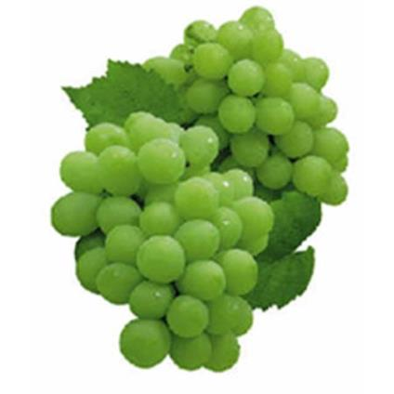
some grapes

Slide 7
fruit

Slide 8
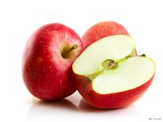
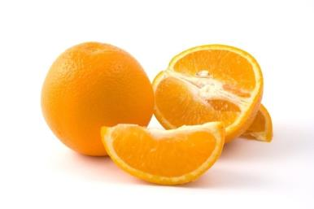
some apples
an apple
an orange
some oranges

Slide 9
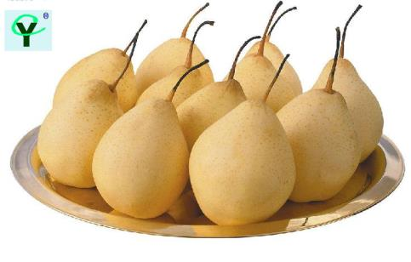
a pear
some pears

Slide 10
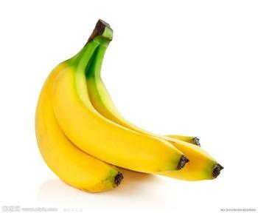
a banana
some bananas

Slide 11
some grapes
grape
green
purple

Slide 12
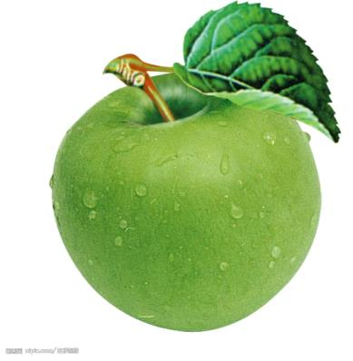
apple
red
green

Slide 13
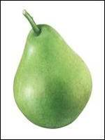
pear
yellow
green

Slide 14
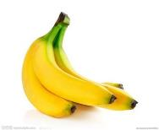
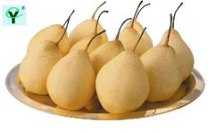
What fruit do you like?
I like + 水果（复数）.
What fruit do you like?
I like apples.

Slide 15
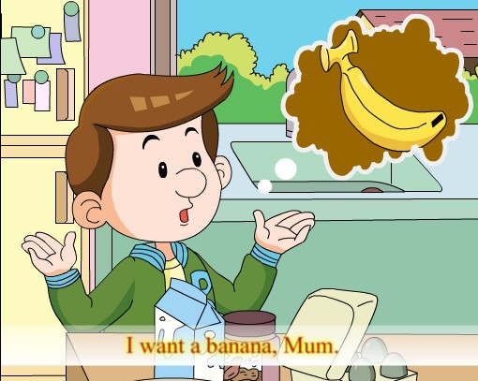
want
想、想要
I want a/some…
我想要一个/一些…..
I want a banana，Mum.

Slide 16
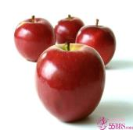
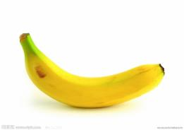
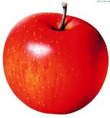
some apples
some oranges
a banana
an apples
A: I want a/an/some …
Do we have …?
B: Yes,we do. / No, we don’t.

Slide 17
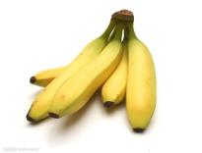
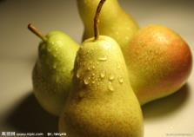
some bananas
some pears
some grapes
A: I want a/an/some …
Do we have …?
B: Yes,we do. / No, we don’t.

Slide 18
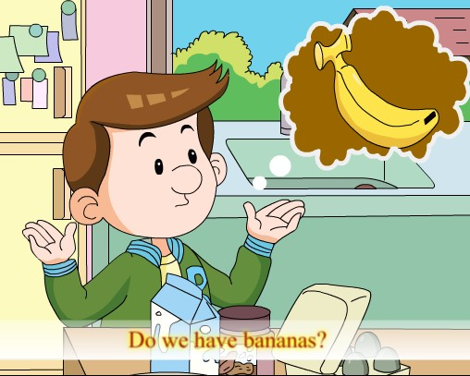
we
我们
Do we have…?
Yes, we do.
No, we don’t.
Do we have bananas?

Slide 19
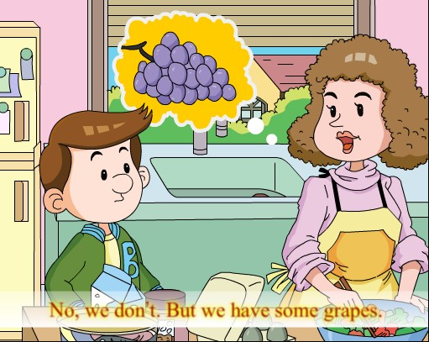
but
但是
some
一些
grape
葡萄
No, we don’t . But we have some grapes.

Slide 20
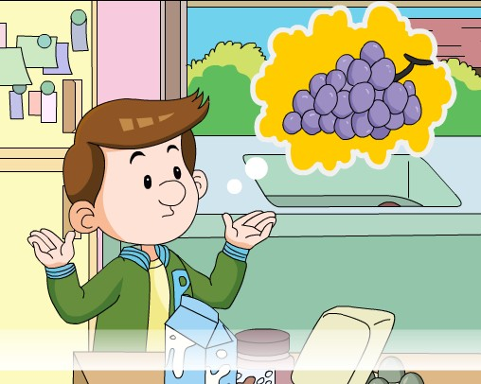
like
喜欢
I like grapes .

Slide 21
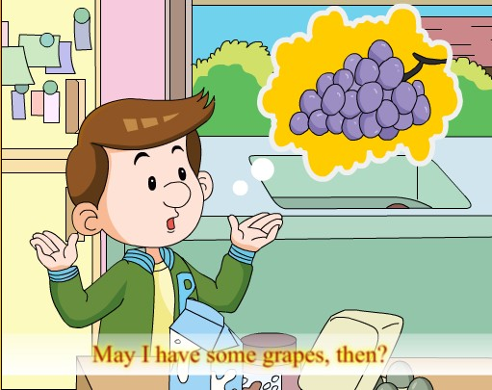
then
那么
May I have some…?
Yes .Here you are.
May I have some grapes, then?

Slide 22
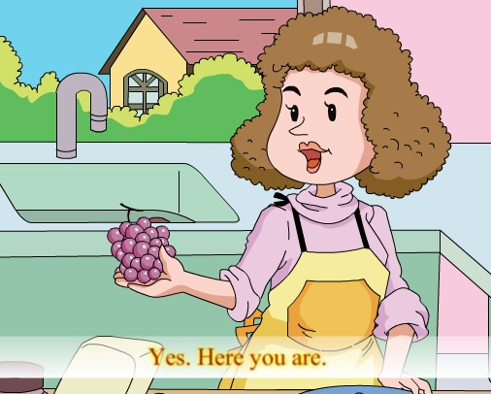
Here you are.
Yes , Here you are.

Slide 23
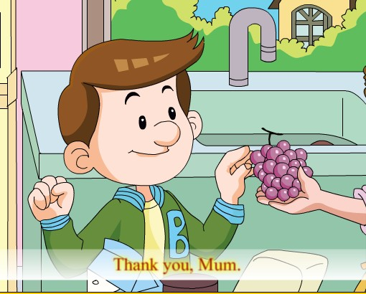
Thank you！
Thank you, Mum.

Slide 24
fruit

Slide 25
1、I want a/an/some…

Slide 26
2、What fruit do you like?
I like + 水果（复数）.

Slide 27
3、Do we have…?
Yes, we do./
No. we don’t.

Slide 28
4、May I have a/an/some…?
Yes . Here you are.
Thank you.

Slide 29
an
w_ _t
a
a
a
b_n_n_
e
w_
想要
香蕉
我们
u
ra
e
b_t
o
e
g_ _p_
s_m_
但是
一些
葡萄
n
pp
p_ _r
e a
en
a_ a_ _le
th_ _
一个苹果
梨
那么

