Slide 1
Unit 1 The lion and a mouse
第2课时
六年级
WWW.PPT818.COM

Slide 2
What to learn?
1. I can read and understand the story of Cartoon time.
2. I know the intonation(语调) of Wh-questions.
3. I know there are many animal stories in Aesop’s Fables and Chinese idiom books.

Slide 3
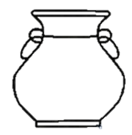
Do you want these balls?
每当你完成一个Task，都可以向罐子里注入一些水。

Slide 4
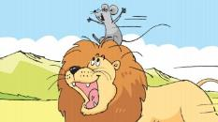
Task1: Revision
Fill in the blanks
One day, a ______ mouse woke the ______ lion up. The lion caught the mouse and wanted to eat him. However, the lion _____ the mouse go.
The next day, the lion was _______ by men. The mouse made a hole and saved the lion.
weak
strong
let
caught
From _____ on, the lion and the mouse became friends.
then

Slide 5
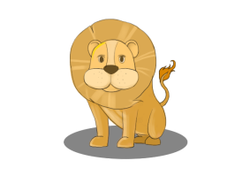
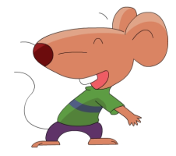
The lion and the mouse became friends.

Slide 6
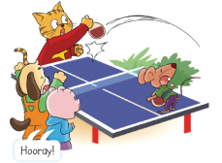
Task2: True or False
( ) 1. Sam is good at table tennis.
( ) 2. Bobby hits the ball hard.
( ) 3. Sam and Bobby find a hole in the playground.
( ) 4. Sam can reach the ball in the hole.

Slide 7
Task2: True or False
( ) 1. Sam is good at table tennis.
( ) 2. Bobby hits the ball hard.
( ) 3. Sam and Bobby find a hole in the playground.
( ) 4. Sam can reach the ball in the hole.
T
hit
F
Sam
打，击
F
ground
地面，地上
Sam cannot reach the ball in the hole.
reach
F
够得着
Because the hole is too deep .
deep
深

Slide 8
Task3: Read and Answer
Read and underline the answers (先自己读Cartoon time, 然后画出答案)
Q1: What do Billy and Willy do near the table?
A: They cheer for Sam and Bobby loudly.
Q2: What is Sam’s idea?
A: He brings some water
quickly and pours it into the hole.
Hooray!
(万岁！)
为……欢呼
向……内注入，灌注……

Slide 9
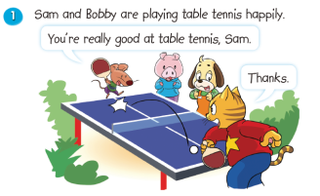
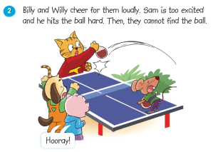
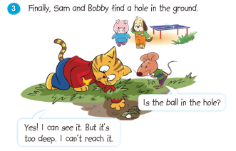
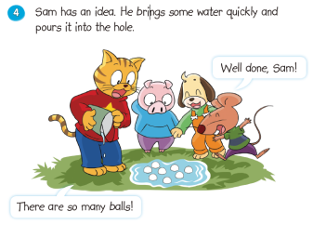

Slide 10
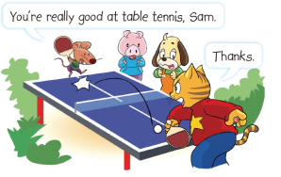
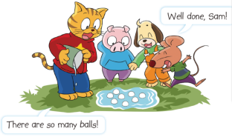
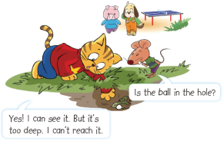
Task4：Read or Act
1、Read in roles.(分角色读。)
2、Read together.(齐读。)
3、Act in roles.
(分角色演。)

Slide 11
lollipop

Slide 12
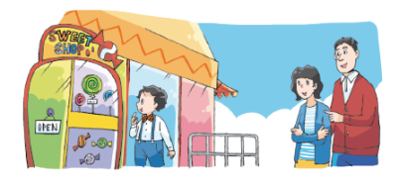
Task 5: Read and find
Where are you going?
What do you want to buy? A lollipop.
Who is it for? The boy over there.
What will he say? It doesn’t matter.
To the sweet shop.
你还知道哪些疑问词开头的句子是降调呢？

Slide 13
Task6: Read and find

Slide 14
A good book is a good friend.

Slide 15
We know:
1. I can read and understand the cartoon.
2. The falling intonation(降调) of Wh-questions.
3. There are many animal stories in Aesop’s Fables and Chinese idiom books.

Slide 16
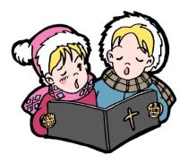
Homework
Read Cartoon time for 5 times. Try to imitate the recording.
Tell one animal story to your friends and parents.

