Slide 1
Unit 10
I’ve had this bike for three years.
Section B 1a—2d
WWW.PPT818.COM

Slide 2
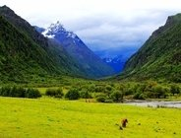
New words:
hill-hills
crayon-crayons

Slide 3
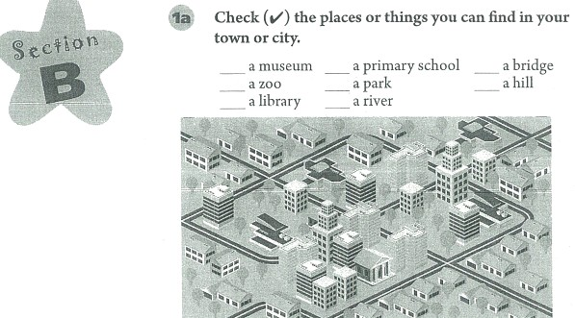
Do a survey!
1a

Slide 4
Guessing!
2a
参考答案：1. They leave their hometown to search for work ing cities.
2.Hardly ever.
3. Large hospitals, new roads and new schools.

Slide 5
Language points
(1) millions of 成百万上千万
million, 百万，使用时前面如果有基数词修饰时不能加“ s”, 只有与of 连用时才可以加。
Example: There are millions of things living on the earth.
There are two million people in this city.
(2) among 在……（三者以上）中之一
I live among the mountains.
(3) 46-year-old 46岁的， 在句中做形容词修饰名词用。
He is a 46-year-old worker.
(4) used to 过去常常，以前常常，后接动词原形。
I used to return home at least twice a year.
(5) regard with... 以……的态度看待某人
He regards me with favour. 他很赏识我。
(6) since the mid-20th century 自从20世纪中期， 通常与现在完成时连用。
Kids have learned English since the mid-20th century.

Slide 6
Language Points
(7) stay the same 保持相同
same, 形容词，相同的，同样的，通常与定冠词“the”连用。
His hometown can’t stay the same.
(8) opposite 介词，表示位置，在……对面
There is a big supermarket opposite my school.
有一个大超市在我学校对面。
(9) such a happy childhood 这样一个快乐的童年
such, 这样的，如此的，通常修饰名词。
There is no such thing.

Slide 7
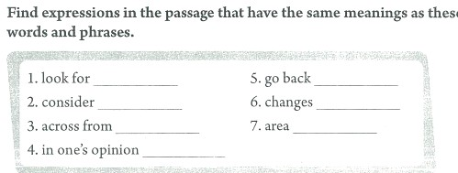
Have a race!
2b
[参考答案：1. search for 2. regard 3. opposite 4. according to 5. return 6. become 7. place]

Slide 8
Play a game!
找对子！
look for
search for
=
especialy
particularly
=
area
place
=

Slide 9
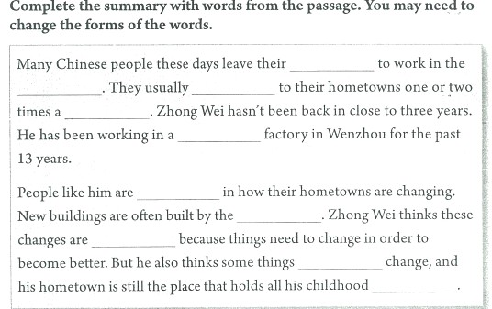
To be a reporter.
2c
[参考答案：hometown, cities, return, year, crayon, interested, government, good, never, memories]

Slide 10
Do a survey!
2d
Names | Changs | How long | good | bad
Lucy | Built a new school | two months | close to home | can’t have PE class

Slide 11
Summary
A: How old is Zhong Wei ?
B: 46 years old.
A: Where does he work ?
B: He works in a crayon factory.
A: How long has he lived in Wenzhou?
B: For 13 years.
A: How long has he been back?
B: …
Notes:
11

Slide 12
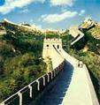
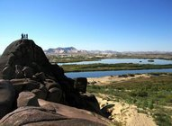
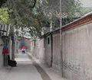
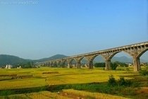
Homework
Write an article about your hometown according to 2a.
Notes:
12

